Slide 1
Tutorial on deep transformer themed “Gemini family”
Professor Dr. Loc Nguyen, PhD, Postdoc
Loc Nguyen’s Academic Network, Vietnam
Email: ng_phloc@yahoo.com
Homepage: www.locnguyen.net

Slide 2
Abstract
Development of transformer is a far progressive step in the long journeys of both generative artificial intelligence (GenAI) and statistical translation machine (STM) with support of deep neural network (DNN), in which STM can be known as interesting result of GenAI because of encoder-decoder mechanism for sequence generation built in transformer. But why is transformer being preeminent in GenAI and STM? Firstly, transformer has a so-called self-attention mechanism that discovers contextual meaning of every token in sequence, which contributes to reduce ambiguousness. Secondly, transformer does not concern ordering of tokens in sequence, which allows to train transformer from many parts of sequences in parallel. Thirdly, the third reason which is result of the two previous reasons is that transformer can be trained from large corpus with high accuracy as well as highly computational performance. Moreover, transformer is implemented by DNN which is one of important and effective approaches in artificial intelligence (AI) in recent time. Although transformer is preeminent because of its good consistency, it is not easily understandable. Therefore, this technical report aims to describe transformer with explanations which are as easily understandable as possible.

Slide 3
Table of contents
Introduction
Sequence generation and attention
Transformer
Pre-trained model
Gemini family
Conclusions

Slide 4
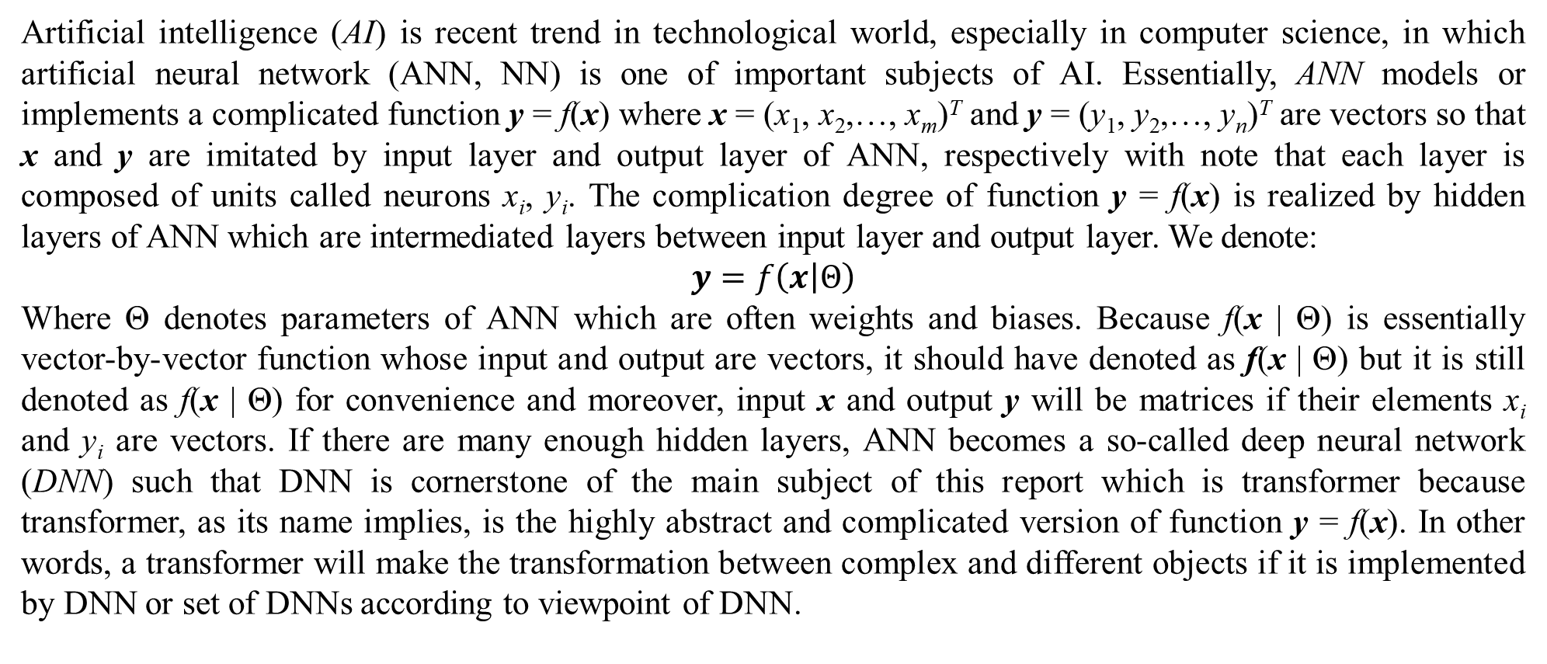
1. Introduction
Artificial intelligence (AI) is recent trend in technological world, especially in computer science, in which artificial neural network (ANN, NN) is one of important subjects of AI. Essentially, ANN models or implements a complicated function y = f(x) where x = (x₁, x₂,…, x_{m})^{T} and y = (y₁, y₂,…, y_{n})^{T} are vectors so that x and y are imitated by input layer and output layer of ANN, respectively with note that each layer is composed of units called neurons x_{i}, y_{i}. The complication degree of function y = f(x) is realized by hidden layers of ANN which are intermediated layers between input layer and output layer. We denote:
$$y=f\left(x | Θ\right)$$
Where Θ denotes parameters of ANN which are often weights and biases. Because f(x | Θ) is essentially vector-by-vector function whose input and output are vectors, it should have denoted as f(x | Θ) but it is still denoted as f(x | Θ) for convenience and moreover, input x and output y will be matrices if their elements x_{i} and y_{i} are vectors. If there are many enough hidden layers, ANN becomes a so-called deep neural network (DNN) such that DNN is cornerstone of the main subject of this report which is transformer because transformer, as its name implies, is the highly abstract and complicated version of function y = f(x). In other words, a transformer will make the transformation between complex and different objects if it is implemented by DNN or set of DNNs according to viewpoint of DNN.

Slide 5
1. Introduction
Although transformer can be applied into many areas, especially machine translation and computer vision, this report focuses on statistical machine translation (STM) because complex and different objects x and y in STM transformer are two sentences in two different languages where x is source language sentence and y is target language sentence. If ordering of elements x_{i} / y_{i} in vector x / y specifying sentence is concerned as ordering of words x_{i} / y_{i} in a sentence, transformer will relate to sequence generation. Therefore, transformer as well as STM are inspired from sequence generation which, in turn, relates to recurrent neural network (RNN) as well as long short-term memory (LSTM) because sequence generation models are often implemented by RNN or LSTM. The most standard ANN/DNN called feedforward network (FFN) follows the one-way direction from input layer to hidden layers to output layer without reverse direction, which means that there is neither connections from output layer to hidden layers nor connections from hidden layers to input layers. In other words, there is no cycle in FFN, which cause the side-effect that it is difficult to model a sequence vector x = (x₁, x₂,…, x_{m})^{T} like a sentence in natural language processing (NLP) because elements / words / terms / tokens x_{i} in such sequence/sentence vector have the same structure and every connection x_{i} → x_{i+1} of two successive words x_{i} and x_{i+1} is, actually, a cycle. This is the reason that recurrent neural network (RNN) is better than FFN to generate sequence. Therefore, we research transformer after researching sequence generation which is concerned after RNN is concerned. Note, sequence and sentence are two exchangeable concepts in this research.

Slide 6
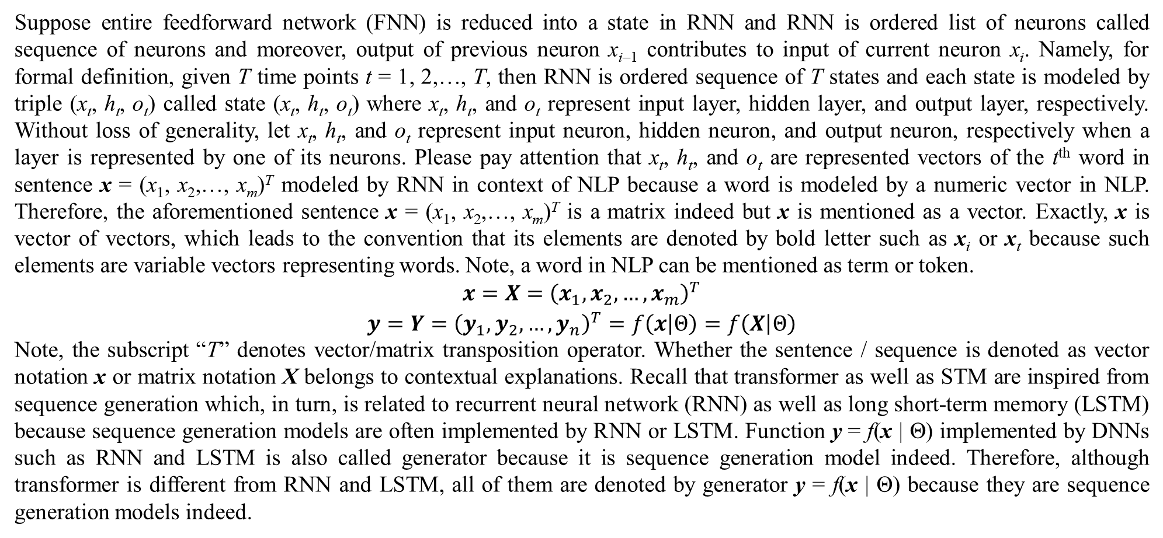
1. Introduction
Suppose entire feedforward network (FNN) is reduced into a state in RNN and RNN is ordered list of neurons called sequence of neurons and moreover, output of previous neuron x_{i–1} contributes to input of current neuron x_{i}. Namely, for formal definition, given T time points t = 1, 2,…, T, then RNN is ordered sequence of T states and each state is modeled by triple (x_{t}, h_{t}, o_{t}) called state (x_{t}, h_{t}, o_{t}) where x_{t}, h_{t}, and o_{t} represent input layer, hidden layer, and output layer, respectively. Without loss of generality, let x_{t}, h_{t}, and o_{t} represent input neuron, hidden neuron, and output neuron, respectively when a layer is represented by one of its neurons. Please pay attention that x_{t}, h_{t}, and o_{t} are represented vectors of the t^{th} word in sentence x = (x₁, x₂,…, x_{m})^{T} modeled by RNN in context of NLP because a word is modeled by a numeric vector in NLP. Therefore, the aforementioned sentence x = (x₁, x₂,…, x_{m})^{T} is a matrix indeed but x is mentioned as a vector. Exactly, x is vector of vectors, which leads to the convention that its elements are denoted by bold letter such as x_{i} or x_{t} because such elements are variable vectors representing words. Note, a word in NLP can be mentioned as term or token.
$$\begin{matrix}x=X={\left(x_{1},x_{2},…,x_{m}\right)}^{T} \\ y=Y={\left(y_{1},y_{2},…,y_{n}\right)}^{T}=f\left(x | Θ\right)=f\left(X | Θ\right)\end{matrix}$$
Note, the subscript “T” denotes vector/matrix transposition operator. Whether the sentence / sequence is denoted as vector notation x or matrix notation X belongs to contextual explanations. Recall that transformer as well as STM are inspired from sequence generation which, in turn, is related to recurrent neural network (RNN) as well as long short-term memory (LSTM) because sequence generation models are often implemented by RNN or LSTM. Function y = f(x | Θ) implemented by DNNs such as RNN and LSTM is also called generator because it is sequence generation model indeed. Therefore, although transformer is different from RNN and LSTM, all of them are denoted by generator y = f(x | Θ) because they are sequence generation models indeed.

Slide 7
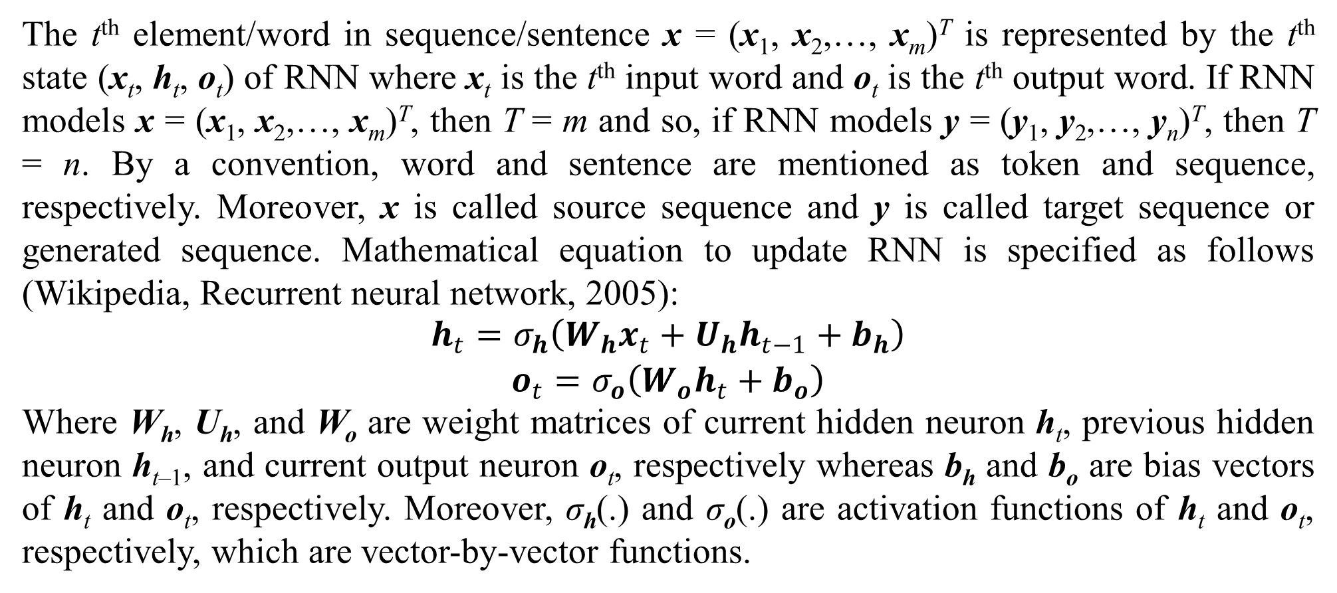
1. Introduction
The t^{th} element/word in sequence/sentence x = (x₁, x₂,…, x_{m})^{T} is represented by the t^{th} state (x_{t}, h_{t}, o_{t}) of RNN where x_{t} is the t^{th} input word and o_{t} is the t^{th} output word. If RNN models x = (x₁, x₂,…, x_{m})^{T}, then T = m and so, if RNN models y = (y₁, y₂,…, y_{n})^{T}, then T = n. By a convention, word and sentence are mentioned as token and sequence, respectively. Moreover, x is called source sequence and y is called target sequence or generated sequence. Mathematical equation to update RNN is specified as follows (Wikipedia, Recurrent neural network, 2005):
$$\begin{matrix}h_{t}=σ_{h}\left(W_{h}x_{t}+U_{h}h_{t−1}+b_{h}\right) \\ o_{t}=σ_{o}\left(W_{o}h_{t}+b_{o}\right)\end{matrix}$$
Where W_{h}, U_{h}, and W_{o} are weight matrices of current hidden neuron h_{t}, previous hidden neuron h_{t–1}, and current output neuron o_{t}, respectively whereas b_{h} and b_{o} are bias vectors of h_{t} and o_{t}, respectively. Moreover, σ_{h}(.) and σ_{o}(.) are activation functions of h_{t} and o_{t}, respectively, which are vector-by-vector functions.

Slide 8
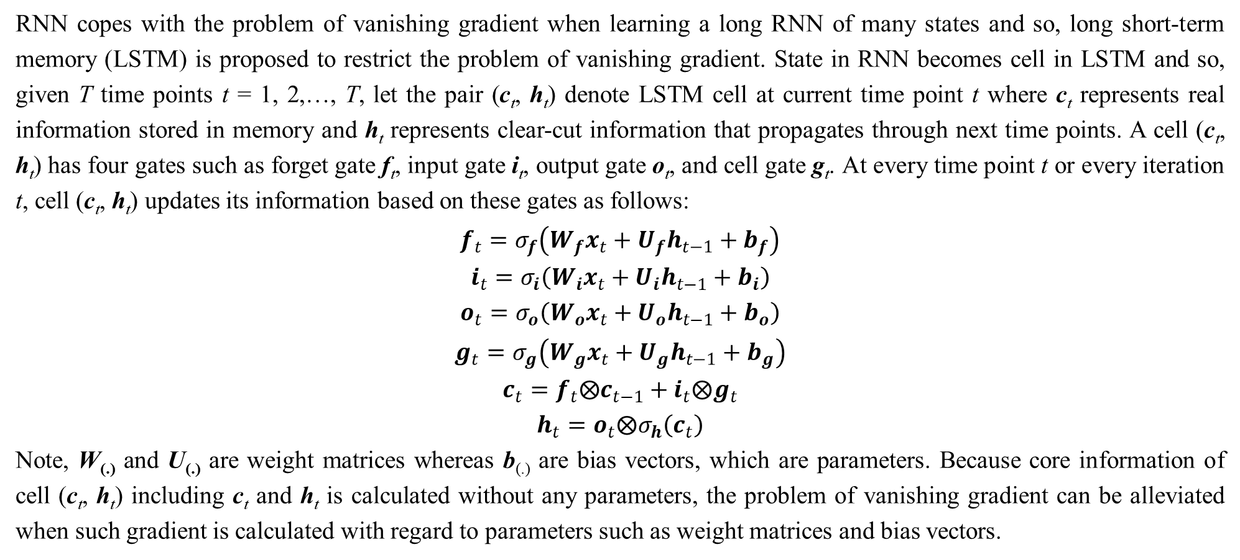
1. Introduction
RNN copes with the problem of vanishing gradient when learning a long RNN of many states and so, long short-term memory (LSTM) is proposed to restrict the problem of vanishing gradient. State in RNN becomes cell in LSTM and so, given T time points t = 1, 2,…, T, let the pair (c_{t}, h_{t}) denote LSTM cell at current time point t where c_{t} represents real information stored in memory and h_{t} represents clear-cut information that propagates through next time points. A cell (c_{t}, h_{t}) has four gates such as forget gate f_{t}, input gate i_{t}, output gate o_{t}, and cell gate g_{t}. At every time point t or every iteration t, cell (c_{t}, h_{t}) updates its information based on these gates as follows:
$$f_{t}=σ_{f}\left(W_{f}x_{t}+U_{f}h_{t−1}+b_{f}\right)$$
$$i_{t}=σ_{i}\left(W_{i}x_{t}+U_{i}h_{t−1}+b_{i}\right)$$
$$o_{t}=σ_{o}\left(W_{o}x_{t}+U_{o}h_{t−1}+b_{o}\right)$$
$$g_{t}=σ_{g}\left(W_{g}x_{t}+U_{g}h_{t−1}+b_{g}\right)$$
$$c_{t}=f_{t}⨂c_{t−1}+i_{t}⨂g_{t}$$
$$h_{t}=o_{t}⨂σ_{h}\left(c_{t}\right)$$
Note, W_{(.)} and U_{(.)} are weight matrices whereas b_{(.)} are bias vectors, which are parameters. Because core information of cell (c_{t}, h_{t}) including c_{t} and h_{t} is calculated without any parameters, the problem of vanishing gradient can be alleviated when such gradient is calculated with regard to parameters such as weight matrices and bias vectors.

Slide 9
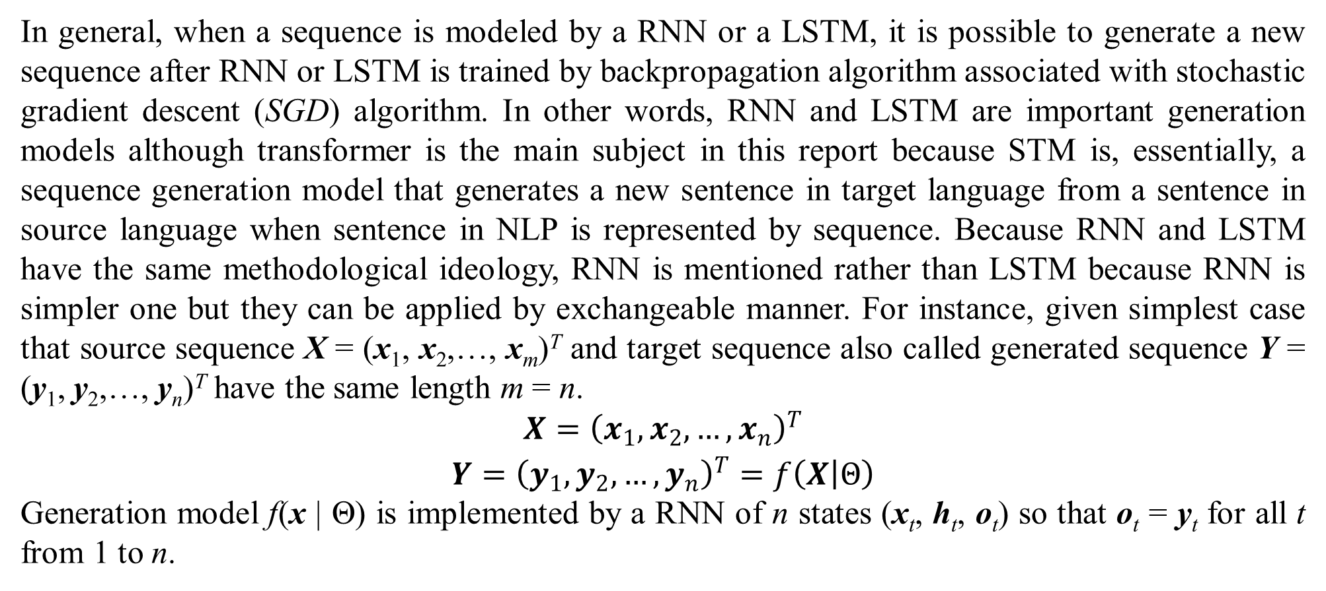
1. Introduction
In general, when a sequence is modeled by a RNN or a LSTM, it is possible to generate a new sequence after RNN or LSTM is trained by backpropagation algorithm associated with stochastic gradient descent (SGD) algorithm. In other words, RNN and LSTM are important generation models although transformer is the main subject in this report because STM is, essentially, a sequence generation model that generates a new sentence in target language from a sentence in source language when sentence in NLP is represented by sequence. Because RNN and LSTM have the same methodological ideology, RNN is mentioned rather than LSTM because RNN is simpler one but they can be applied by exchangeable manner. For instance, given simplest case that source sequence X = (x₁, x₂,…, x_{m})^{T} and target sequence also called generated sequence Y = (y₁, y₂,…, y_{n})^{T} have the same length m = n.
$$\begin{matrix}X={\left(x_{1},x_{2},…,x_{n}\right)}^{T} \\ Y={\left(y_{1},y_{2},…,y_{n}\right)}^{T}=f\left(X | Θ\right)\end{matrix}$$
Generation model f(x | Θ) is implemented by a RNN of n states (x_{t}, h_{t}, o_{t}) so that o_{t} = y_{t} for all t from 1 to n.

Slide 10
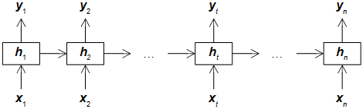
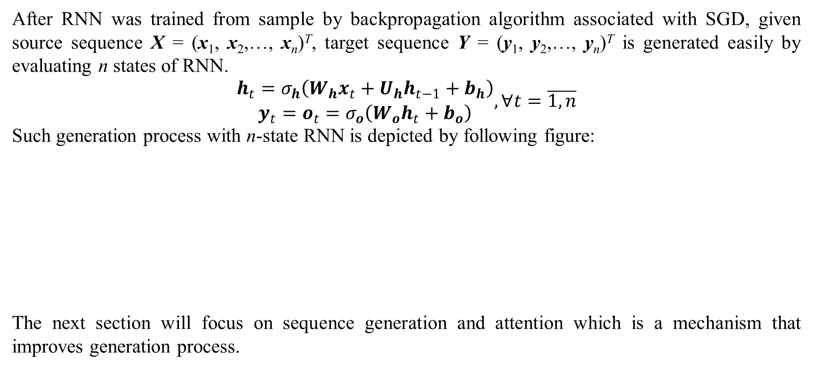
1. Introduction
After RNN was trained from sample by backpropagation algorithm associated with SGD, given source sequence X = (x₁, x₂,…, x_{n})^{T}, target sequence Y = (y₁, y₂,…, y_{n})^{T} is generated easily by evaluating n states of RNN.
$$\begin{matrix}h_{t}=σ_{h}\left(W_{h}x_{t}+U_{h}h_{t−1}+b_{h}\right) \\ y_{t}=o_{t}=σ_{o}\left(W_{o}h_{t}+b_{o}\right)\end{matrix},∀t=\overline{1,n}$$
Such generation process with n-state RNN is depicted by following figure:
The next section will focus on sequence generation and attention which is a mechanism that improves generation process.
Figure 1.1. RNN generation model

Slide 11
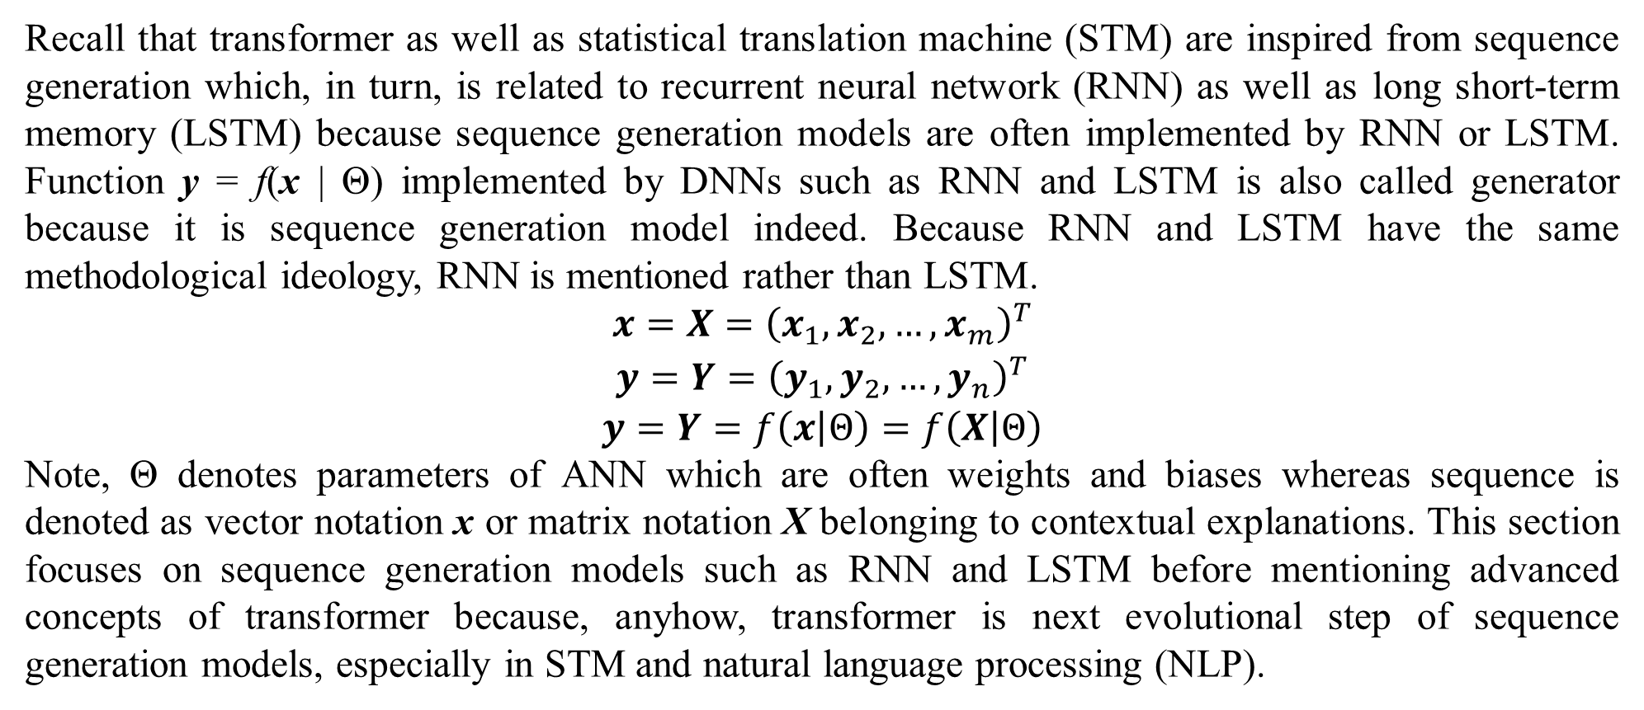
2. Sequence generation and attention
Recall that transformer as well as statistical translation machine (STM) are inspired from sequence generation which, in turn, is related to recurrent neural network (RNN) as well as long short-term memory (LSTM) because sequence generation models are often implemented by RNN or LSTM. Function y = f(x | Θ) implemented by DNNs such as RNN and LSTM is also called generator because it is sequence generation model indeed. Because RNN and LSTM have the same methodological ideology, RNN is mentioned rather than LSTM.
$$\begin{matrix}x=X={\left(x_{1},x_{2},…,x_{m}\right)}^{T} \\ y=Y={\left(y_{1},y_{2},…,y_{n}\right)}^{T} \\ y=Y=f\left(x | Θ\right)=f\left(X | Θ\right)\end{matrix}$$
Note, Θ denotes parameters of ANN which are often weights and biases whereas sequence is denoted as vector notation x or matrix notation X belonging to contextual explanations. This section focuses on sequence generation models such as RNN and LSTM before mentioning advanced concepts of transformer because, anyhow, transformer is next evolutional step of sequence generation models, especially in STM and natural language processing (NLP).

Slide 12
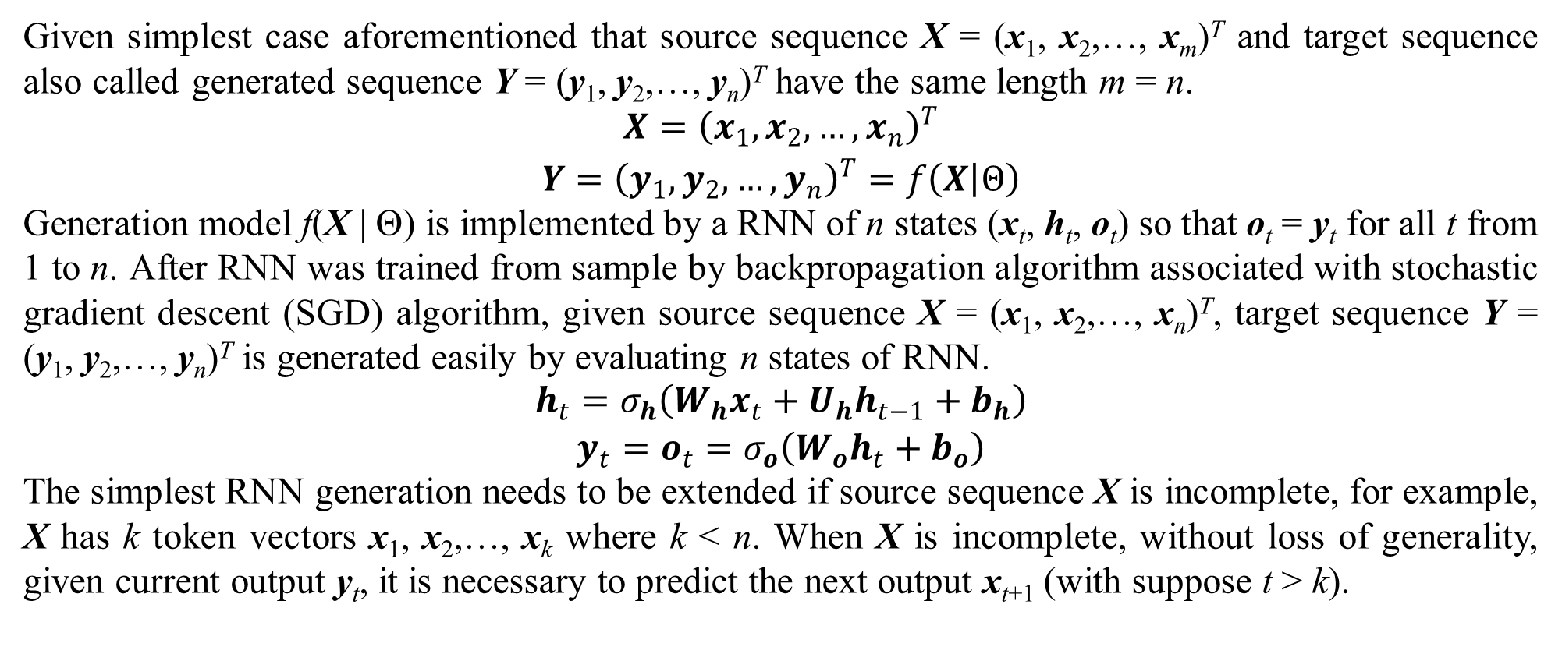
2. Sequence generation and attention
Given simplest case aforementioned that source sequence X = (x₁, x₂,…, x_{m})^{T} and target sequence also called generated sequence Y = (y₁, y₂,…, y_{n})^{T} have the same length m = n.
$$\begin{matrix}X={\left(x_{1},x_{2},…,x_{n}\right)}^{T} \\ Y={\left(y_{1},y_{2},…,y_{n}\right)}^{T}=f\left(X | Θ\right)\end{matrix}$$
Generation model f(X | Θ) is implemented by a RNN of n states (x_{t}, h_{t}, o_{t}) so that o_{t} = y_{t} for all t from 1 to n. After RNN was trained from sample by backpropagation algorithm associated with stochastic gradient descent (SGD) algorithm, given source sequence X = (x₁, x₂,…, x_{n})^{T}, target sequence Y = (y₁, y₂,…, y_{n})^{T} is generated easily by evaluating n states of RNN.
$$\begin{matrix}h_{t}=σ_{h}\left(W_{h}x_{t}+U_{h}h_{t−1}+b_{h}\right) \\ y_{t}=o_{t}=σ_{o}\left(W_{o}h_{t}+b_{o}\right)\end{matrix}$$
The simplest RNN generation needs to be extended if source sequence X is incomplete, for example, X has k token vectors x₁, x₂,…, x_{k} where k < n. When X is incomplete, without loss of generality, given current output y_{t}, it is necessary to predict the next output x_{t+1} (with suppose t > k).

Slide 13
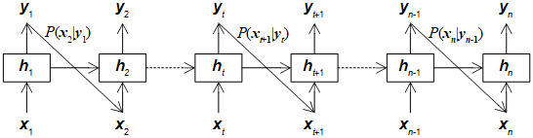
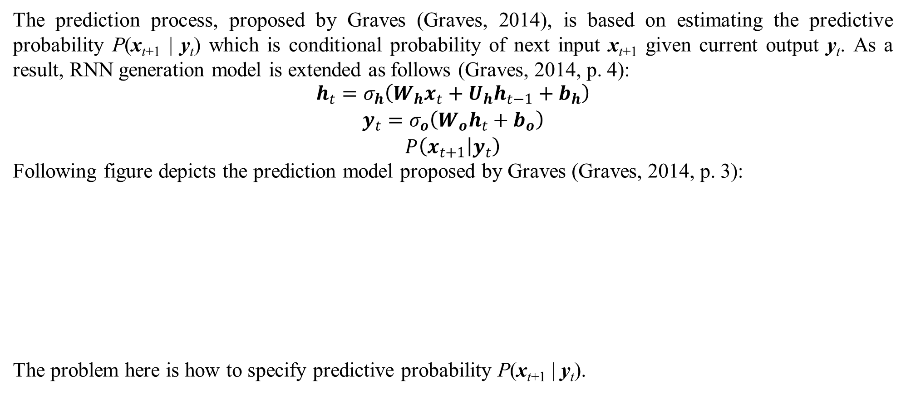
2. Sequence generation and attention
The prediction process, proposed by Graves (Graves, 2014), is based on estimating the predictive probability P(x_{t+1} | y_{t}) which is conditional probability of next input x_{t+1} given current output y_{t}. As a result, RNN generation model is extended as follows (Graves, 2014, p. 4):
$$\begin{matrix}h_{t}=σ_{h}\left(W_{h}x_{t}+U_{h}h_{t−1}+b_{h}\right) \\ y_{t}=σ_{o}\left(W_{o}h_{t}+b_{o}\right) \\ P\left(x_{t+1} | y_{t}\right)\end{matrix}$$
Following figure depicts the prediction model proposed by Graves (Graves, 2014, p. 3):
The problem here is how to specify predictive probability P(x_{t+1} | y_{t}).
Figure 2.1. RNN prediction model

Slide 14
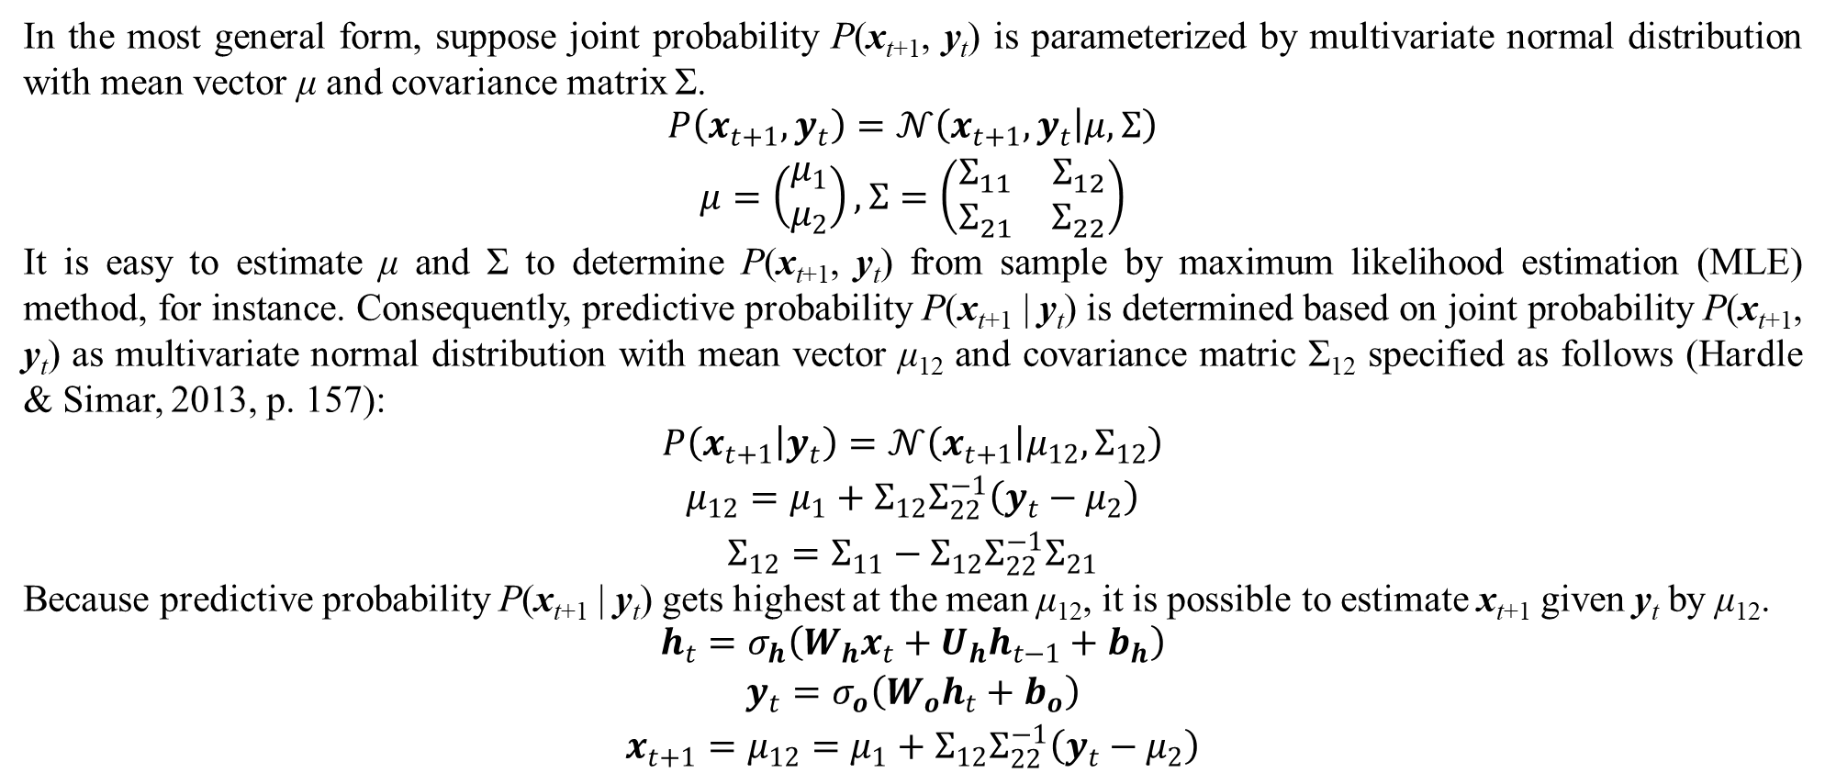
2. Sequence generation and attention
In the most general form, suppose joint probability P(x_{t+1}, y_{t}) is parameterized by multivariate normal distribution with mean vector μ and covariance matrix Σ.
$$\begin{matrix}P\left(x_{t+1},y_{t}\right)=𝒩\left(x_{t+1},y_{t} | μ,Σ\right) \\ μ=\left(\begin{matrix}μ_{1} \\ μ_{2}\end{matrix}\right),Σ=\left(\begin{matrix}Σ_{11} & Σ_{12} \\ Σ_{21} & Σ_{22}\end{matrix}\right)\end{matrix}$$
It is easy to estimate μ and Σ to determine P(x_{t+1}, y_{t}) from sample by maximum likelihood estimation (MLE) method, for instance. Consequently, predictive probability P(x_{t+1} | y_{t}) is determined based on joint probability P(x_{t+1}, y_{t}) as multivariate normal distribution with mean vector μ₁₂ and covariance matric Σ₁₂ specified as follows (Hardle & Simar, 2013, p. 157):
$$\begin{matrix}P\left(x_{t+1} | y_{t}\right)=𝒩\left(x_{t+1} | μ_{12},Σ_{12}\right) \\ μ_{12}=μ_{1}+Σ_{12}Σ_{22}^{−1}\left(y_{t}−μ_{2}\right) \\ Σ_{12}=Σ_{11}−Σ_{12}Σ_{22}^{−1}Σ_{21}\end{matrix}$$
Because predictive probability P(x_{t+1} | y_{t}) gets highest at the mean μ₁₂, it is possible to estimate x_{t+1} given y_{t} by μ₁₂.
$$\begin{matrix}h_{t}=σ_{h}\left(W_{h}x_{t}+U_{h}h_{t−1}+b_{h}\right) \\ y_{t}=σ_{o}\left(W_{o}h_{t}+b_{o}\right) \\ x_{t+1}=μ_{12}=μ_{1}+Σ_{12}Σ_{22}^{−1}\left(y_{t}−μ_{2}\right)\end{matrix}$$

Slide 15
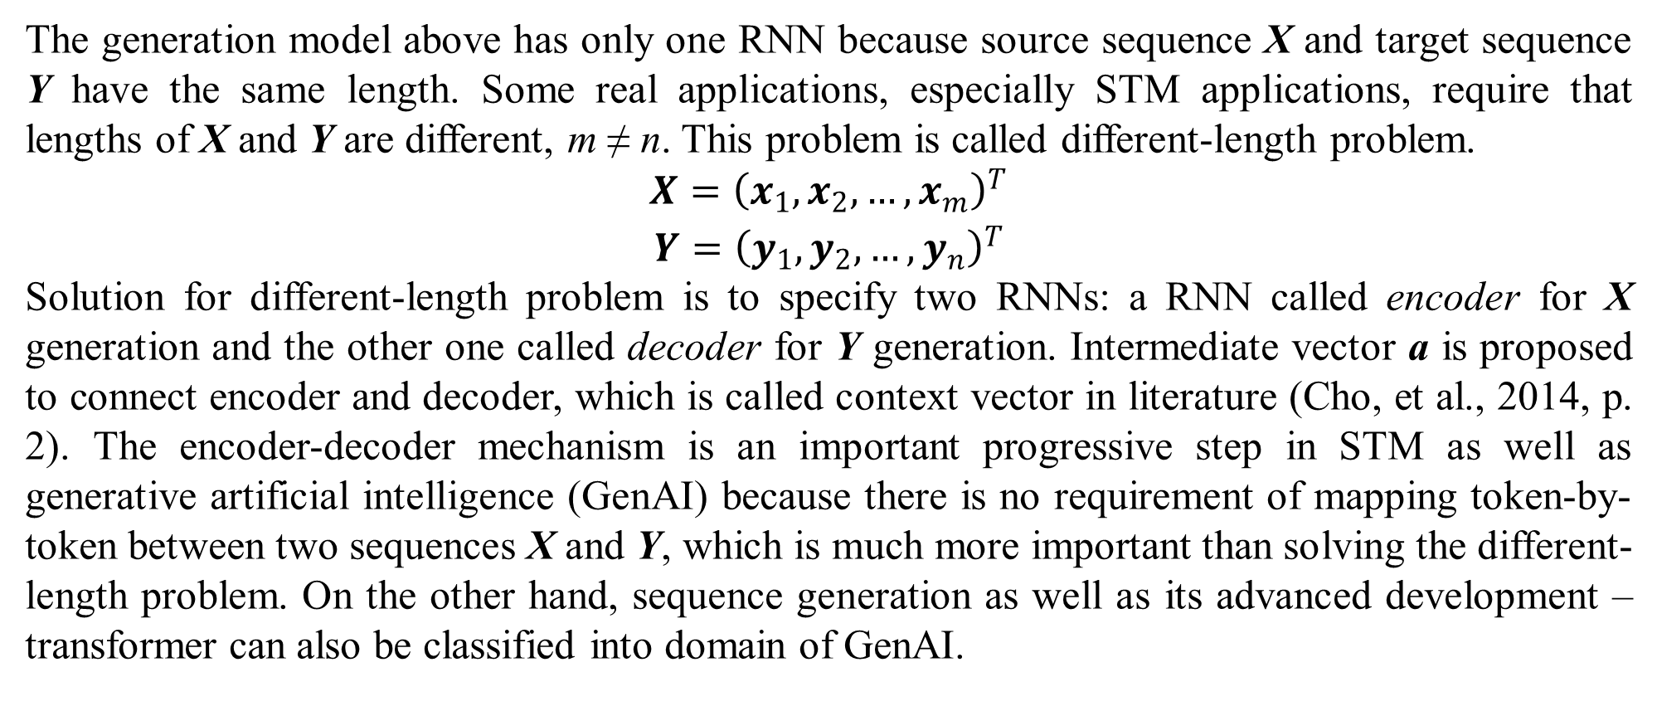
2. Sequence generation and attention
The generation model above has only one RNN because source sequence X and target sequence Y have the same length. Some real applications, especially STM applications, require that lengths of X and Y are different, m ≠ n. This problem is called different-length problem.
$$\begin{matrix}X={\left(x_{1},x_{2},…,x_{m}\right)}^{T} \\ Y={\left(y_{1},y_{2},…,y_{n}\right)}^{T}\end{matrix}$$
Solution for different-length problem is to specify two RNNs: a RNN called encoder for X generation and the other one called decoder for Y generation. Intermediate vector a is proposed to connect encoder and decoder, which is called context vector in literature (Cho, et al., 2014, p. 2). The encoder-decoder mechanism is an important progressive step in STM as well as generative artificial intelligence (GenAI) because there is no requirement of mapping token-by-token between two sequences X and Y, which is much more important than solving the different-length problem. On the other hand, sequence generation as well as its advanced development – transformer can also be classified into domain of GenAI.

Slide 16
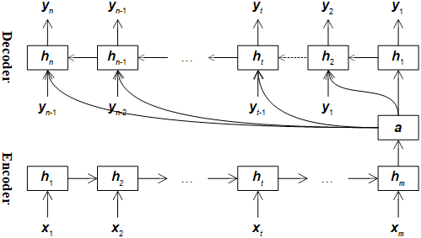
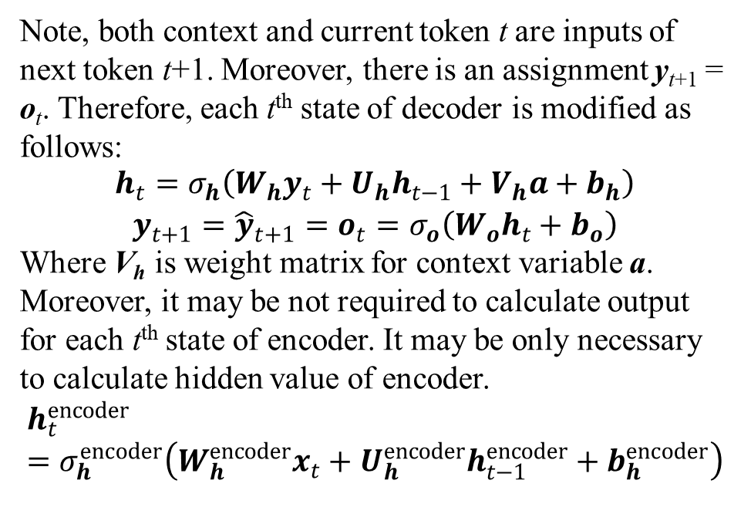
2. Sequence generation and attention
According to Cho et al. (Cho, et al., 2014), context variable a, which is last output of encoder, becomes input of decoder. Following figure depicts encoder-decoder model proposed by Cho et al. (Cho, et al., 2014, p. 2) with note that context vector a has fixed length.
Note, both context and current token t are inputs of next token t+1. Moreover, there is an assignment y_{t+1} = o_{t}. Therefore, each t^{th} state of decoder is modified as follows:
$$\begin{matrix}h_{t}=σ_{h}\left(W_{h}y_{t}+U_{h}h_{t−1}+V_{h}a+b_{h}\right) \\ y_{t+1}={\hat{y}}_{t+1}=o_{t}=σ_{o}\left(W_{o}h_{t}+b_{o}\right)\end{matrix}$$
Where V_{h} is weight matrix for context variable a. Moreover, it may be not required to calculate output for each t^{th} state of encoder. It may be only necessary to calculate hidden value of encoder.
$$h_{t}^{encoder}=σ_{h}^{encoder}\left(W_{h}^{encoder}x_{t}+U_{h}^{encoder}h_{t−1}^{encoder}+b_{h}^{encoder}\right)$$
Figure 2.2. Encoder-decoder model with fixed-length context

Slide 17
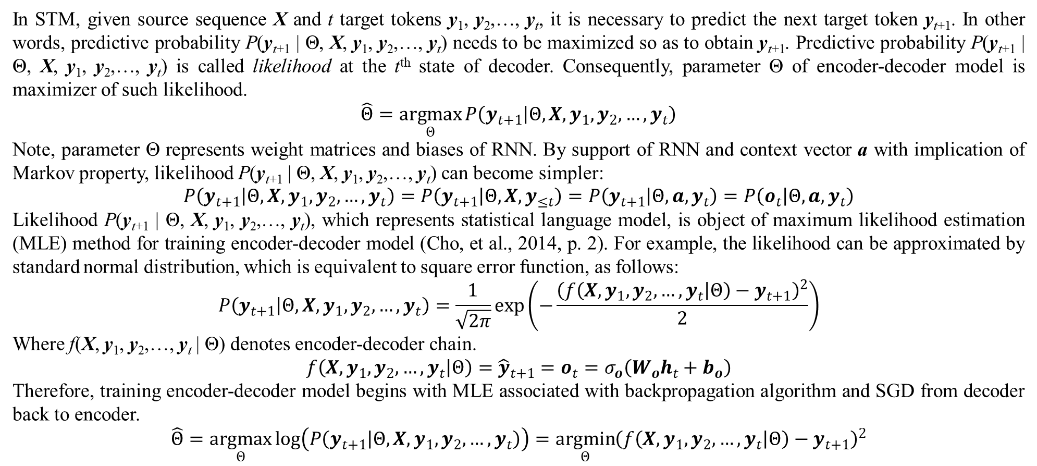
2. Sequence generation and attention
In STM, given source sequence X and t target tokens y₁, y₂,…, y_{t}, it is necessary to predict the next target token y_{t+1}. In other words, predictive probability P(y_{t+1} | Θ, X, y₁, y₂,…, y_{t}) needs to be maximized so as to obtain y_{t+1}. Predictive probability P(y_{t+1} | Θ, X, y₁, y₂,…, y_{t}) is called likelihood at the t^{th} state of decoder. Consequently, parameter Θ of encoder-decoder model is maximizer of such likelihood.
$$\hat{Θ}=\underset{Θ}{argmax}{P\left(y_{t+1} | Θ,X,y_{1},y_{2},…,y_{t}\right)}$$
Note, parameter Θ represents weight matrices and biases of RNN. By support of RNN and context vector a with implication of Markov property, likelihood P(y_{t+1} | Θ, X, y₁, y₂,…, y_{t}) can become simpler:
$$P\left(y_{t+1} | Θ,X,y_{1},y_{2},…,y_{t}\right)=P\left(y_{t+1} | Θ,X,y_{≤t}\right)=P\left(y_{t+1} | Θ,a,y_{t}\right)=P\left(o_{t} | Θ,a,y_{t}\right)$$
Likelihood P(y_{t+1} | Θ, X, y₁, y₂,…, y_{t}), which represents statistical language model, is object of maximum likelihood estimation (MLE) method for training encoder-decoder model (Cho, et al., 2014, p. 2). For example, the likelihood can be approximated by standard normal distribution, which is equivalent to square error function, as follows:
$$P\left(y_{t+1} | Θ,X,y_{1},y_{2},…,y_{t}\right)=\frac{1}{\sqrt{2π}}exp\left(−\frac{{\left(f\left(X,y_{1},y_{2},…,y_{t} | Θ\right)−y_{t+1}\right)}^{2}}{2}\right)$$
Where f(X, y₁, y₂,…, y_{t} | Θ) denotes encoder-decoder chain.
$$f\left(X,y_{1},y_{2},…,y_{t} | Θ\right)={\hat{y}}_{t+1}=o_{t}=σ_{o}\left(W_{o}h_{t}+b_{o}\right)$$
Therefore, training encoder-decoder model begins with MLE associated with backpropagation algorithm and SGD from decoder back to encoder.
$$\hat{Θ}=\underset{Θ}{argmax}{log\left(P\left(y_{t+1} | Θ,X,y_{1},y_{2},…,y_{t}\right)\right)}=\underset{Θ}{argmin}{{\left(f\left(X,y_{1},y_{2},…,y_{t} | Θ\right)−y_{t+1}\right)}^{2}}$$

Slide 18
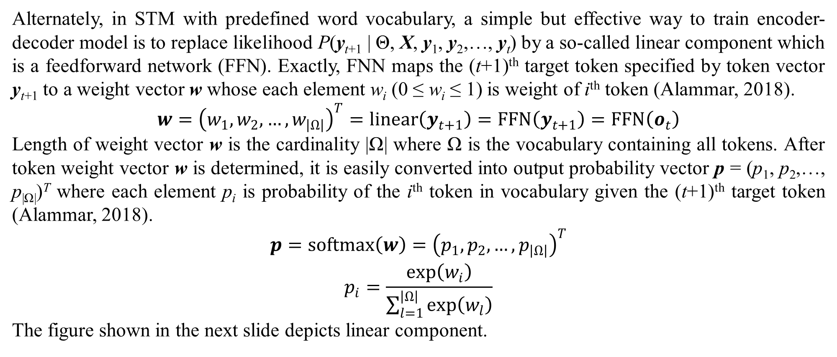
2. Sequence generation and attention
Alternately, in STM with predefined word vocabulary, a simple but effective way to train encoder-decoder model is to replace likelihood P(y_{t+1} | Θ, X, y₁, y₂,…, y_{t}) by a so-called linear component which is a feedforward network (FFN). Exactly, FNN maps the (t+1)^{th} target token specified by token vector y_{t+1} to a weight vector w whose each element w_{i} (0 ≤ w_{i} ≤ 1) is weight of i^{th} token (Alammar, 2018).
$$w={\left(w_{1},w_{2},…,w_{\left|Ω\right|}\right)}^{T}=linear\left(y_{t+1}\right)=FFN\left(y_{t+1}\right)=FFN\left(o_{t}\right)$$
Length of weight vector w is the cardinality |Ω| where Ω is the vocabulary containing all tokens. After token weight vector w is determined, it is easily converted into output probability vector p = (p₁, p₂,…, p_{|Ω|})^{T} where each element p_{i} is probability of the i^{th} token in vocabulary given the (t+1)^{th} target token (Alammar, 2018).
$$\begin{matrix}p=softmax\left(w\right)={\left(p_{1},p_{2},…,p_{\left|Ω\right|}\right)}^{T} \\ p_{i}=\frac{exp\left(w_{i}\right)}{\sum_{l=1}^{\left|Ω\right|}{exp\left(w_{l}\right)}}\end{matrix}$$
The figure shown in the next slide depicts linear component.

Slide 19
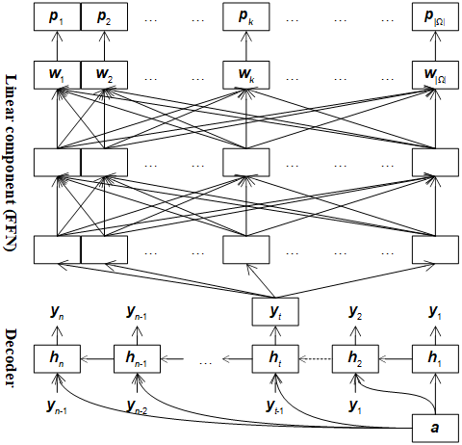
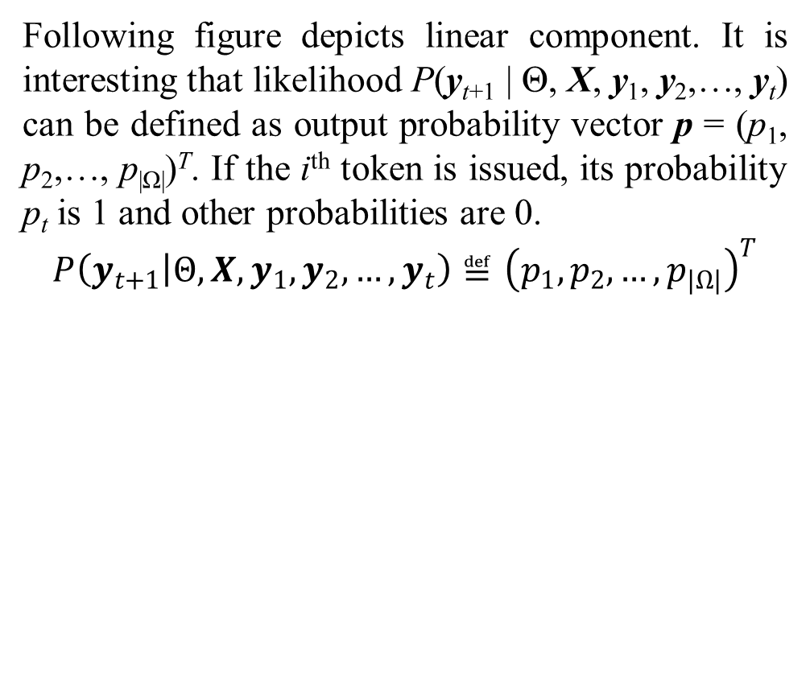
2. Sequence generation and attention
Following figure depicts linear component. It is interesting that likelihood P(y_{t+1} | Θ, X, y₁, y₂,…, y_{t}) can be defined as output probability vector p = (p₁, p₂,…, p_{|Ω|})^{T}. If the i^{th} token is issued, its probability p_{t} is 1 and other probabilities are 0.
$$P\left(y_{t+1} | Θ,X,y_{1},y_{2},…,y_{t}\right)≝{\left(p_{1},p_{2},…,p_{\left|Ω\right|}\right)}^{T}$$
Figure 2.3. Linear component of encoder-decoder model

Slide 20
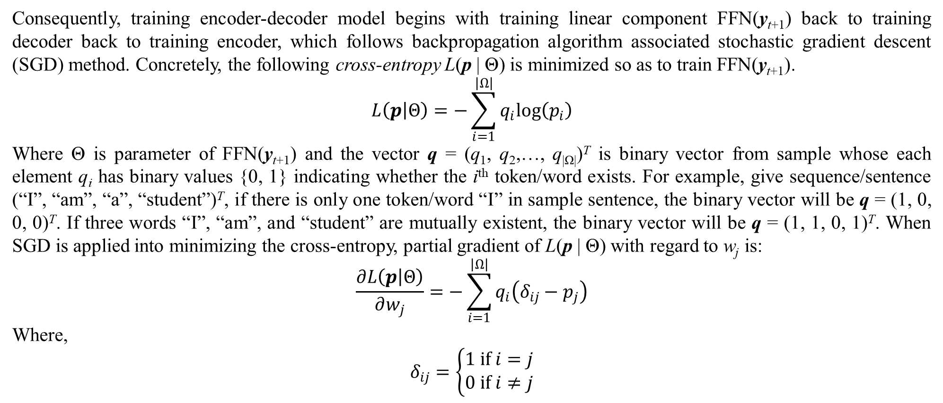
2. Sequence generation and attention
Consequently, training encoder-decoder model begins with training linear component FFN(y_{t+1}) back to training decoder back to training encoder, which follows backpropagation algorithm associated stochastic gradient descent (SGD) method. Concretely, the following cross-entropy L(p | Θ) is minimized so as to train FFN(y_{t+1}).
$$L\left(p | Θ\right)=−\sum_{i=1}^{\left|Ω\right|}{q_{i}log\left(p_{i}\right)}$$
Where Θ is parameter of FFN(y_{t+1}) and the vector q = (q₁, q₂,…, q_{|Ω|})^{T} is binary vector from sample whose each element q_{i} has binary values {0, 1} indicating whether the i^{th} token/word exists. For example, give sequence/sentence (“I”, “am”, “a”, “student”)^{T}, if there is only one token/word “I” in sample sentence, the binary vector will be q = (1, 0, 0, 0)^{T}. If three words “I”, “am”, and “student” are mutually existent, the binary vector will be q = (1, 1, 0, 1)^{T}. When SGD is applied into minimizing the cross-entropy, partial gradient of L(p | Θ) with regard to w_{j} is:
$$\frac{∂L\left(p | Θ\right)}{∂w_{j}}=−\sum_{i=1}^{\left|Ω\right|}{q_{i}\left(δ_{ij}−p_{j}\right)}$$
Where,
$$δ_{ij}=\left\{\begin{matrix}1 if i=j \\ 0 if i≠j\end{matrix}\right.$$

Slide 21
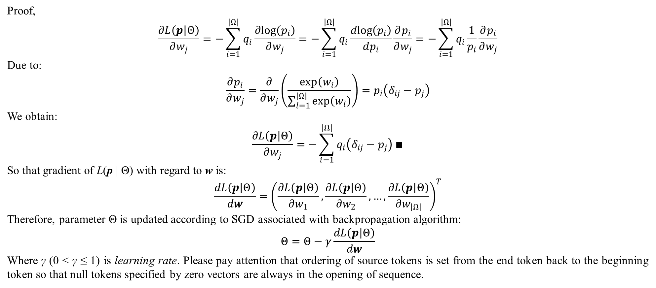
2. Sequence generation and attention
Proof,
$$\frac{∂L\left(p | Θ\right)}{∂w_{j}}=−\sum_{i=1}^{\left|Ω\right|}{q_{i}\frac{∂log\left(p_{i}\right)}{∂w_{j}}}=−\sum_{i=1}^{\left|Ω\right|}{q_{i}\frac{dlog\left(p_{i}\right)}{dp_{i}}\frac{∂p_{i}}{∂w_{j}}}=−\sum_{i=1}^{\left|Ω\right|}{q_{i}\frac{1}{p_{i}}\frac{∂p_{i}}{∂w_{j}}}$$
Due to:
$$\frac{∂p_{i}}{∂w_{j}}=\frac{∂}{∂w_{j}}\left(\frac{exp\left(w_{i}\right)}{\sum_{l=1}^{\left|Ω\right|}{exp\left(w_{l}\right)}}\right)=p_{i}\left(δ_{ij}−p_{j}\right)$$
We obtain:
$$\frac{∂L\left(p | Θ\right)}{∂w_{j}}=−\sum_{i=1}^{\left|Ω\right|}{q_{i}\left(δ_{ij}−p_{j}\right)}∎$$
So that gradient of L(p | Θ) with regard to w is:
$$\frac{dL\left(p | Θ\right)}{dw}={\left(\frac{∂L\left(p | Θ\right)}{∂w_{1}},\frac{∂L\left(p | Θ\right)}{∂w_{2}},…,\frac{∂L\left(p | Θ\right)}{∂w_{\left|Ω\right|}}\right)}^{T}$$
Therefore, parameter Θ is updated according to SGD associated with backpropagation algorithm:
$$Θ=Θ−γ\frac{dL\left(p | Θ\right)}{dw}$$
Where γ (0 < γ ≤ 1) is learning rate. Please pay attention that ordering of source tokens is set from the end token back to the beginning token so that null tokens specified by zero vectors are always in the opening of sequence.

Slide 22
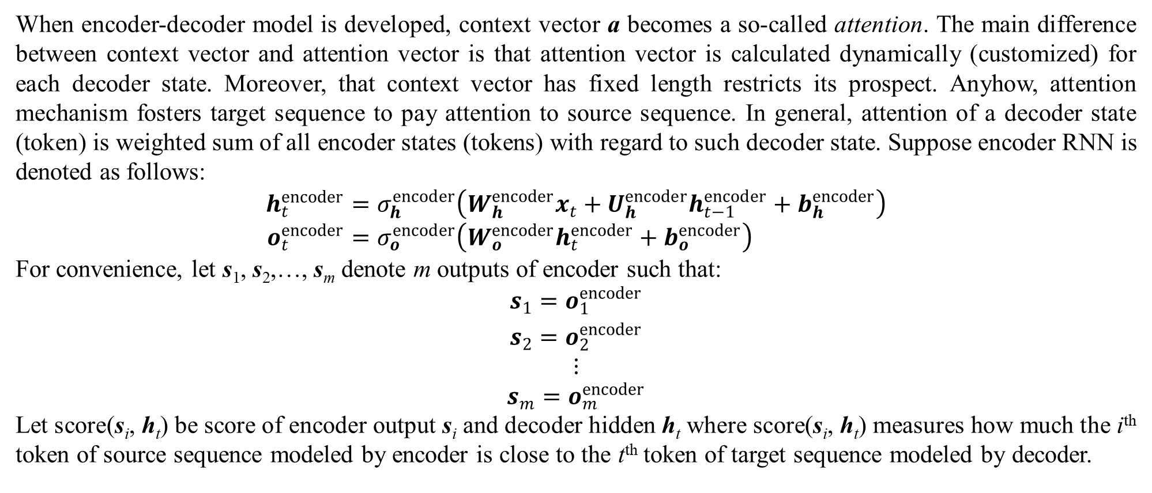
2. Sequence generation and attention
When encoder-decoder model is developed, context vector a becomes a so-called attention. The main difference between context vector and attention vector is that attention vector is calculated dynamically (customized) for each decoder state. Moreover, that context vector has fixed length restricts its prospect. Anyhow, attention mechanism fosters target sequence to pay attention to source sequence. In general, attention of a decoder state (token) is weighted sum of all encoder states (tokens) with regard to such decoder state. Suppose encoder RNN is denoted as follows:
$$h_{t}^{encoder}=σ_{h}^{encoder}\left(W_{h}^{encoder}x_{t}+U_{h}^{encoder}h_{t−1}^{encoder}+b_{h}^{encoder}\right) \\ o_{t}^{encoder}=σ_{o}^{encoder}\left(W_{o}^{encoder}h_{t}^{encoder}+b_{o}^{encoder}\right)$$
For convenience, let s₁, s₂,…, s_{m} denote m outputs of encoder such that:
$$\begin{matrix}s_{1}=o_{1}^{encoder} \\ s_{2}=o_{2}^{encoder} \\ ⋮ \\ s_{m}=o_{m}^{encoder}\end{matrix}$$
Let score(s_{i}, h_{t}) be score of encoder output s_{i} and decoder hidden h_{t} where score(s_{i}, h_{t}) measures how much the i^{th} token of source sequence modeled by encoder is close to the t^{th} token of target sequence modeled by decoder.

Slide 23
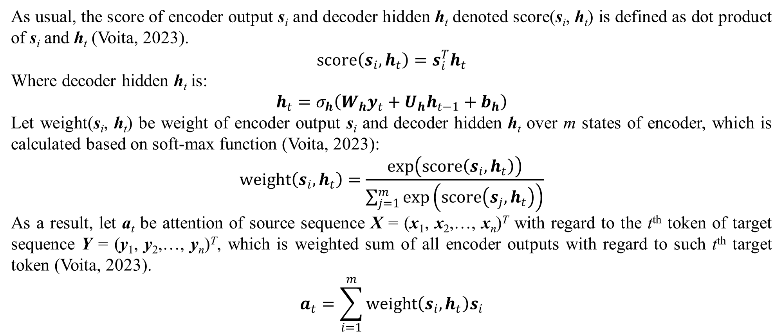
2. Sequence generation and attention
As usual, the score of encoder output s_{i} and decoder hidden h_{t} denoted score(s_{i}, h_{t}) is defined as dot product of s_{i} and h_{t} (Voita, 2023).
$$score\left(s_{i},h_{t}\right)=s_{i}^{T}h_{t}$$
Where decoder hidden h_{t} is:
$$h_{t}=σ_{h}\left(W_{h}y_{t}+U_{h}h_{t−1}+b_{h}\right)$$
Let weight(s_{i}, h_{t}) be weight of encoder output s_{i} and decoder hidden h_{t} over m states of encoder, which is calculated based on soft-max function (Voita, 2023):
$$weight\left(s_{i},h_{t}\right)=\frac{exp\left(score\left(s_{i},h_{t}\right)\right)}{\sum_{j=1}^{m}{exp\left(score\left(s_{j},h_{t}\right)\right)}}$$
As a result, let a_{t} be attention of source sequence X = (x₁, x₂,…, x_{n})^{T} with regard to the t^{th} token of target sequence Y = (y₁, y₂,…, y_{n})^{T}, which is weighted sum of all encoder outputs with regard to such t^{th} target token (Voita, 2023).
$$a_{t}=\sum_{i=1}^{m}{weight\left(s_{i},h_{t}\right)s_{i}}$$

Slide 24
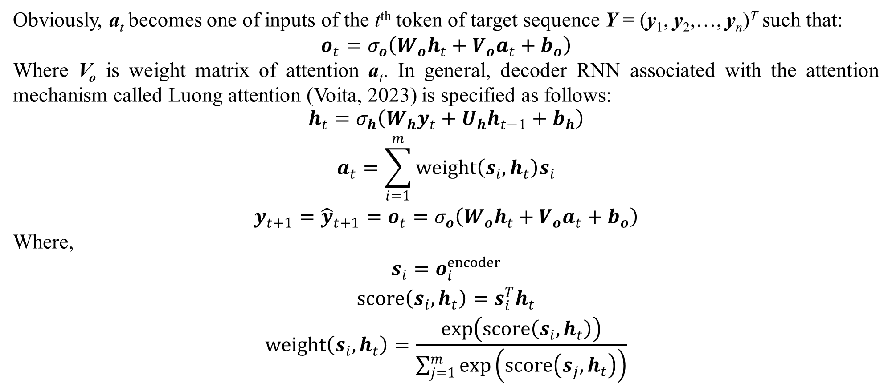
2. Sequence generation and attention
Obviously, a_{t} becomes one of inputs of the t^{th} token of target sequence Y = (y₁, y₂,…, y_{n})^{T} such that:
$$o_{t}=σ_{o}\left(W_{o}h_{t}+V_{o}a_{t}+b_{o}\right)$$
Where V_{o} is weight matrix of attention a_{t}. In general, decoder RNN associated with the attention mechanism called Luong attention (Voita, 2023) is specified as follows:
$$\begin{matrix}h_{t}=σ_{h}\left(W_{h}y_{t}+U_{h}h_{t−1}+b_{h}\right) \\ a_{t}=\sum_{i=1}^{m}{weight\left(s_{i},h_{t}\right)s_{i}} \\ y_{t+1}={\hat{y}}_{t+1}=o_{t}=σ_{o}\left(W_{o}h_{t}+V_{o}a_{t}+b_{o}\right)\end{matrix}$$
Where,
$$\begin{matrix}s_{i}=o_{i}^{encoder} \\ score\left(s_{i},h_{t}\right)=s_{i}^{T}h_{t} \\ weight\left(s_{i},h_{t}\right)=\frac{exp\left(score\left(s_{i},h_{t}\right)\right)}{\sum_{j=1}^{m}{exp\left(score\left(s_{j},h_{t}\right)\right)}}\end{matrix}$$

Slide 25
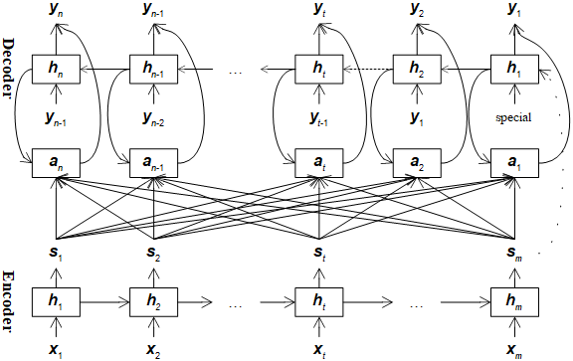
2. Sequence generation and attention
Following figure depicts encoder-decoder model with attention (Voita, 2023):
Training encoder-decoder model with support attention is still based on likelihood maximization or linear component aforementioned. Attention mechanism mentioned here does not ever concern internal meaning of every token, which only fosters target sequence to pay attention at source sequence. The attention that concerns internal meanings of tokens is called self-attention which is an advancement of attention. In other words, self-attention fosters source sequence to pay attention to itself. Transformer mentioned in the next section will implement self-attention.
Figure 2.4. Encoder-decoder model with attention

Slide 26
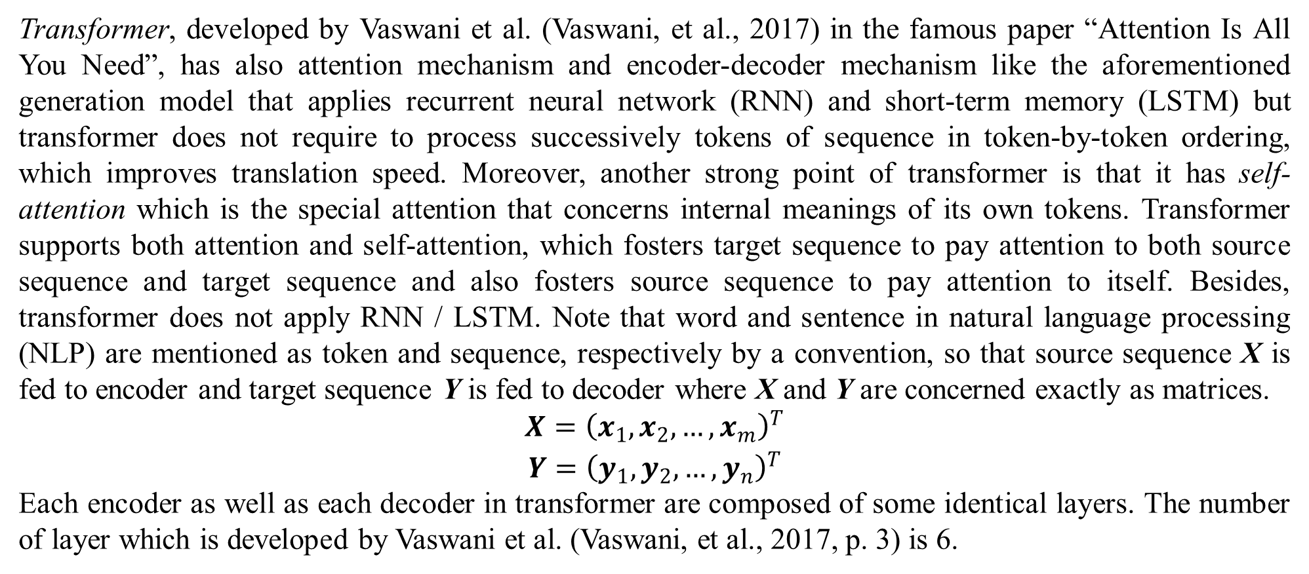
3. Transformer
Transformer, developed by Vaswani et al. (Vaswani, et al., 2017) in the famous paper “Attention Is All You Need”, has also attention mechanism and encoder-decoder mechanism like the aforementioned generation model that applies recurrent neural network (RNN) and short-term memory (LSTM) but transformer does not require to process successively tokens of sequence in token-by-token ordering, which improves translation speed. Moreover, another strong point of transformer is that it has self-attention which is the special attention that concerns internal meanings of its own tokens. Transformer supports both attention and self-attention, which fosters target sequence to pay attention to both source sequence and target sequence and also fosters source sequence to pay attention to itself. Besides, transformer does not apply RNN / LSTM. Note that word and sentence in natural language processing (NLP) are mentioned as token and sequence, respectively by a convention, so that source sequence X is fed to encoder and target sequence Y is fed to decoder where X and Y are concerned exactly as matrices.
$$\begin{matrix}X={\left(x_{1},x_{2},…,x_{m}\right)}^{T} \\ Y={\left(y_{1},y_{2},…,y_{n}\right)}^{T}\end{matrix}$$
Each encoder as well as each decoder in transformer are composed of some identical layers. The number of layer which is developed by Vaswani et al. (Vaswani, et al., 2017, p. 3) is 6.

Slide 27
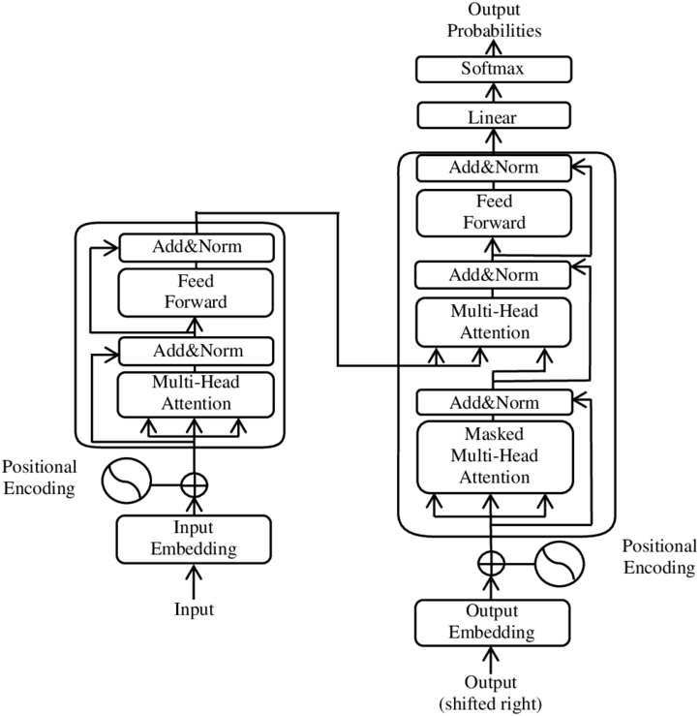
3. Transformer
Each encoder layer has two sublayers which are multi-head attention sublayer and feedforward sublayer whereas each decoder layer has three sublayers which are masked multi-head attention sublayer, multi-head attention sublayer, and feedforward sublayer. Every sublayer is followed by association of residual mechanism and layer normalization, denoted as Add & Norm = LayerNorm(X + Sublayer(X)). The residual mechanism means that sublayer Sublayer(X) is added with its input as the sum X + Sublayer(X). Note, Sublayer(X) can be attention sublayer or feedforward sublayer. The layer normalization is to normalize such sum. Following figure summarizes transformer developed by Vaswani et al. (Vaswani, et al., 2017, p. 3).
Feedforward sublayer also called feedforward network (FNN) aims to fine-tune attention by increasing degree of complication.

Slide 28
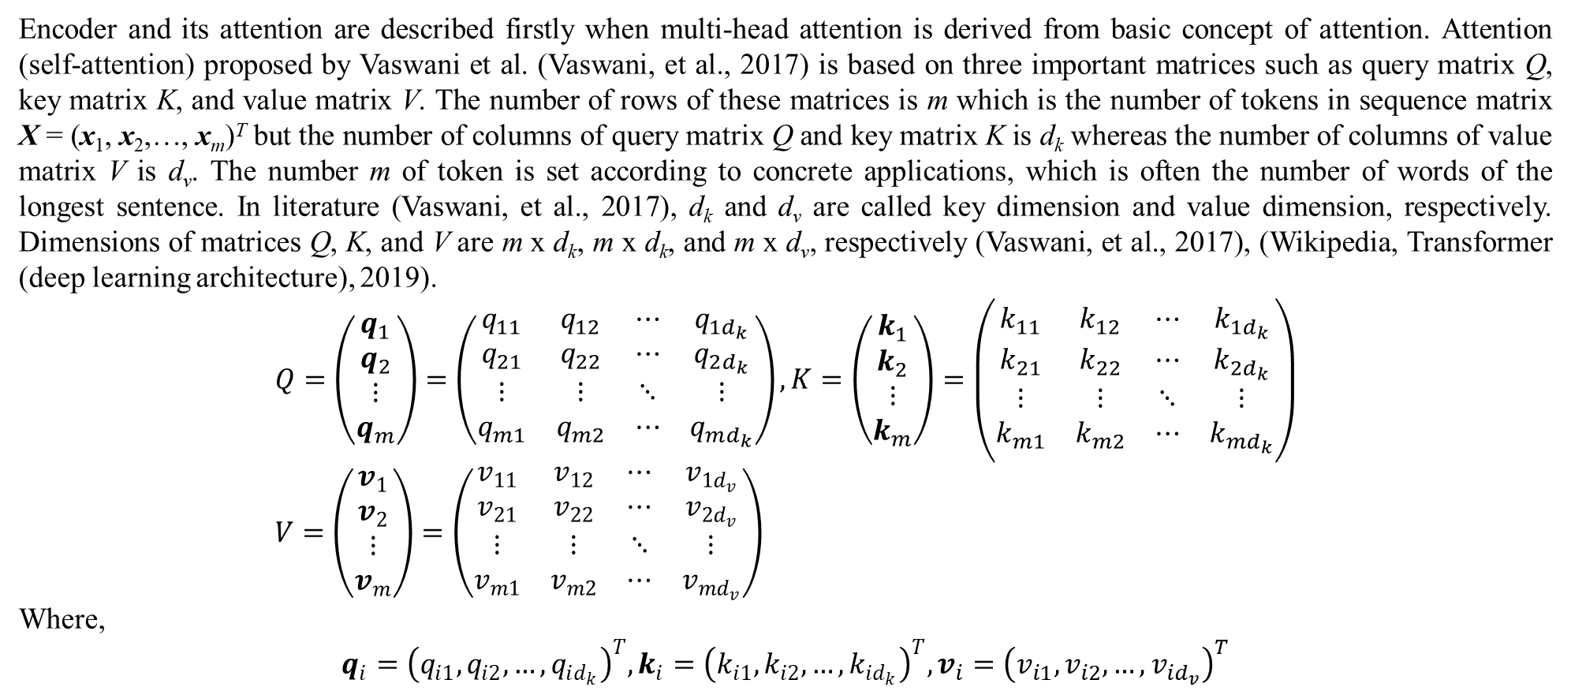
3. Transformer
Encoder and its attention are described firstly when multi-head attention is derived from basic concept of attention. Attention (self-attention) proposed by Vaswani et al. (Vaswani, et al., 2017) is based on three important matrices such as query matrix Q, key matrix K, and value matrix V. The number of rows of these matrices is m which is the number of tokens in sequence matrix X = (x₁, x₂,…, x_{m})^{T} but the number of columns of query matrix Q and key matrix K is d_{k} whereas the number of columns of value matrix V is d_{v}. The number m of token is set according to concrete applications, which is often the number of words of the longest sentence. In literature (Vaswani, et al., 2017), d_{k} and d_{v} are called key dimension and value dimension, respectively. Dimensions of matrices Q, K, and V are m x d_{k}, m x d_{k}, and m x d_{v}, respectively (Vaswani, et al., 2017), (Wikipedia, Transformer (deep learning architecture), 2019).
$$Q=\left(\begin{matrix}q_{1} \\ q_{2} \\ ⋮ \\ q_{m}\end{matrix}\right)=\left(\begin{matrix}q_{11} & q_{12} & ⋯ & q_{1d_{k}} \\ q_{21} & q_{22} & ⋯ & q_{2d_{k}} \\ ⋮ & ⋮ & ⋱ & ⋮ \\ q_{m1} & q_{m2} & ⋯ & q_{md_{k}}\end{matrix}\right),K=\left(\begin{matrix}k_{1} \\ k_{2} \\ ⋮ \\ k_{m}\end{matrix}\right)=\left(\begin{matrix}k_{11} & k_{12} & ⋯ & k_{1d_{k}} \\ k_{21} & k_{22} & ⋯ & k_{2d_{k}} \\ ⋮ & ⋮ & ⋱ & ⋮ \\ k_{m1} & k_{m2} & ⋯ & k_{md_{k}}\end{matrix}\right) \\ V=\left(\begin{matrix}v_{1} \\ v_{2} \\ ⋮ \\ v_{m}\end{matrix}\right)=\left(\begin{matrix}v_{11} & v_{12} & ⋯ & v_{1d_{v}} \\ v_{21} & v_{22} & ⋯ & v_{2d_{v}} \\ ⋮ & ⋮ & ⋱ & ⋮ \\ v_{m1} & v_{m2} & ⋯ & v_{md_{v}}\end{matrix}\right)$$
Where,
$$q_{i}={\left(q_{i1},q_{i2},…,q_{id_{k}}\right)}^{T},k_{i}={\left(k_{i1},k_{i2},…,k_{id_{k}}\right)}^{T},v_{i}={\left(v_{i1},v_{i2},…,v_{id_{v}}\right)}^{T}$$

Slide 29
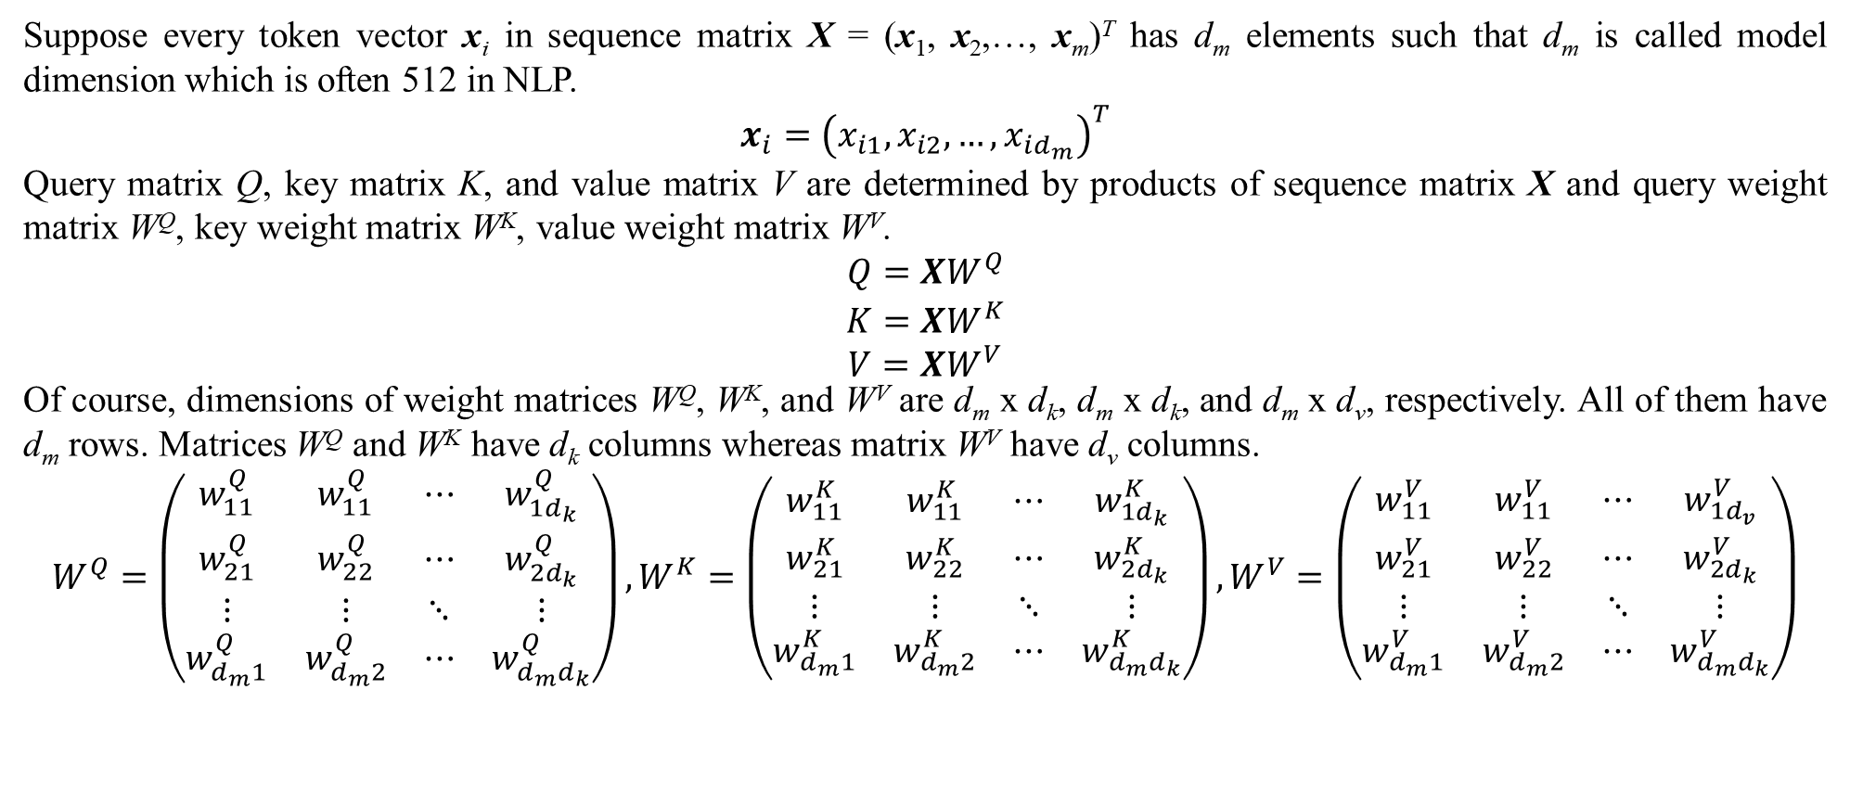
3. Transformer
Suppose every token vector x_{i} in sequence matrix X = (x₁, x₂,…, x_{m})^{T} has d_{m} elements such that d_{m} is called model dimension which is often 512 in NLP.
$$x_{i}={\left(x_{i1},x_{i2},…,x_{id_{m}}\right)}^{T}$$
Query matrix Q, key matrix K, and value matrix V are determined by products of sequence matrix X and query weight matrix W^{Q}, key weight matrix W^{K}, value weight matrix W^{V}.
$$\begin{matrix}Q=XW^{Q} \\ K=XW^{K} \\ V=XW^{V}\end{matrix}$$
Of course, dimensions of weight matrices W^{Q}, W^{K}, and W^{V} are d_{m} x d_{k}, d_{m} x d_{k}, and d_{m} x d_{v}, respectively. All of them have d_{m} rows. Matrices W^{Q} and W^{K} have d_{k} columns whereas matrix W^{V} have d_{v} columns.
$$W^{Q}=\left(\begin{matrix}w_{11}^{Q} & w_{11}^{Q} & ⋯ & w_{1d_{k}}^{Q} \\ w_{21}^{Q} & w_{22}^{Q} & ⋯ & w_{2d_{k}}^{Q} \\ ⋮ & ⋮ & ⋱ & ⋮ \\ w_{d_{m}1}^{Q} & w_{d_{m}2}^{Q} & ⋯ & w_{d_{m}d_{k}}^{Q}\end{matrix}\right),W^{K}=\left(\begin{matrix}w_{11}^{K} & w_{11}^{K} & ⋯ & w_{1d_{k}}^{K} \\ w_{21}^{K} & w_{22}^{K} & ⋯ & w_{2d_{k}}^{K} \\ ⋮ & ⋮ & ⋱ & ⋮ \\ w_{d_{m}1}^{K} & w_{d_{m}2}^{K} & ⋯ & w_{d_{m}d_{k}}^{K}\end{matrix}\right),W^{V}=\left(\begin{matrix}w_{11}^{V} & w_{11}^{V} & ⋯ & w_{1d_{v}}^{V} \\ w_{21}^{V} & w_{22}^{V} & ⋯ & w_{2d_{k}}^{V} \\ ⋮ & ⋮ & ⋱ & ⋮ \\ w_{d_{m}1}^{V} & w_{d_{m}2}^{V} & ⋯ & w_{d_{m}d_{k}}^{V}\end{matrix}\right)$$

Slide 30
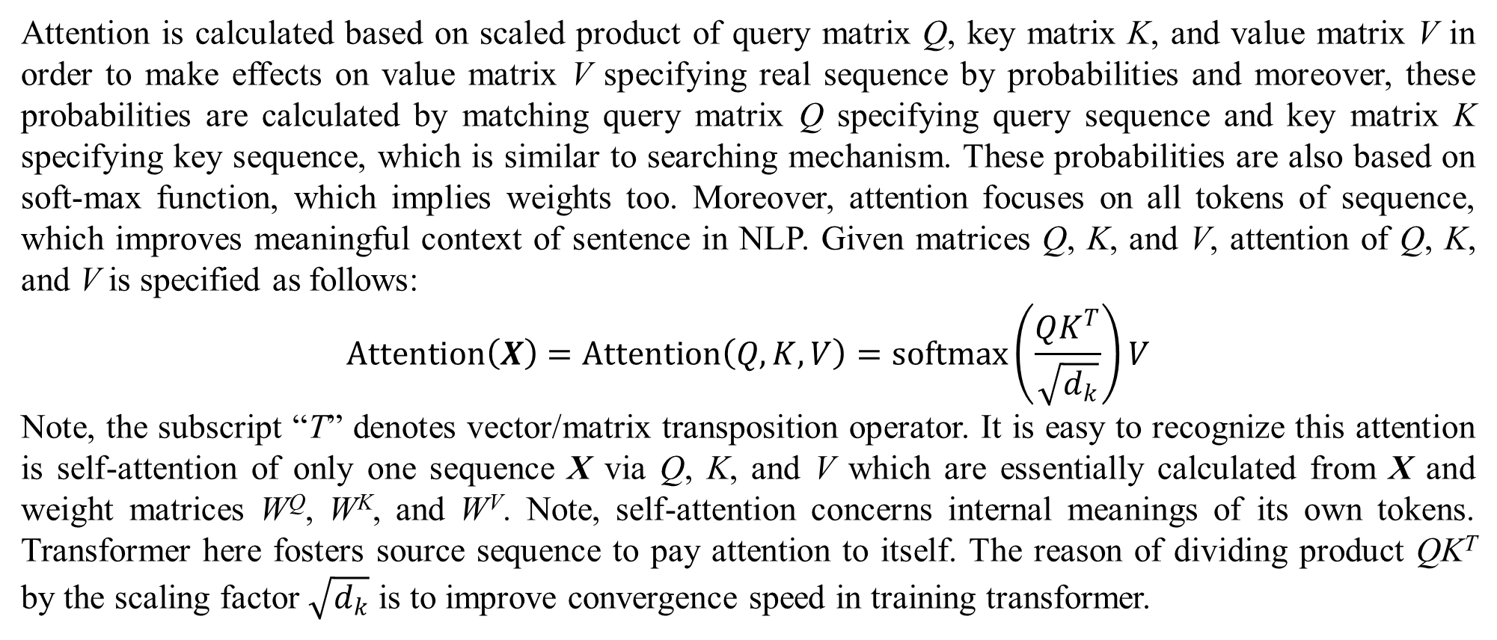
3. Transformer
Attention is calculated based on scaled product of query matrix Q, key matrix K, and value matrix V in order to make effects on value matrix V specifying real sequence by probabilities and moreover, these probabilities are calculated by matching query matrix Q specifying query sequence and key matrix K specifying key sequence, which is similar to searching mechanism. These probabilities are also based on soft-max function, which implies weights too. Moreover, attention focuses on all tokens of sequence, which improves meaningful context of sentence in NLP. Given matrices Q, K, and V, attention of Q, K, and V is specified as follows:
$$Attention\left(X\right)=Attention\left(Q,K,V\right)=softmax\left(\frac{QK^{T}}{\sqrt{d_{k}}}\right)V$$
Note, the subscript “T” denotes vector/matrix transposition operator. It is easy to recognize this attention is self-attention of only one sequence X via Q, K, and V which are essentially calculated from X and weight matrices W^{Q}, W^{K}, and W^{V}. Note, self-attention concerns internal meanings of its own tokens. Transformer here fosters source sequence to pay attention to itself. The reason of dividing product QK^{T} by the scaling factor $\sqrt{d_{k}}$ is to improve convergence speed in training transformer.

Slide 31
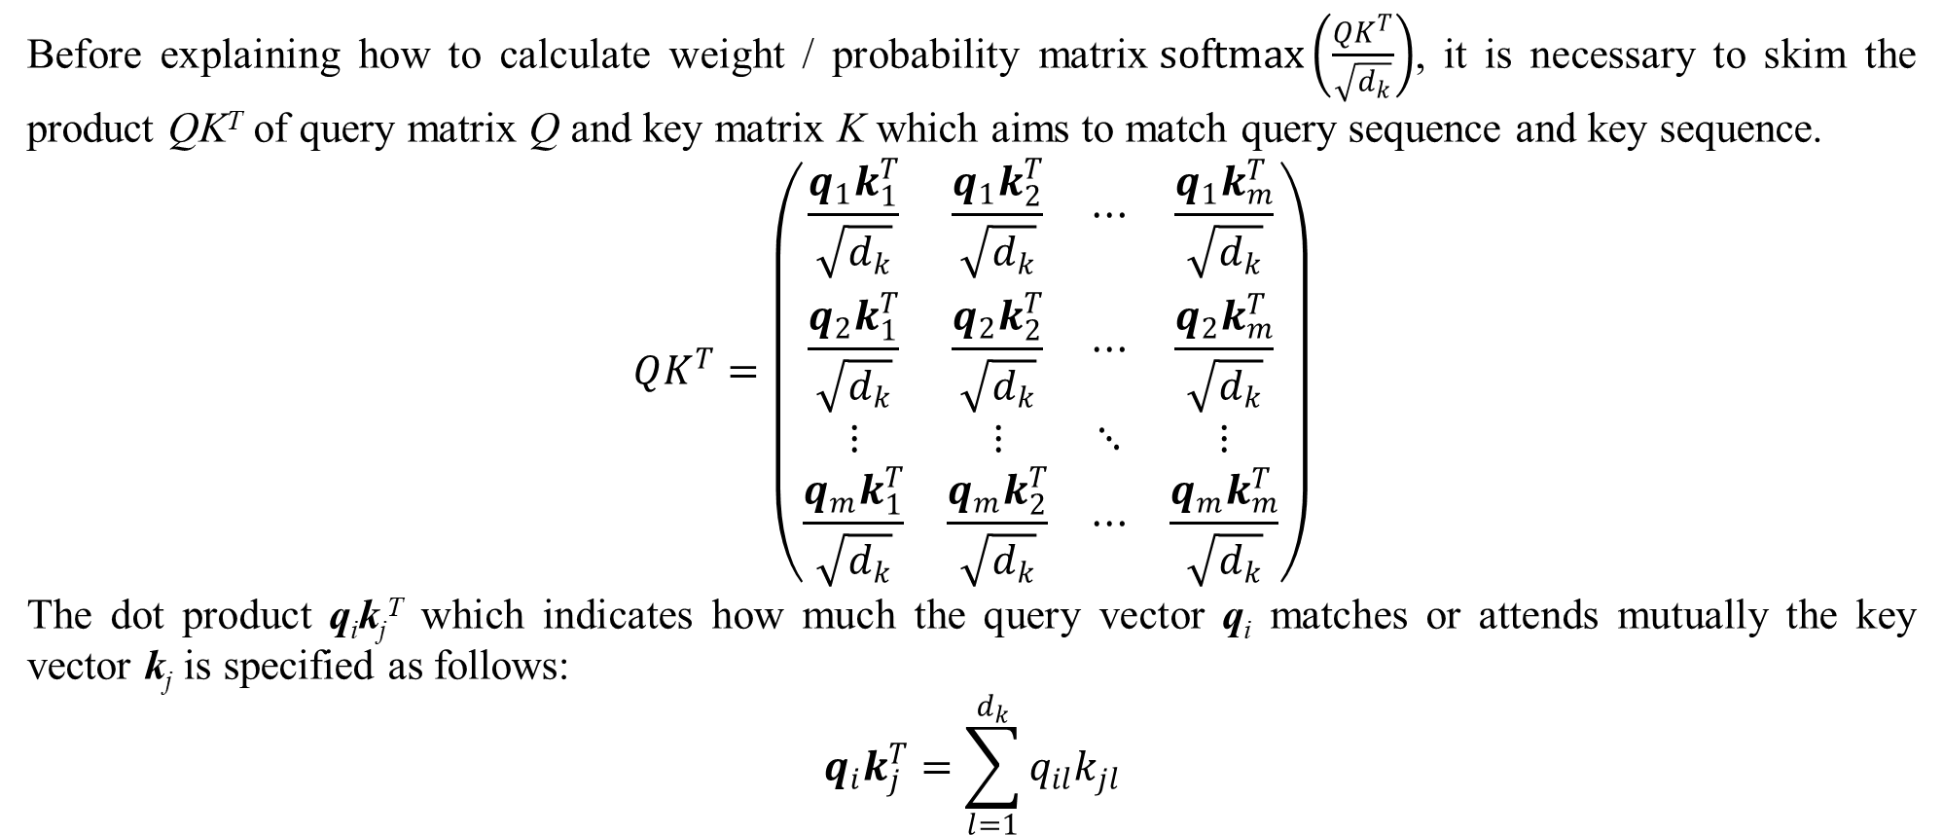
3. Transformer
Before explaining how to calculate weight / probability matrix$softmax\left(\frac{QK^{T}}{\sqrt{d_{k}}}\right)$, it is necessary to skim the product QK^{T} of query matrix Q and key matrix K which aims to match query sequence and key sequence.
$$QK^{T}=\left(\begin{matrix}\frac{q_{1}k_{1}^{T}}{\sqrt{d_{k}}} & \frac{q_{1}k_{2}^{T}}{\sqrt{d_{k}}} & ⋯ & \frac{q_{1}k_{m}^{T}}{\sqrt{d_{k}}} \\ \frac{q_{2}k_{1}^{T}}{\sqrt{d_{k}}} & \frac{q_{2}k_{2}^{T}}{\sqrt{d_{k}}} & ⋯ & \frac{q_{2}k_{m}^{T}}{\sqrt{d_{k}}} \\ ⋮ & ⋮ & ⋱ & ⋮ \\ \frac{q_{m}k_{1}^{T}}{\sqrt{d_{k}}} & \frac{q_{m}k_{2}^{T}}{\sqrt{d_{k}}} & ⋯ & \frac{q_{m}k_{m}^{T}}{\sqrt{d_{k}}}\end{matrix}\right)$$
The dot product q_{i}k_{j}^{T} which indicates how much the query vector q_{i} matches or attends mutually the key vector k_{j} is specified as follows:
$$q_{i}k_{j}^{T}=\sum_{l=1}^{d_{k}}{q_{il}k_{jl}}$$

Slide 32
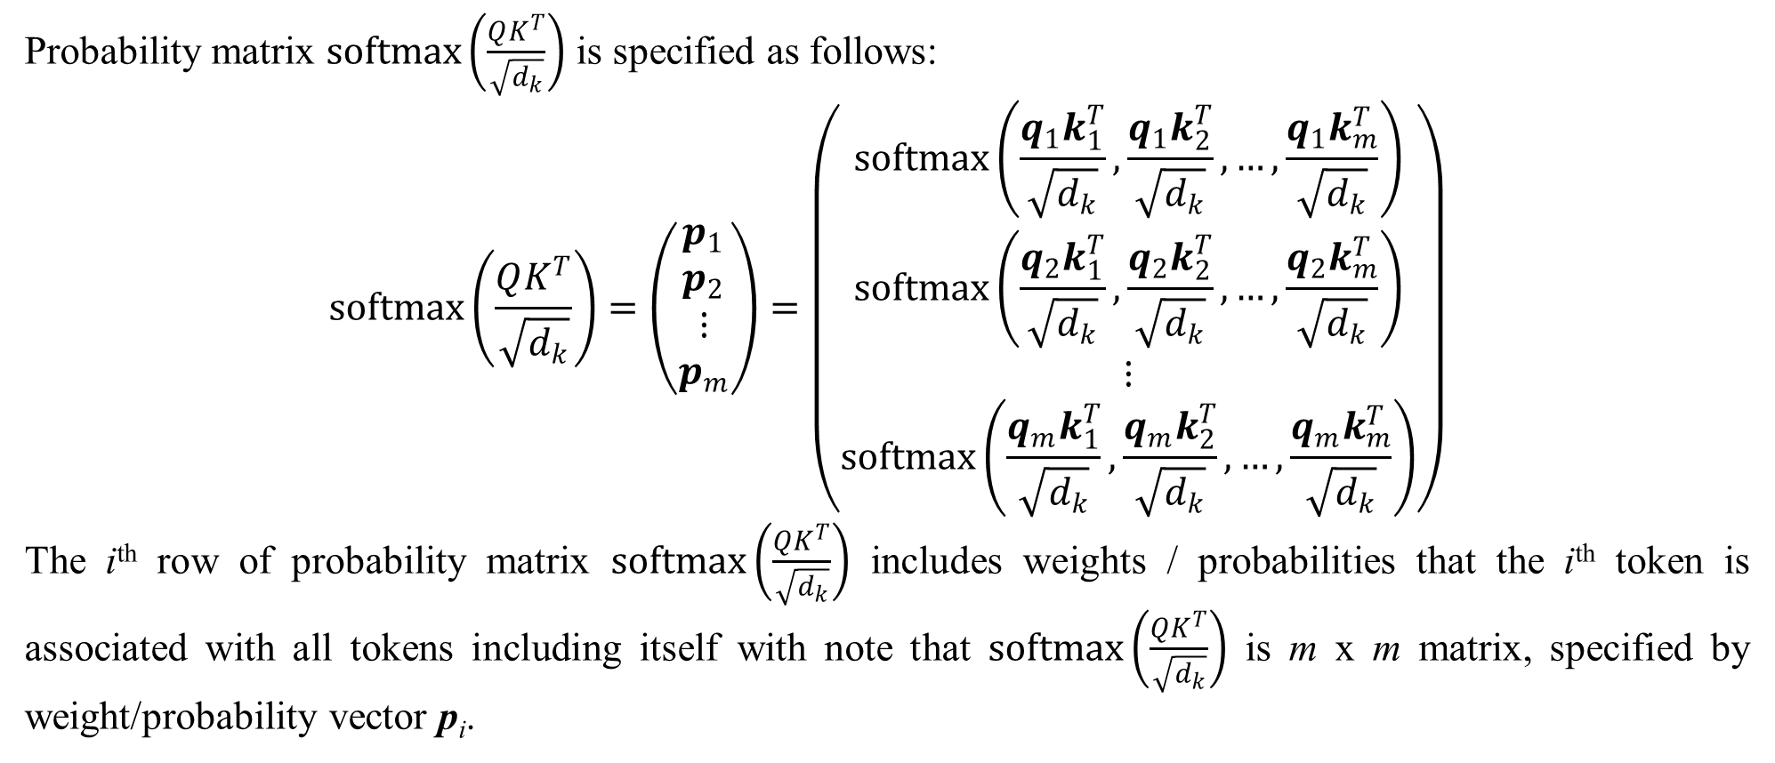
3. Transformer
Probability matrix $softmax\left(\frac{QK^{T}}{\sqrt{d_{k}}}\right)$ is specified as follows:
$$softmax\left(\frac{QK^{T}}{\sqrt{d_{k}}}\right)=\left(\begin{matrix}p_{1} \\ p_{2} \\ ⋮ \\ p_{m}\end{matrix}\right)=\left(\begin{matrix}softmax\left(\frac{q_{1}k_{1}^{T}}{\sqrt{d_{k}}},\frac{q_{1}k_{2}^{T}}{\sqrt{d_{k}}},…,\frac{q_{1}k_{m}^{T}}{\sqrt{d_{k}}}\right) \\ softmax\left(\frac{q_{2}k_{1}^{T}}{\sqrt{d_{k}}},\frac{q_{2}k_{2}^{T}}{\sqrt{d_{k}}},…,\frac{q_{2}k_{m}^{T}}{\sqrt{d_{k}}}\right) \\ ⋮ \\ softmax\left(\frac{q_{m}k_{1}^{T}}{\sqrt{d_{k}}},\frac{q_{m}k_{2}^{T}}{\sqrt{d_{k}}},…,\frac{q_{m}k_{m}^{T}}{\sqrt{d_{k}}}\right)\end{matrix}\right)$$
The i^{th} row of probability matrix $softmax\left(\frac{QK^{T}}{\sqrt{d_{k}}}\right)$ includes weights / probabilities that the i^{th} token is associated with all tokens including itself with note that $softmax\left(\frac{QK^{T}}{\sqrt{d_{k}}}\right)$ is m x m matrix, specified by weight/probability vector p_{i}.

Slide 33
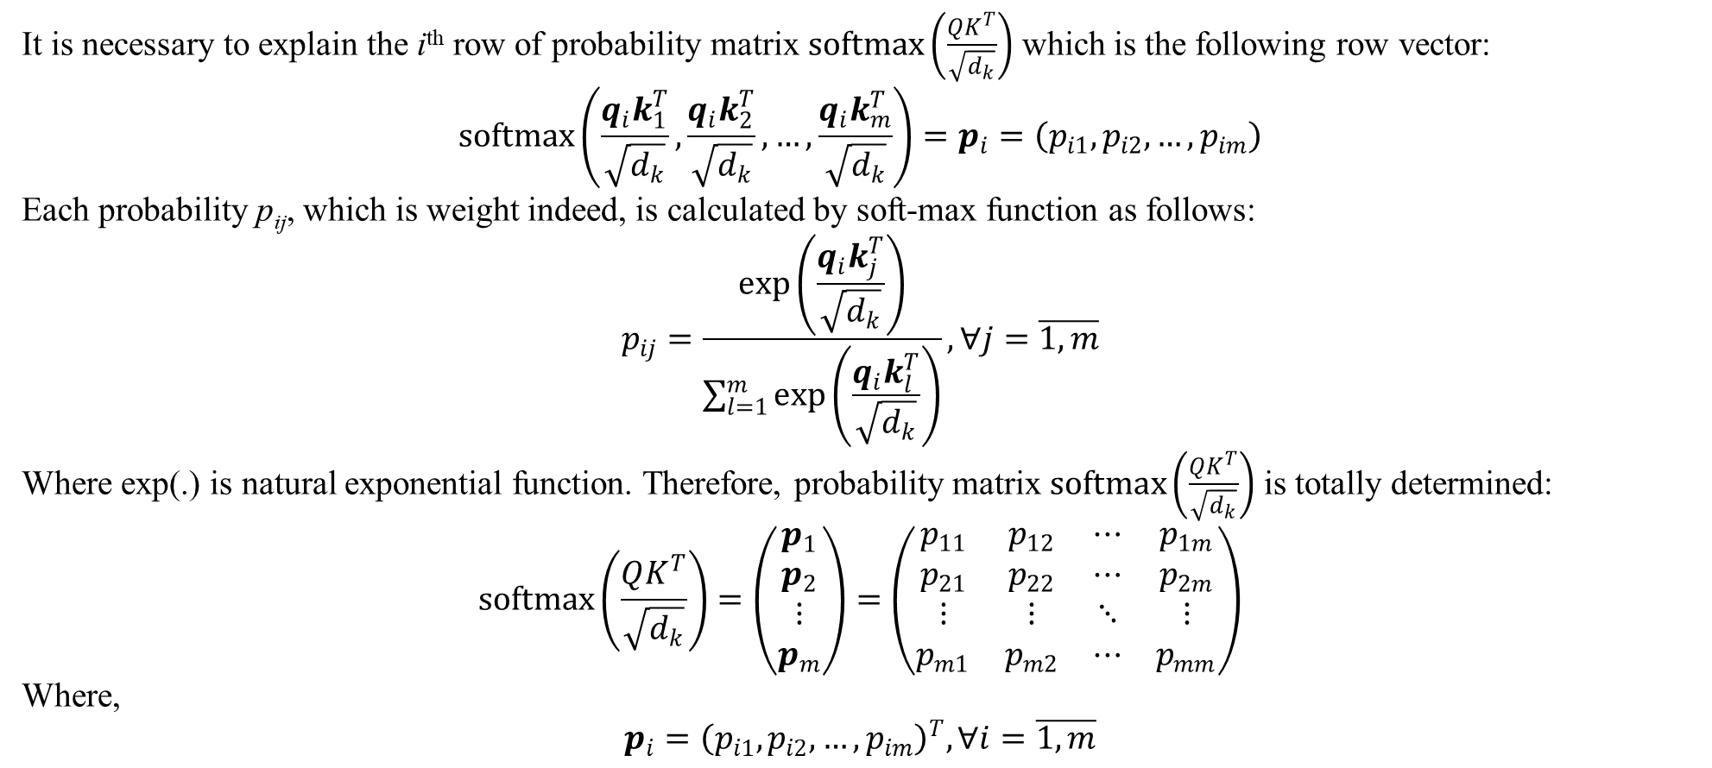
3. Transformer
It is necessary to explain the i^{th} row of probability matrix $softmax\left(\frac{QK^{T}}{\sqrt{d_{k}}}\right)$ which is the following row vector:
$$softmax\left(\frac{q_{i}k_{1}^{T}}{\sqrt{d_{k}}},\frac{q_{i}k_{2}^{T}}{\sqrt{d_{k}}},…,\frac{q_{i}k_{m}^{T}}{\sqrt{d_{k}}}\right)=p_{i}=\left(p_{i1},p_{i2},…,p_{im}\right)$$
Each probability p_{ij}, which is weight indeed, is calculated by soft-max function as follows:
$$p_{ij}=\frac{exp\left(\frac{q_{i}k_{j}^{T}}{\sqrt{d_{k}}}\right)}{\sum_{l=1}^{m}{exp\left(\frac{q_{i}k_{l}^{T}}{\sqrt{d_{k}}}\right)}},∀j=\overline{1,m}$$
Where exp(.) is natural exponential function. Therefore, probability matrix $softmax\left(\frac{QK^{T}}{\sqrt{d_{k}}}\right)$ is totally determined:
$$softmax\left(\frac{QK^{T}}{\sqrt{d_{k}}}\right)=\left(\begin{matrix}p_{1} \\ p_{2} \\ ⋮ \\ p_{m}\end{matrix}\right)=\left(\begin{matrix}p_{11} & p_{12} & ⋯ & p_{1m} \\ p_{21} & p_{22} & ⋯ & p_{2m} \\ ⋮ & ⋮ & ⋱ & ⋮ \\ p_{m1} & p_{m2} & ⋯ & p_{mm}\end{matrix}\right)$$
Where,
$$p_{i}={\left(p_{i1},p_{i2},…,p_{im}\right)}^{T},∀i=\overline{1,m}$$

Slide 34
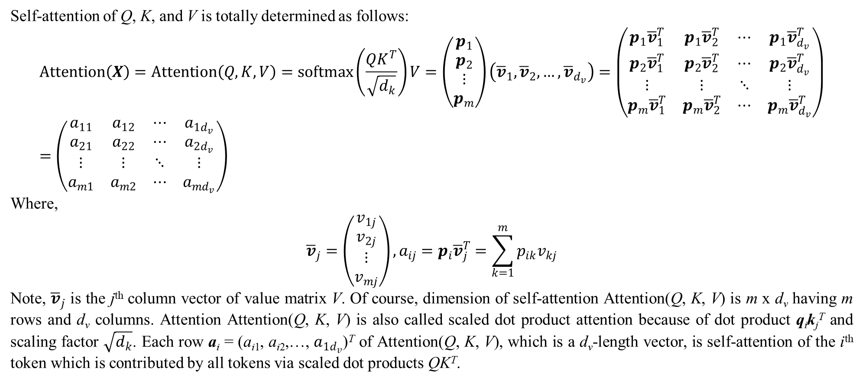
3. Transformer
Self-attention of Q, K, and V is totally determined as follows:
$$Attention\left(X\right)=Attention\left(Q,K,V\right)=softmax\left(\frac{QK^{T}}{\sqrt{d_{k}}}\right)V=\left(\begin{matrix}p_{1} \\ p_{2} \\ ⋮ \\ p_{m}\end{matrix}\right)\left({\overline{v}}_{1},{\overline{v}}_{2},…,{\overline{v}}_{d_{v}}\right)=\left(\begin{matrix}p_{1}{\overline{v}}_{1}^{T} & p_{1}{\overline{v}}_{2}^{T} & ⋯ & p_{1}{\overline{v}}_{d_{v}}^{T} \\ p_{2}{\overline{v}}_{1}^{T} & p_{2}{\overline{v}}_{2}^{T} & ⋯ & p_{2}{\overline{v}}_{d_{v}}^{T} \\ ⋮ & ⋮ & ⋱ & ⋮ \\ p_{m}{\overline{v}}_{1}^{T} & p_{m}{\overline{v}}_{2}^{T} & ⋯ & p_{m}{\overline{v}}_{d_{v}}^{T}\end{matrix}\right)=\left(\begin{matrix}a_{11} & a_{12} & ⋯ & a_{1d_{v}} \\ a_{21} & a_{22} & ⋯ & a_{2d_{v}} \\ ⋮ & ⋮ & ⋱ & ⋮ \\ a_{m1} & a_{m2} & ⋯ & a_{md_{v}}\end{matrix}\right)$$
Where,
$${\overline{v}}_{j}=\left(\begin{matrix}v_{1j} \\ v_{2j} \\ ⋮ \\ v_{mj}\end{matrix}\right),a_{ij}=p_{i}{\overline{v}}_{j}^{T}=\sum_{k=1}^{m}{p_{ik}v_{kj}}$$
Note, ${\overline{v}}_{j}$ is the j^{th} column vector of value matrix V. Of course, dimension of self-attention Attention(Q, K, V) is m x d_{v} having m rows and d_{v} columns. Attention Attention(Q, K, V) is also called scaled dot product attention because of dot product q_{i}k_{j}^{T} and scaling factor $\sqrt{d_{k}}$. Each row a_{i} = (a_{i1}, a_{i2},…, $a_{1d_{v}}$)^{T} of Attention(Q, K, V), which is a d_{v}-length vector, is self-attention of the i^{th} token which is contributed by all tokens via scaled dot products QK^{T}.

Slide 35
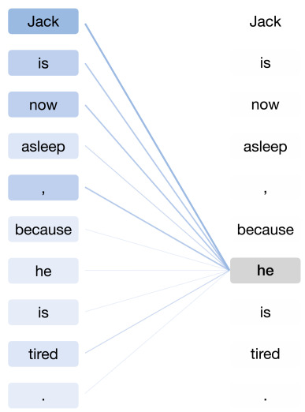
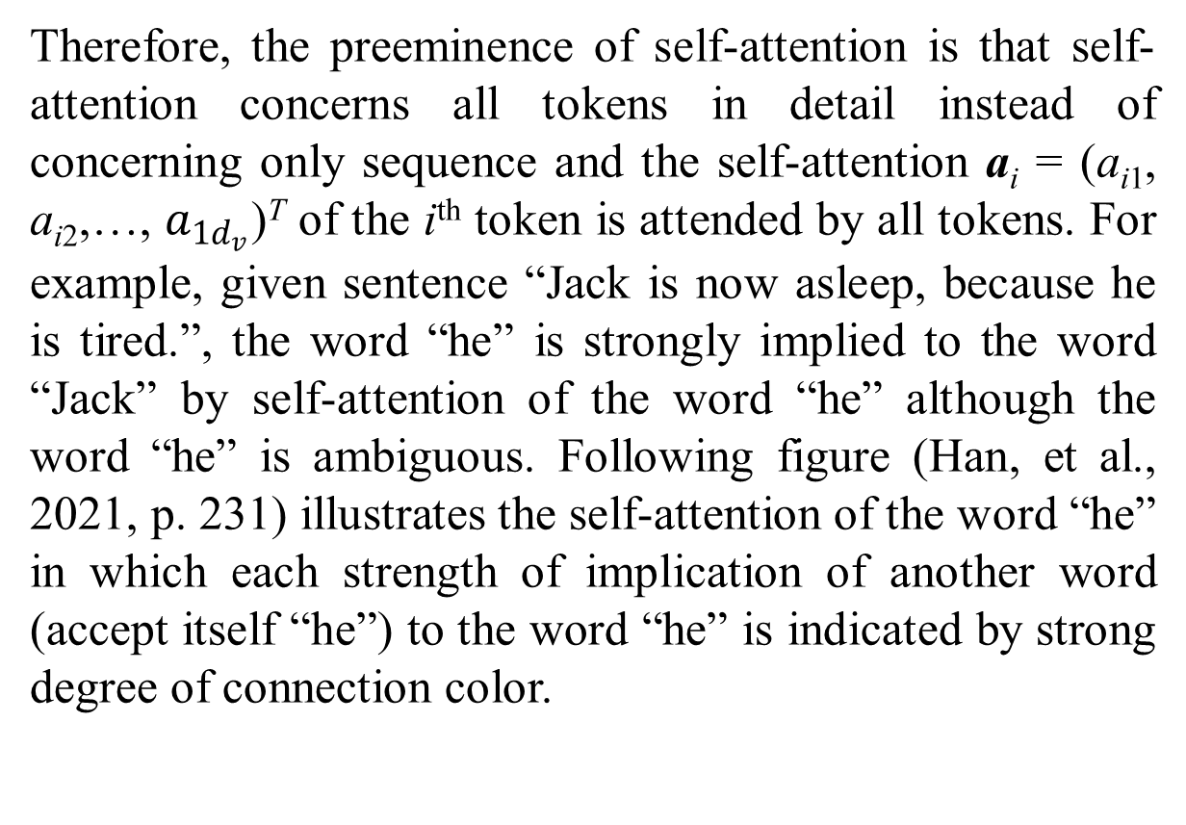
3. Transformer
Therefore, the preeminence of self-attention is that self-attention concerns all tokens in detail instead of concerning only sequence and the self-attention a_{i} = (a_{i1}, a_{i2},…, $a_{1d_{v}}$)^{T} of the i^{th} token is attended by all tokens. For example, given sentence “Jack is now asleep, because he is tired.”, the word “he” is strongly implied to the word “Jack” by self-attention of the word “he” although the word “he” is ambiguous. Following figure (Han, et al., 2021, p. 231) illustrates the self-attention of the word “he” in which each strength of implication of another word (accept itself “he”) to the word “he” is indicated by strong degree of connection color.
Figure 3.2. Self-attention example

Slide 36
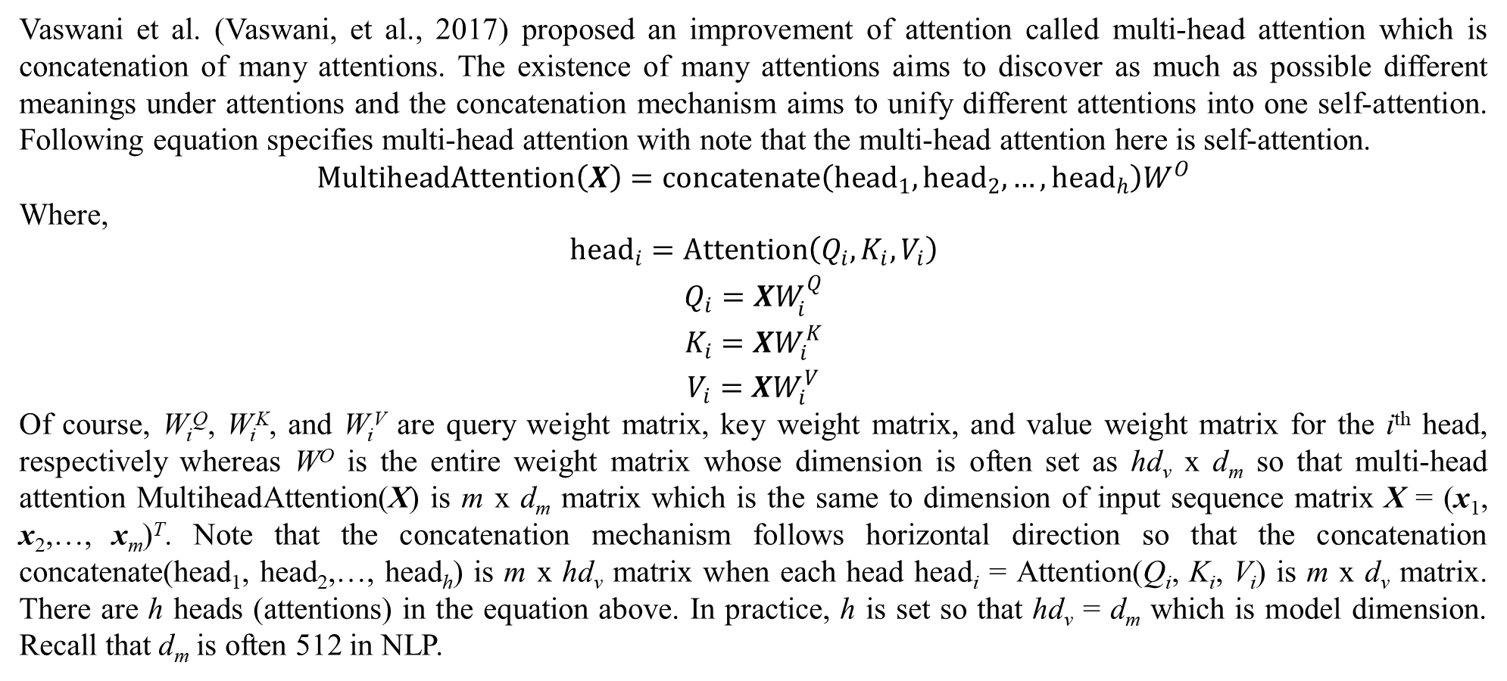
3. Transformer
Vaswani et al. (Vaswani, et al., 2017) proposed an improvement of attention called multi-head attention which is concatenation of many attentions. The existence of many attentions aims to discover as much as possible different meanings under attentions and the concatenation mechanism aims to unify different attentions into one self-attention. Following equation specifies multi-head attention with note that the multi-head attention here is self-attention.
$$MultiheadAttention\left(X\right)=concatenate\left({head}_{1},{head}_{2},…,{head}_{h}\right)W^{O}$$
Where,
$$\begin{matrix}{head}_{i}=Attention\left(Q_{i},K_{i},V_{i}\right) \\ Q_{i}=XW_{i}^{Q} \\ K_{i}=XW_{i}^{K} \\ V_{i}=XW_{i}^{V}\end{matrix}$$
Of course, W_{i}^{Q}, W_{i}^{K}, and W_{i}^{V} are query weight matrix, key weight matrix, and value weight matrix for the i^{th} head, respectively whereas W^{O} is the entire weight matrix whose dimension is often set as hd_{v} x d_{m} so that multi-head attention MultiheadAttention(X) is m x d_{m} matrix which is the same to dimension of input sequence matrix X = (x₁, x₂,…, x_{m})^{T}. Note that the concatenation mechanism follows horizontal direction so that the concatenation concatenate(head₁, head₂,…, head_{h}) is m x hd_{v} matrix when each head head_{i} = Attention(Q_{i}, K_{i}, V_{i}) is m x d_{v} matrix. There are h heads (attentions) in the equation above. In practice, h is set so that hd_{v} = d_{m} which is model dimension. Recall that d_{m} is often 512 in NLP.

Slide 37
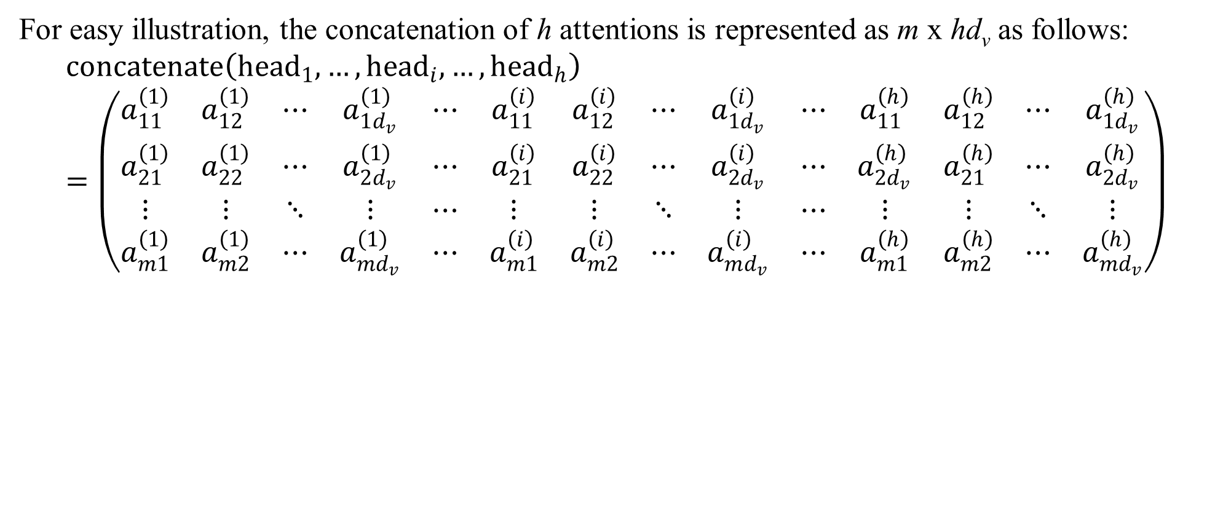
3. Transformer
For easy illustration, the concatenation of h attentions is represented as m x hd_{v} as follows:
$$concatenate\left({head}_{1},…,{head}_{i},…,{head}_{h}\right)=\left(\begin{matrix}a_{11}^{\left(1\right)} & a_{12}^{\left(1\right)} & ⋯ & a_{1d_{v}}^{\left(1\right)} & ⋯ & a_{11}^{\left(i\right)} & a_{12}^{\left(i\right)} & ⋯ & a_{1d_{v}}^{\left(i\right)} & ⋯ & a_{11}^{\left(h\right)} & a_{12}^{\left(h\right)} & ⋯ & a_{1d_{v}}^{\left(h\right)} \\ a_{21}^{\left(1\right)} & a_{22}^{\left(1\right)} & ⋯ & a_{2d_{v}}^{\left(1\right)} & ⋯ & a_{21}^{\left(i\right)} & a_{22}^{\left(i\right)} & ⋯ & a_{2d_{v}}^{\left(i\right)} & ⋯ & a_{2d_{v}}^{\left(h\right)} & a_{21}^{\left(h\right)} & ⋯ & a_{2d_{v}}^{\left(h\right)} \\ ⋮ & ⋮ & ⋱ & ⋮ & ⋯ & ⋮ & ⋮ & ⋱ & ⋮ & ⋯ & ⋮ & ⋮ & ⋱ & ⋮ \\ a_{m1}^{\left(1\right)} & a_{m2}^{\left(1\right)} & ⋯ & a_{md_{v}}^{\left(1\right)} & ⋯ & a_{m1}^{\left(i\right)} & a_{m2}^{\left(i\right)} & ⋯ & a_{md_{v}}^{\left(i\right)} & ⋯ & a_{m1}^{\left(h\right)} & a_{m2}^{\left(h\right)} & ⋯ & a_{md_{v}}^{\left(h\right)}\end{matrix}\right)$$

Slide 38
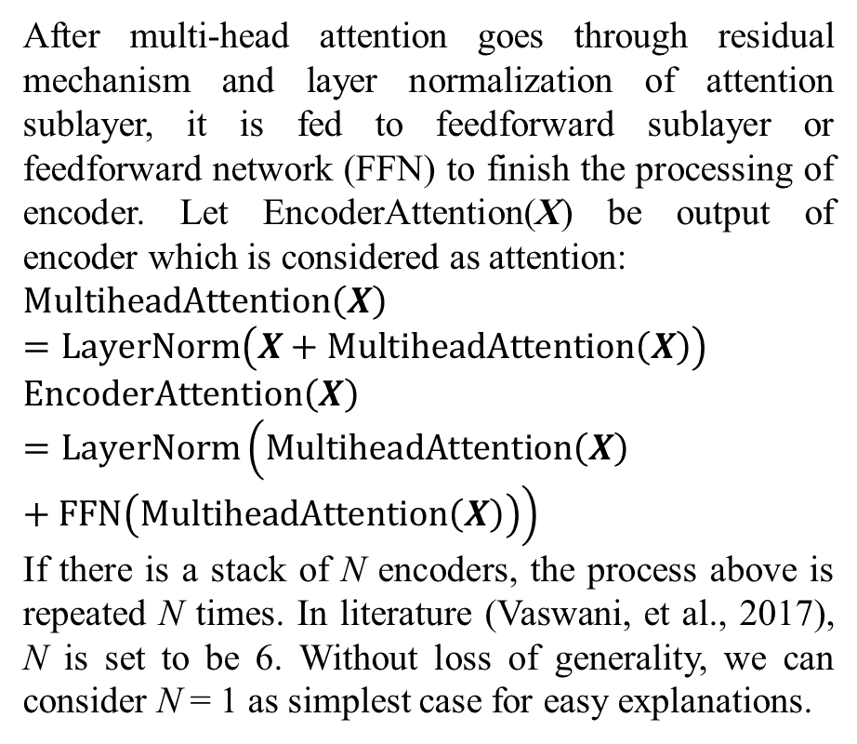
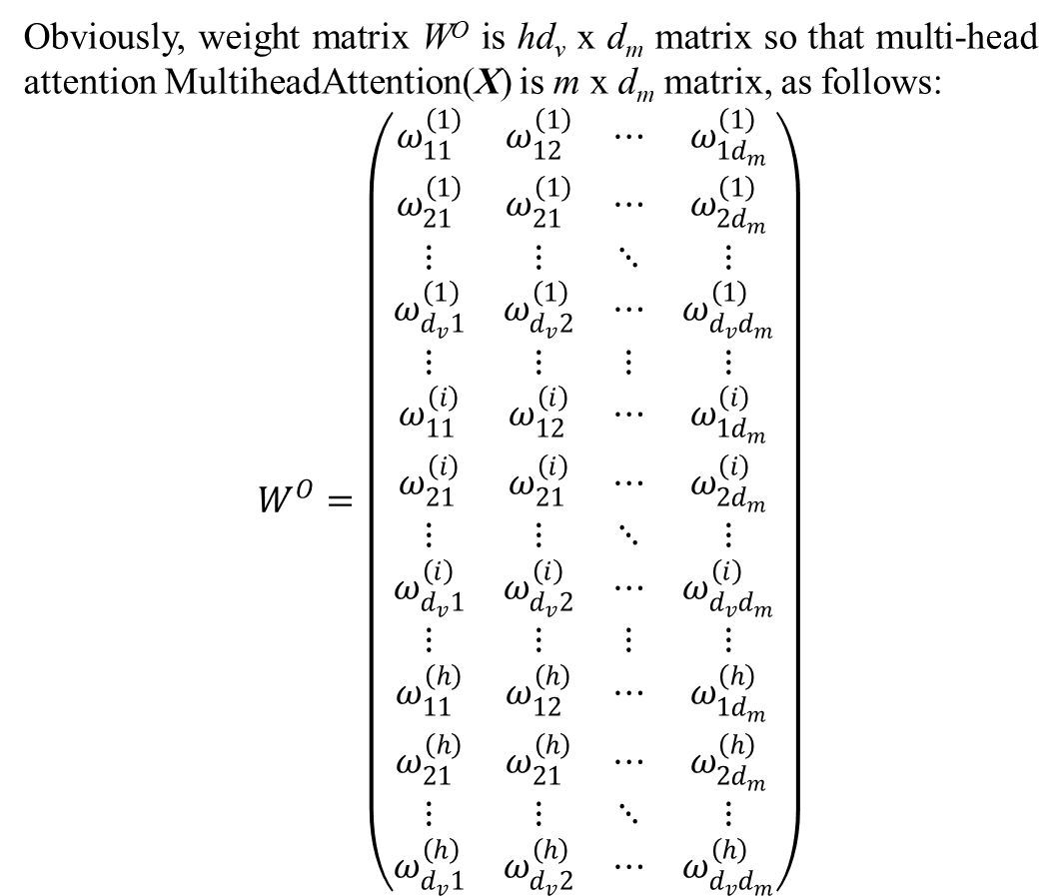
3. Transformer
Obviously, weight matrix W^{O} is hd_{v} x d_{m} matrix so that multi-head attention MultiheadAttention(X) is m x d_{m} matrix, as follows:
$$W^{O}=\left(\begin{matrix}ω_{11}^{\left(1\right)} & ω_{12}^{\left(1\right)} & ⋯ & ω_{1d_{m}}^{\left(1\right)} \\ ω_{21}^{\left(1\right)} & ω_{21}^{\left(1\right)} & ⋯ & ω_{2d_{m}}^{\left(1\right)} \\ ⋮ & ⋮ & ⋱ & ⋮ \\ ω_{d_{v}1}^{\left(1\right)} & ω_{d_{v}2}^{\left(1\right)} & ⋯ & ω_{d_{v}d_{m}}^{\left(1\right)} \\ ⋮ & ⋮ & ⋮ & ⋮ \\ ω_{11}^{\left(i\right)} & ω_{12}^{\left(i\right)} & ⋯ & ω_{1d_{m}}^{\left(i\right)} \\ ω_{21}^{\left(i\right)} & ω_{21}^{\left(i\right)} & ⋯ & ω_{2d_{m}}^{\left(i\right)} \\ ⋮ & ⋮ & ⋱ & ⋮ \\ ω_{d_{v}1}^{\left(i\right)} & ω_{d_{v}2}^{\left(i\right)} & ⋯ & ω_{d_{v}d_{m}}^{\left(i\right)} \\ ⋮ & ⋮ & ⋮ & ⋮ \\ ω_{11}^{\left(h\right)} & ω_{12}^{\left(h\right)} & ⋯ & ω_{1d_{m}}^{\left(h\right)} \\ ω_{21}^{\left(h\right)} & ω_{21}^{\left(h\right)} & ⋯ & ω_{2d_{m}}^{\left(h\right)} \\ ⋮ & ⋮ & ⋱ & ⋮ \\ ω_{d_{v}1}^{\left(h\right)} & ω_{d_{v}2}^{\left(h\right)} & ⋯ & ω_{d_{v}d_{m}}^{\left(h\right)}\end{matrix}\right)$$
After multi-head attention goes through residual mechanism and layer normalization of attention sublayer, it is fed to feedforward sublayer or feedforward network (FFN) to finish the processing of encoder. Let EncoderAttention(X) be output of encoder which is considered as attention:
$$MultiheadAttention\left(X\right)=LayerNorm\left(X+MultiheadAttention\left(X\right)\right) \\ EncoderAttention\left(X\right)=LayerNorm\left(MultiheadAttention\left(X\right)+FFN\left(MultiheadAttention\left(X\right)\right)\right)$$
If there is a stack of N encoders, the process above is repeated N times. In literature (Vaswani, et al., 2017), N is set to be 6. Without loss of generality, we can consider N = 1 as simplest case for easy explanations.

Slide 39
3. Transformer
Now it is essential to survey how decoder applies encoder attention EncoderAttention(X) into its encoding task. Essentially, decoder has two multi-head attentions such as masked multi-head attention and multi-head attention whereas encoder has only one multi-head attention. Their attentions are similar to encoder’s attention but there is a slight difference. Firstly, decoder input sequence Y = (y₁, y₂,…, y_{n})^{T} is fed to masked multi-head attention sublayer with note that Y is n x d_{m} matrix with support that model dimension d_{m}, which is often set to be 512 in natural language processing (NLP), may not be changed with regard to decoder. Because masked multi-head attention is composed by concatenation of masked head attentions by the same way of encoder, we should concern masked head attention. Sequence Y should have n = m tokens like sequence X in practice. This is necessary because the length m = n is the largest number of possible tokens in any sequence. For shorter sentences in NLP, redundant tokens are represented by zeros. Moreover, most of parameters (weight matrices) of encoder and decoder are independent from m and n, especially in the case m = n.

Slide 40
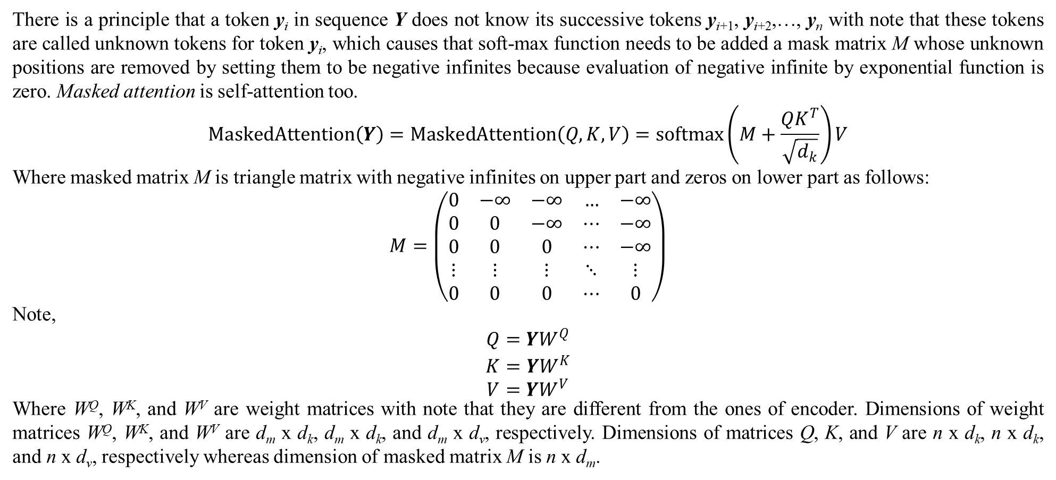
3. Transformer
There is a principle that a token y_{i} in sequence Y does not know its successive tokens y_{i+1}, y_{i+2},…, y_{n} with note that these tokens are called unknown tokens for token y_{i}, which causes that soft-max function needs to be added a mask matrix M whose unknown positions are removed by setting them to be negative infinites because evaluation of negative infinite by exponential function is zero. Masked attention is self-attention too.
$$MaskedAttention\left(Y\right)=MaskedAttention\left(Q,K,V\right)=softmax\left(M+\frac{QK^{T}}{\sqrt{d_{k}}}\right)V$$
Where masked matrix M is triangle matrix with negative infinites on upper part and zeros on lower part as follows:
$$M=\left(\begin{matrix}0 & −∞ & −∞ & … & −∞ \\ 0 & 0 & −∞ & ⋯ & −∞ \\ 0 & 0 & 0 & ⋯ & −∞ \\ ⋮ & ⋮ & ⋮ & ⋱ & ⋮ \\ 0 & 0 & 0 & ⋯ & 0\end{matrix}\right)$$
Note,
$$\begin{matrix}Q=YW^{Q} \\ K=YW^{K} \\ V=YW^{V}\end{matrix}$$
Where W^{Q}, W^{K}, and W^{V} are weight matrices with note that they are different from the ones of encoder. Dimensions of weight matrices W^{Q}, W^{K}, and W^{V} are d_{m} x d_{k}, d_{m} x d_{k}, and d_{m} x d_{v}, respectively. Dimensions of matrices Q, K, and V are n x d_{k}, n x d_{k}, and n x d_{v}, respectively whereas dimension of masked matrix M is n x d_{m}.

Slide 41
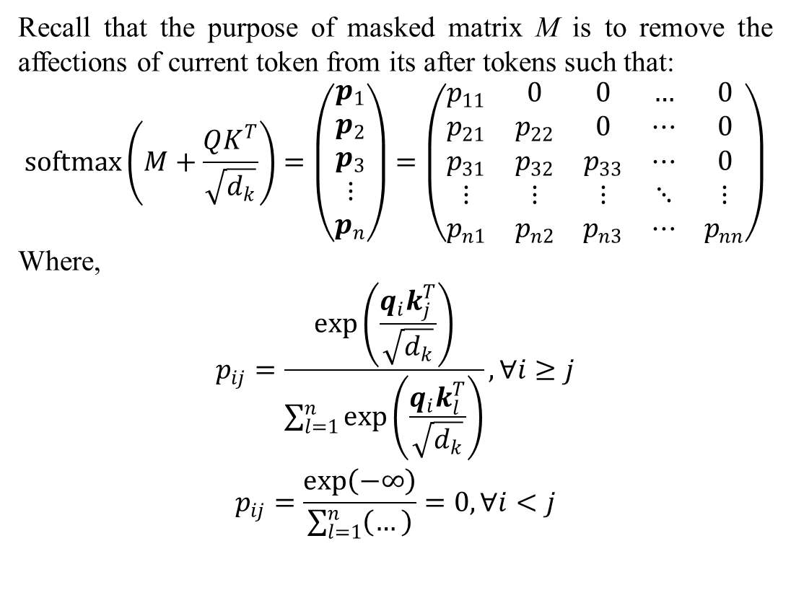
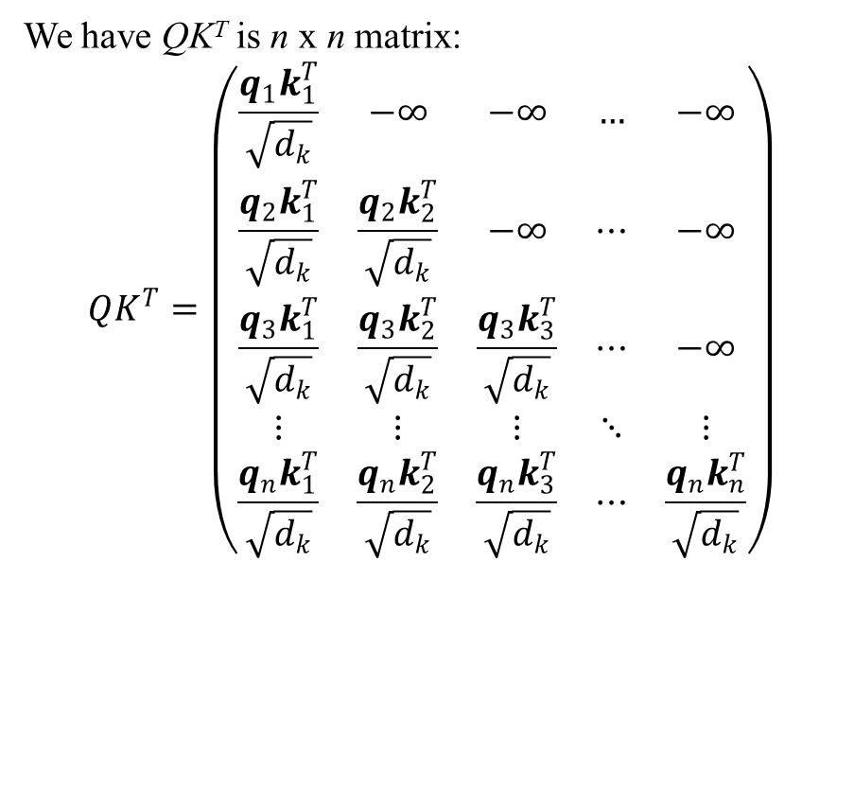
3. Transformer
We have QK^{T} is n x n matrix:
$$QK^{T}=\left(\begin{matrix}\frac{q_{1}k_{1}^{T}}{\sqrt{d_{k}}} & −∞ & −∞ & … & −∞ \\ \frac{q_{2}k_{1}^{T}}{\sqrt{d_{k}}} & \frac{q_{2}k_{2}^{T}}{\sqrt{d_{k}}} & −∞ & ⋯ & −∞ \\ \frac{q_{3}k_{1}^{T}}{\sqrt{d_{k}}} & \frac{q_{3}k_{2}^{T}}{\sqrt{d_{k}}} & \frac{q_{3}k_{3}^{T}}{\sqrt{d_{k}}} & ⋯ & −∞ \\ ⋮ & ⋮ & ⋮ & ⋱ & ⋮ \\ \frac{q_{n}k_{1}^{T}}{\sqrt{d_{k}}} & \frac{q_{n}k_{2}^{T}}{\sqrt{d_{k}}} & \frac{q_{n}k_{3}^{T}}{\sqrt{d_{k}}} & ⋯ & \frac{q_{n}k_{n}^{T}}{\sqrt{d_{k}}}\end{matrix}\right)$$
Recall that the purpose of masked matrix M is to remove the affections of current token from its after tokens such that:
$$softmax\left(M+\frac{QK^{T}}{\sqrt{d_{k}}}\right)=\left(\begin{matrix}p_{1} \\ p_{2} \\ p_{3} \\ ⋮ \\ p_{n}\end{matrix}\right)=\left(\begin{matrix}p_{11} & 0 & 0 & … & 0 \\ p_{21} & p_{22} & 0 & ⋯ & 0 \\ p_{31} & p_{32} & p_{33} & ⋯ & 0 \\ ⋮ & ⋮ & ⋮ & ⋱ & ⋮ \\ p_{n1} & p_{n2} & p_{n3} & ⋯ & p_{nn}\end{matrix}\right)$$
Where,
$$\begin{matrix}p_{ij}=\frac{exp\left(\frac{q_{i}k_{j}^{T}}{\sqrt{d_{k}}}\right)}{\sum_{l=1}^{n}{exp\left(\frac{q_{i}k_{l}^{T}}{\sqrt{d_{k}}}\right)}},∀i≥j \\ p_{ij}=\frac{exp\left(−∞\right)}{\sum_{l=1}^{n}{\left(…\right)}}=0,∀i<j\end{matrix}$$

Slide 42
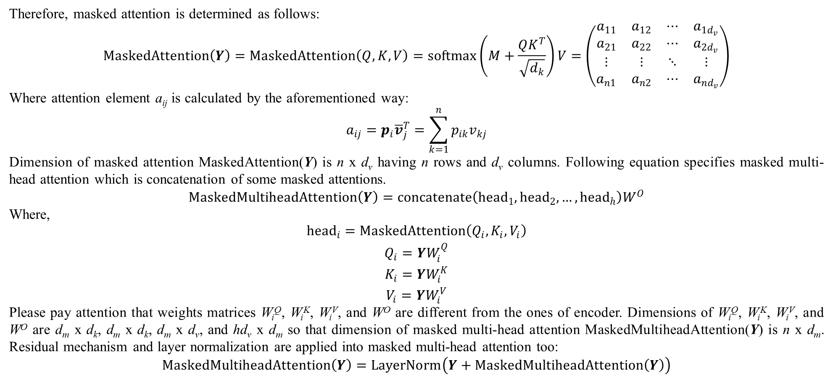
3. Transformer
Therefore, masked attention is determined as follows:
$$MaskedAttention\left(Y\right)=MaskedAttention\left(Q,K,V\right)=softmax\left(M+\frac{QK^{T}}{\sqrt{d_{k}}}\right)V=\left(\begin{matrix}a_{11} & a_{12} & ⋯ & a_{1d_{v}} \\ a_{21} & a_{22} & ⋯ & a_{2d_{v}} \\ ⋮ & ⋮ & ⋱ & ⋮ \\ a_{n1} & a_{n2} & ⋯ & a_{nd_{v}}\end{matrix}\right)$$
Where attention element a_{ij} is calculated by the aforementioned way:
$$a_{ij}=p_{i}{\overline{v}}_{j}^{T}=\sum_{k=1}^{n}{p_{ik}v_{kj}}$$
Dimension of masked attention MaskedAttention(Y) is n x d_{v} having n rows and d_{v} columns. Following equation specifies masked multi-head attention which is concatenation of some masked attentions.
$$MaskedMultiheadAttention\left(Y\right)=concatenate\left({head}_{1},{head}_{2},…,{head}_{h}\right)W^{O}$$
Where,
$$\begin{matrix}{head}_{i}=MaskedAttention\left(Q_{i},K_{i},V_{i}\right) \\ Q_{i}=YW_{i}^{Q} \\ K_{i}=YW_{i}^{K} \\ V_{i}=YW_{i}^{V}\end{matrix}$$
Please pay attention that weights matrices W_{i}^{Q}, W_{i}^{K}, W_{i}^{V}, and W^{O} are different from the ones of encoder. Dimensions of W_{i}^{Q}, W_{i}^{K}, W_{i}^{V}, and W^{O} are d_{m} x d_{k}, d_{m} x d_{k}, d_{m} x d_{v}, and hd_{v} x d_{m} so that dimension of masked multi-head attention MaskedMultiheadAttention(Y) is n x d_{m}. Residual mechanism and layer normalization are applied into masked multi-head attention too:
$$MaskedMultiheadAttention\left(Y\right)=LayerNorm\left(Y+MaskedMultiheadAttention\left(Y\right)\right)$$

Slide 43
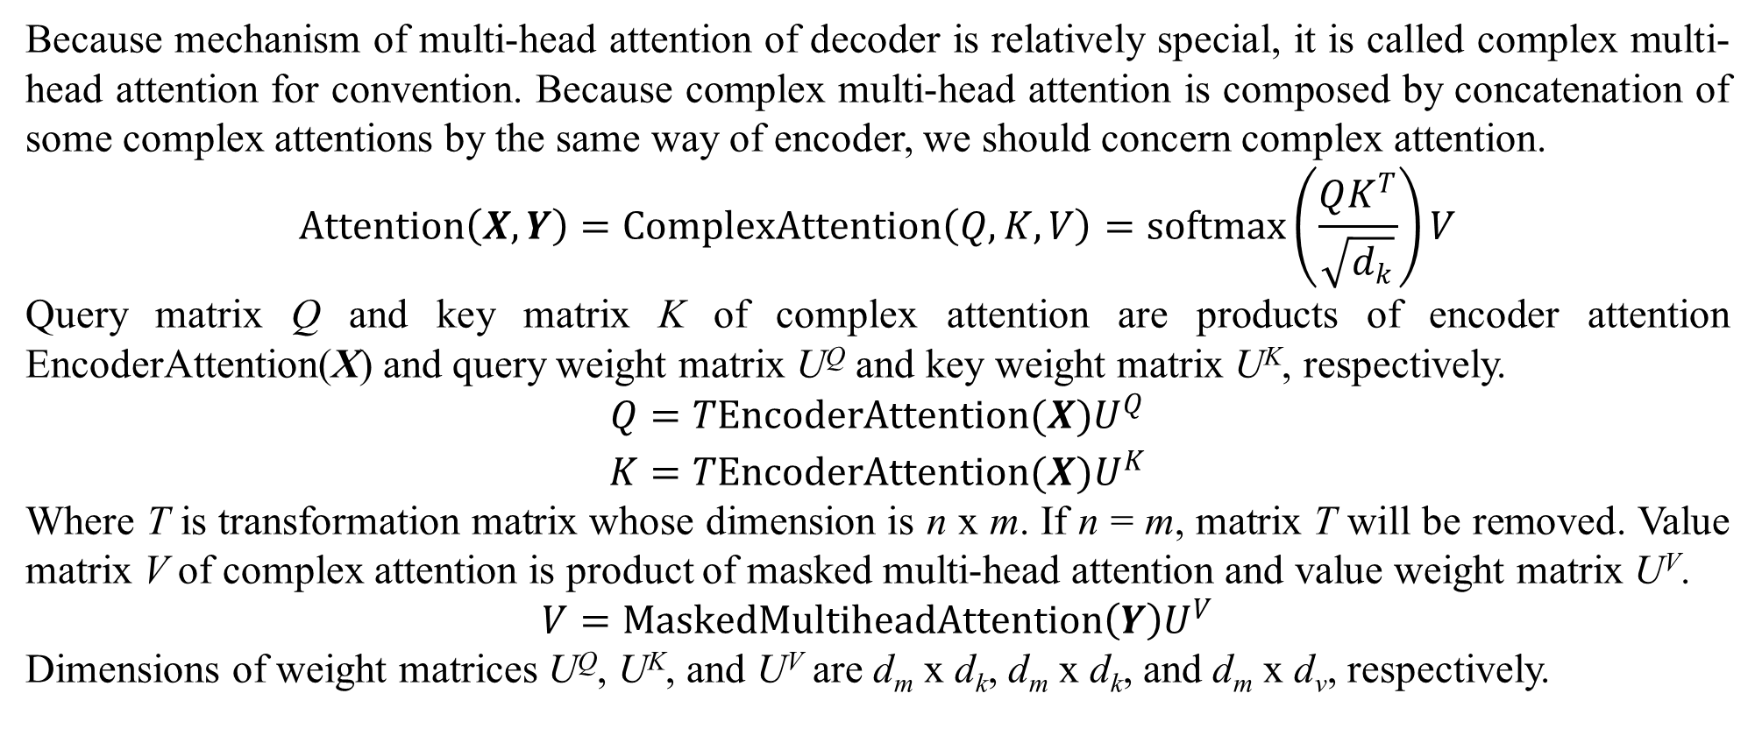
3. Transformer
Because mechanism of multi-head attention of decoder is relatively special, it is called complex multi-head attention for convention. Because complex multi-head attention is composed by concatenation of some complex attentions by the same way of encoder, we should concern complex attention.
$$Attention\left(X,Y\right)=ComplexAttention\left(Q,K,V\right)=softmax\left(\frac{QK^{T}}{\sqrt{d_{k}}}\right)V$$
Query matrix Q and key matrix K of complex attention are products of encoder attention EncoderAttention(X) and query weight matrix U^{Q} and key weight matrix U^{K}, respectively.
$$\begin{matrix}Q=TEncoderAttention(X)U^{Q} \\ K=TEncoderAttention(X)U^{K}\end{matrix}$$
Where T is transformation matrix whose dimension is n x m. If n = m, matrix T will be removed. Value matrix V of complex attention is product of masked multi-head attention and value weight matrix U^{V}.
$$V=MaskedMultiheadAttention\left(Y\right)U^{V}$$
Dimensions of weight matrices U^{Q}, U^{K}, and U^{V} are d_{m} x d_{k}, d_{m} x d_{k}, and d_{m} x d_{v}, respectively.

Slide 44
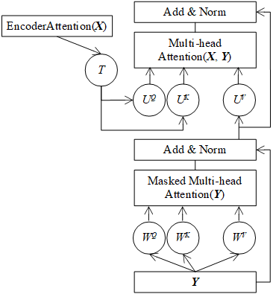
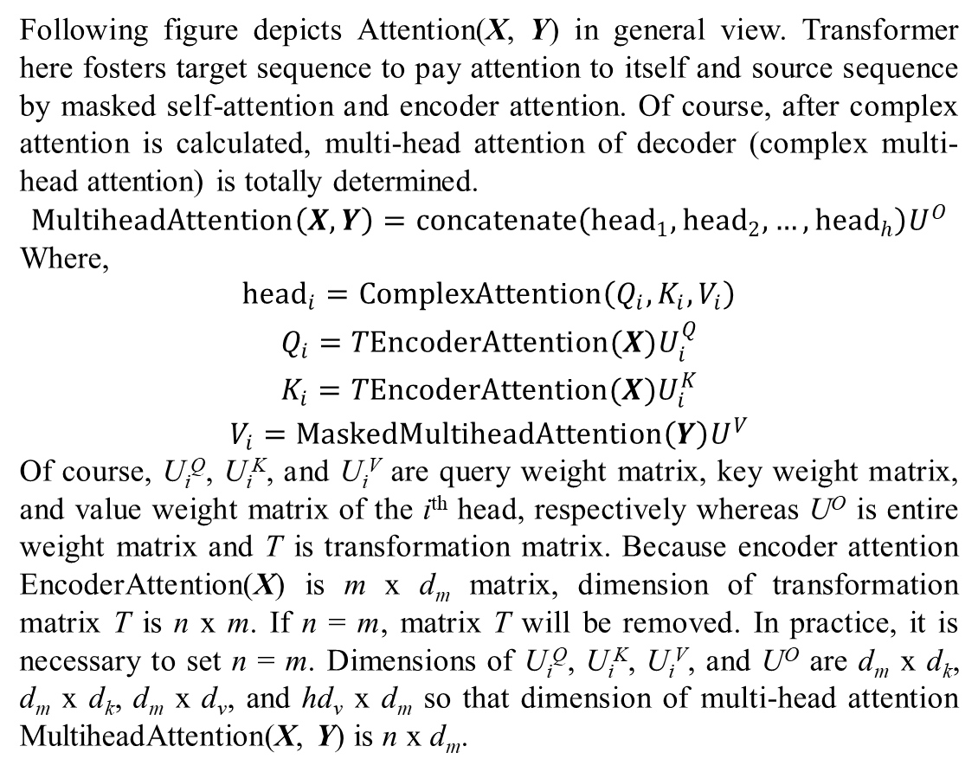
3. Transformer
Following figure depicts Attention(X, Y) in general view. Transformer here fosters target sequence to pay attention to itself and source sequence by masked self-attention and encoder attention. Of course, after complex attention is calculated, multi-head attention of decoder (complex multi-head attention) is totally determined.
$$MultiheadAttention\left(X,Y\right)=concatenate\left({head}_{1},{head}_{2},…,{head}_{h}\right)U^{O}$$
Where,
$$\begin{matrix}{head}_{i}=ComplexAttention\left(Q_{i},K_{i},V_{i}\right) \\ Q_{i}=TEncoderAttention(X)U_{i}^{Q} \\ K_{i}=TEncoderAttention(X)U_{i}^{K} \\ V_{i}=MaskedMultiheadAttention\left(Y\right)U^{V}\end{matrix}$$
Of course, U_{i}^{Q}, U_{i}^{K}, and U_{i}^{V} are query weight matrix, key weight matrix, and value weight matrix of the i^{th} head, respectively whereas U^{O} is entire weight matrix and T is transformation matrix. Because encoder attention EncoderAttention(X) is m x d_{m} matrix, dimension of transformation matrix T is n x m. If n = m, matrix T will be removed. In practice, it is necessary to set n = m. Dimensions of U_{i}^{Q}, U_{i}^{K}, U_{i}^{V}, and U^{O} are d_{m} x d_{k}, d_{m} x d_{k}, d_{m} x d_{v}, and hd_{v} x d_{m} so that dimension of multi-head attention MultiheadAttention(X, Y) is n x d_{m}.
Figure 3.3. Decoder attention Attention(X, Y) in general view

Slide 45
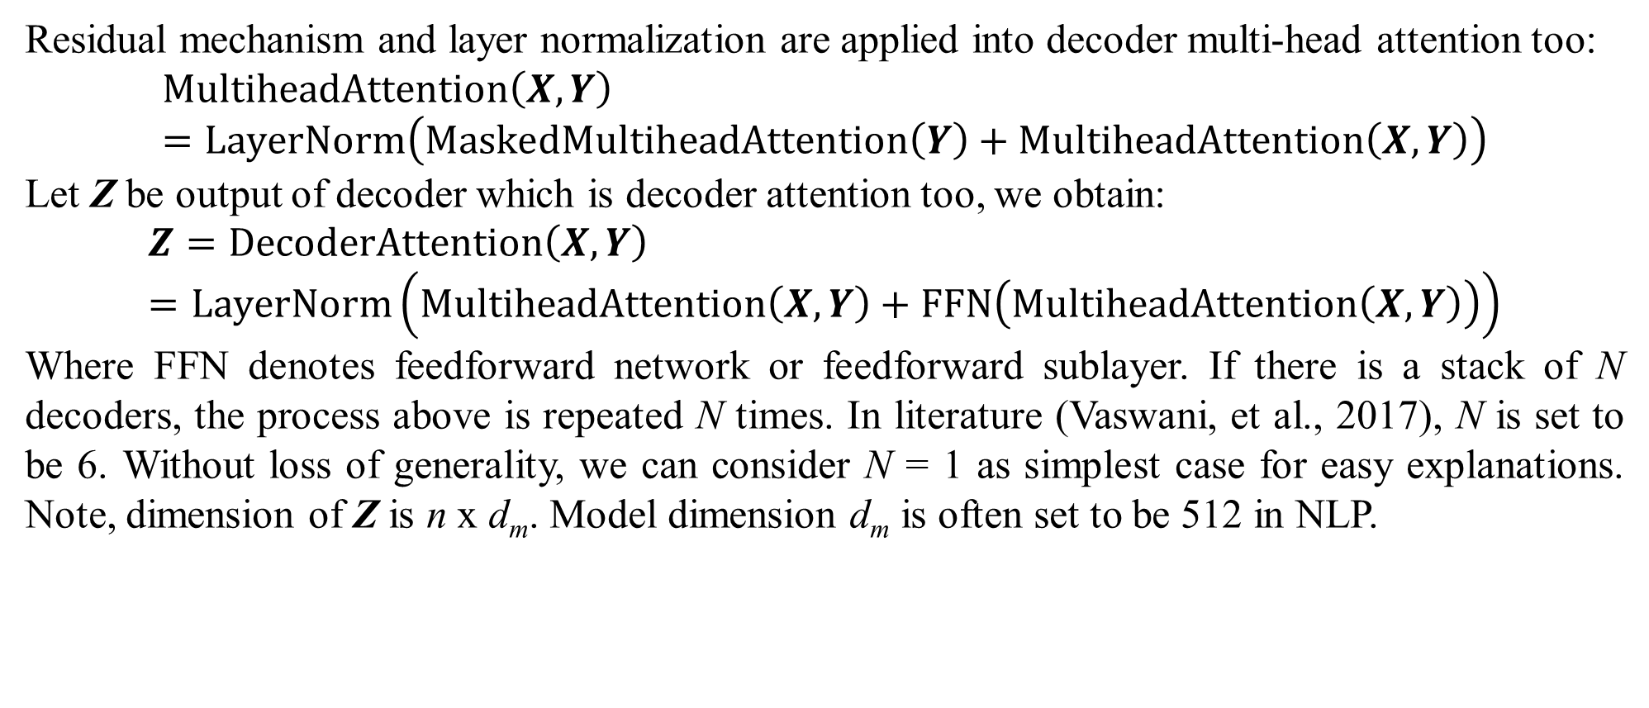
3. Transformer
Residual mechanism and layer normalization are applied into decoder multi-head attention too:
$$MultiheadAttention\left(X,Y\right)=LayerNorm\left(MaskedMultiheadAttention\left(Y\right)+MultiheadAttention\left(X,Y\right)\right)$$
Let Z be output of decoder which is decoder attention too, we obtain:
$$Z=DecoderAttention\left(X,Y\right)=LayerNorm\left(MultiheadAttention\left(X,Y\right)+FFN\left(MultiheadAttention\left(X,Y\right)\right)\right)$$
Where FFN denotes feedforward network or feedforward sublayer. If there is a stack of N decoders, the process above is repeated N times. In literature (Vaswani, et al., 2017), N is set to be 6. Without loss of generality, we can consider N = 1 as simplest case for easy explanations. Note, dimension of Z is n x d_{m}. Model dimension d_{m} is often set to be 512 in NLP.

Slide 46
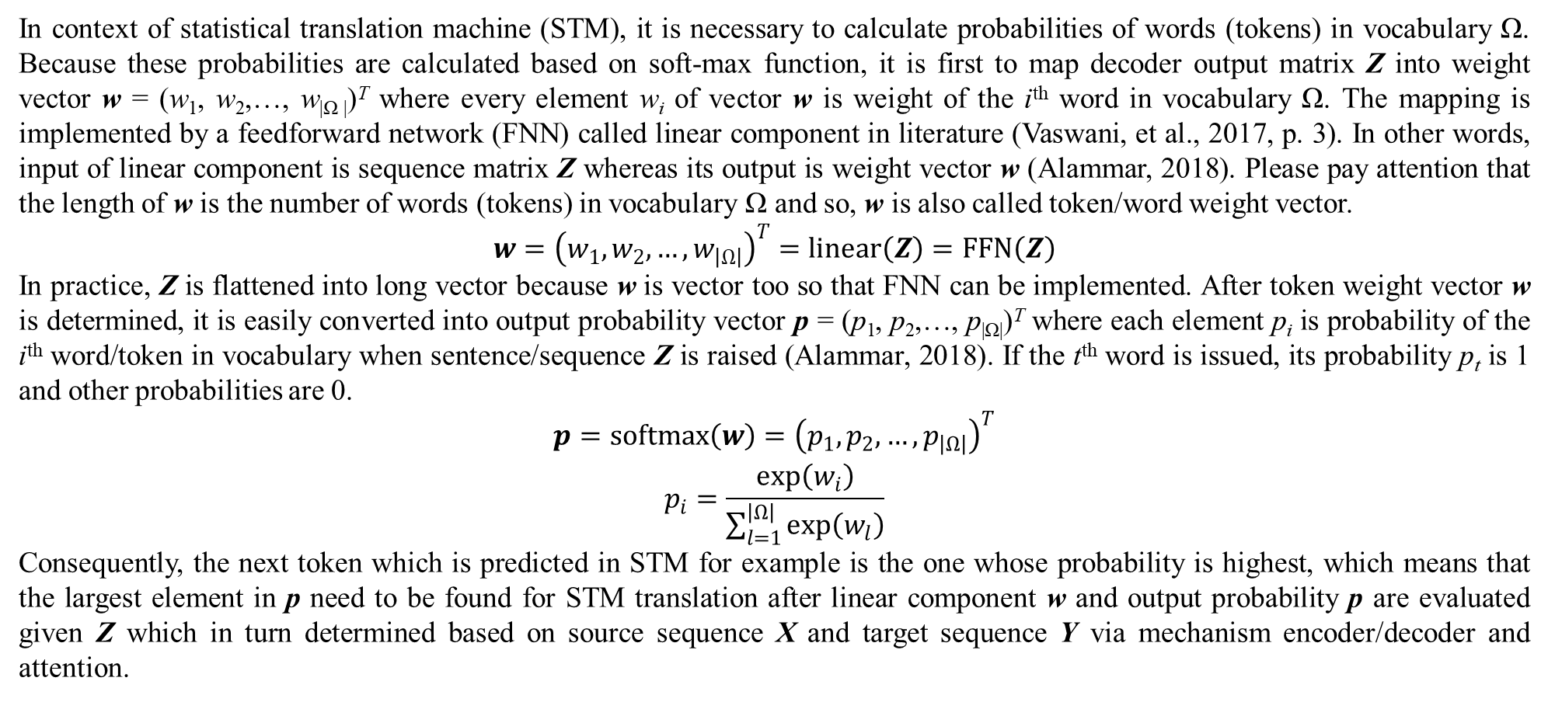
3. Transformer
In context of statistical translation machine (STM), it is necessary to calculate probabilities of words (tokens) in vocabulary Ω. Because these probabilities are calculated based on soft-max function, it is first to map decoder output matrix Z into weight vector w = (w₁, w₂,…, w_{|Ω |})^{T} where every element w_{i} of vector w is weight of the i^{th} word in vocabulary Ω. The mapping is implemented by a feedforward network (FNN) called linear component in literature (Vaswani, et al., 2017, p. 3). In other words, input of linear component is sequence matrix Z whereas its output is weight vector w (Alammar, 2018). Please pay attention that the length of w is the number of words (tokens) in vocabulary Ω and so, w is also called token/word weight vector.
$$w={\left(w_{1},w_{2},…,w_{\left|Ω\right|}\right)}^{T}=linear\left(Z\right)=FFN\left(Z\right)$$
In practice, Z is flattened into long vector because w is vector too so that FNN can be implemented. After token weight vector w is determined, it is easily converted into output probability vector p = (p₁, p₂,…, p_{|Ω|})^{T} where each element p_{i} is probability of the i^{th} word/token in vocabulary when sentence/sequence Z is raised (Alammar, 2018). If the t^{th} word is issued, its probability p_{t} is 1 and other probabilities are 0.
$$\begin{matrix}p=softmax\left(w\right)={\left(p_{1},p_{2},…,p_{\left|Ω\right|}\right)}^{T} \\ p_{i}=\frac{exp\left(w_{i}\right)}{\sum_{l=1}^{\left|Ω\right|}{exp\left(w_{l}\right)}}\end{matrix}$$
Consequently, the next token which is predicted in STM for example is the one whose probability is highest, which means that the largest element in p need to be found for STM translation after linear component w and output probability p are evaluated given Z which in turn determined based on source sequence X and target sequence Y via mechanism encoder/decoder and attention.

Slide 47
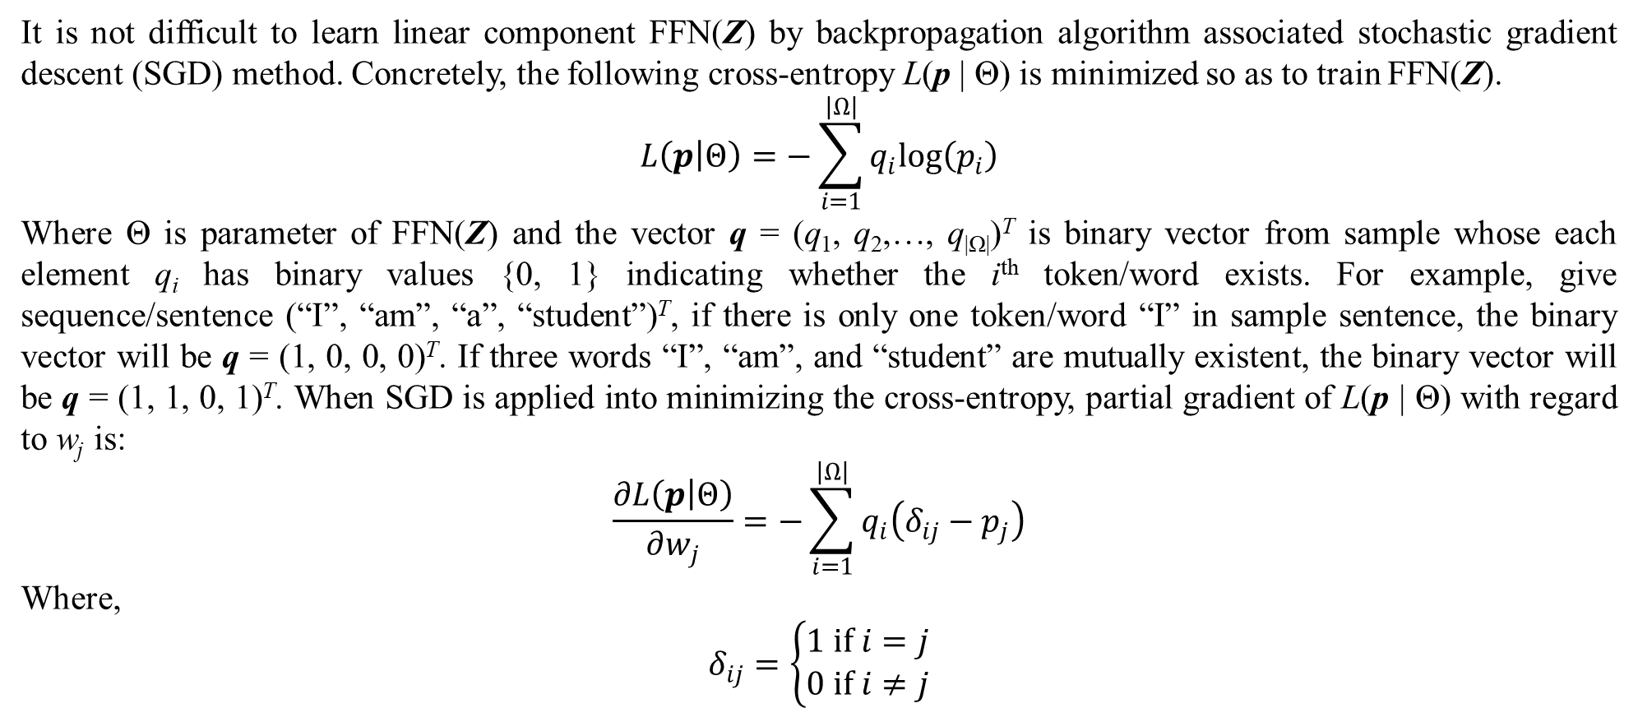
3. Transformer
It is not difficult to learn linear component FFN(Z) by backpropagation algorithm associated stochastic gradient descent (SGD) method. Concretely, the following cross-entropy L(p | Θ) is minimized so as to train FFN(Z).
$$L\left(p | Θ\right)=−\sum_{i=1}^{\left|Ω\right|}{q_{i}log\left(p_{i}\right)}$$
Where Θ is parameter of FFN(Z) and the vector q = (q₁, q₂,…, q_{|Ω|})^{T} is binary vector from sample whose each element q_{i} has binary values {0, 1} indicating whether the i^{th} token/word exists. For example, give sequence/sentence (“I”, “am”, “a”, “student”)^{T}, if there is only one token/word “I” in sample sentence, the binary vector will be q = (1, 0, 0, 0)^{T}. If three words “I”, “am”, and “student” are mutually existent, the binary vector will be q = (1, 1, 0, 1)^{T}. When SGD is applied into minimizing the cross-entropy, partial gradient of L(p | Θ) with regard to w_{j} is:
$$\frac{∂L\left(p | Θ\right)}{∂w_{j}}=−\sum_{i=1}^{\left|Ω\right|}{q_{i}\left(δ_{ij}−p_{j}\right)}$$
Where,
$$δ_{ij}=\left\{\begin{matrix}1 if i=j \\ 0 if i≠j\end{matrix}\right.$$

Slide 48

3. Transformer
Proof,
$$\frac{∂L\left(p | Θ\right)}{∂w_{j}}=−\sum_{i=1}^{\left|Ω\right|}{q_{i}\frac{∂log\left(p_{i}\right)}{∂w_{j}}}=−\sum_{i=1}^{\left|Ω\right|}{q_{i}\frac{dlog\left(p_{i}\right)}{dp_{i}}\frac{∂p_{i}}{∂w_{j}}}=−\sum_{i=1}^{\left|Ω\right|}{q_{i}\frac{1}{p_{i}}\frac{∂p_{i}}{∂w_{j}}}$$
Due to:
$$\frac{∂p_{i}}{∂w_{j}}=\frac{∂}{∂w_{j}}\left(\frac{exp\left(w_{i}\right)}{\sum_{l=1}^{\left|Ω\right|}{exp\left(w_{l}\right)}}\right)=p_{i}\left(δ_{ij}−p_{j}\right)$$
We obtain:
$$\frac{∂L\left(p | Θ\right)}{∂w_{j}}=−\sum_{i=1}^{\left|Ω\right|}{q_{i}\left(δ_{ij}−p_{j}\right)}∎$$
So that gradient of L(p | Θ) with regard to w is:
$$\frac{dL\left(p | Θ\right)}{dw}={\left(\frac{∂L\left(p | Θ\right)}{∂w_{1}},\frac{∂L\left(p | Θ\right)}{∂w_{2}},…,\frac{∂L\left(p | Θ\right)}{∂w_{\left|Ω\right|}}\right)}^{T}$$
Therefore, parameter Θ is updated according to SGD associated with backpropagation algorithm:
$$Θ=Θ−γ\frac{dL\left(p | Θ\right)}{dw}$$
Where γ (0 < γ ≤ 1) is learning rate.

Slide 49
3. Transformer
For STM example, given French source sentence “Je suis étudiant” (Alammar, 2018) is translated into English target sentence “I am a student” (Alammar, 2018) by transformer which is trained with corpus before (transformer was determined), which goes through following rounds:
Round 1:
French source sentence “Je suis étudiant” coded by sentence/sequence matrix X = (x₁ = c(“<bos>”), x₂ = c(“je”), x₃ = c(“suis”), x₄ = c(“étudiant”), x₅ = c(“<eos>”))^{T} where c(.) is embedding numeric vector of given word with note that words “<bos>” and “<eos>” are special predefined words indicating the beginning of sentence and the end of sentence, respectively. As a convention, c(.) is called word/token vector whose dimension can be d_{m}=512. If predefined sentence length is longer, redundant word vectors are set to be zeros, for example, let x₆ = 0, x₇ = 0,…, x₁₀₀ = 0 given the maximum number words in sentence is 100. These zero vectors do not affect decoder evaluation and training parameters.
Source sequence X is fed to encoder so as to produce encoder attention EncoderAttention(X).
Round 2:
English target sentence is coded by sequence/matrix Y = (y₁ = c(“<bos>”))^{T}. If predefined sentence length is longer, redundant word vectors are set to be zeros.
Target sequence Y = (y₁ = c(“<bos>”))^{T} and encoder attention EncoderAttention(X) are fed to decoder so as to produce decode output Z.
Output Z goes through linear component w = linear(Z) and soft-max function component p = softmax(w) so as to find out the maximum probability p_{i} so that the i^{th} associated word in vocabulary is “i”. As a result, the embedding numeric vector of the word “i” is added to target sequence so that we obtain Y = (y₁ = c(“<bos>”), y₂ = c(“i”))^{T}.

Slide 50
3. Transformer
Round 3:
Both target sequence Y = (y₁ = c(“<bos>”), y₂ = c(“i”))^{T} and encoder attention EncoderAttention(X) are fed to decoder so as to produce decode output Z.
Output Z goes through linear component w = linear(Z) and soft-max function component p = softmax(w) so as to find out the maximum probability p_{i} so that the i^{th} associated word in vocabulary is “am”. As a result, the embedding numeric vector of the word “am” is added to target sequence so that we obtain Y = (y₁ = c(“<bos>”), y₂ = c(“i”) , y₃ = c(“am”))^{T}.
Similarly, rounds 4, 5, and 6 are processed by the same way so as to obtain final target sequence Y = (y₁ = c(“<bos>”), y₂ = c(“i”), y₃ = c(“am”) , y₄ = c(“a”), y₅ = c(“student”) , y₆ = c(“<eos>”))^{T} which is the English sentence “I am a student” translated from the French sentence “Je suis étudiant”. Note, the translation process is stopped when the end-of-sentence word “<eos>” is met.

Slide 51

3. Transformer
Main ideas of transformer were described but there are two improvements such as positional encoding and normalization. Firstly, positional encoding is that sequences X and Y were added by their corresponding position vectors:
$$X=X+{\left(pos\left(x_{1}\right),pos\left(x_{2}\right),…,pos\left(x_{m}\right)\right)}^{T}$$
$$Y=Y+{\left(pos\left(y_{1}\right),pos\left(y_{2}\right),…,pos\left(y_{n}\right)\right)}^{T}$$
Without loss of generality, let POS(X) = (pos(x₁), pos(x₂),…, pos(x_{m}))^{T} be position vector whose each element is position pos(x_{i}) of token x_{i}. It is necessary to survey pos(x_{i}).
$$pos\left(x_{i}\right)=pos\left({\left(x_{i1},x_{i2},…,x_{ij},…,x_{id_{m}}\right)}^{T}\right)={\left(pos\left(x_{i1}\right),pos\left(x_{i2}\right),…,pos\left(x_{ij}\right),…,pos\left(x_{id_{m}}\right)\right)}^{T}$$
This implies how to calculate position vector POS(X) is how to calculate position pos(x_{ij}) where i is position of the i^{th} token and j is position of the j^{th} numeric value of such token vector. We have:
$$pos\left(x_{ij}\right)=pos\left(i,j\right)$$
Suppose two successive numeric values such as j^{th} numeric value and (j+1)^{th} numeric value such that j = 2k and j+1 = 2k+1, we need to calculate two kinds of positions as follows:
$$\begin{matrix}pos\left(i,2k\right) \\ pos\left(i,2k+1\right)\end{matrix}$$

Slide 52

3. Transformer
Fortunately, these positions are easily calculated by sine function and cosine function as follows (Vaswani, et al., 2017, p. 6):
$$\begin{matrix}pos\left(i,2k\right)=\sin\left(\frac{i}{{10000}^{{2k}/{d_{m}}}}\right) \\ pos\left(i,2k+1\right)=\cos\left(\frac{i}{{10000}^{{2k}/{d_{m}}}}\right)\end{matrix}$$
Recall that d_{m} is model dimension which is the length of token vector x_{i}. It is often set to be 512 in NLP. As a result, we have:
$$X=X+POS\left(X\right) \\ POS\left(X\right)={\left(pos\left(x_{1}\right),pos\left(x_{2}\right),…,pos\left(x_{m}\right)\right)}^{T} \\ pos\left(x_{i}\right)={\left(pos\left(i,1\right),pos\left(i,2\right),…,pos\left(i,d_{m}\right)\right)}^{T} \\ pos\left(i,j\right)=\left\{\begin{matrix}\sin\left(\frac{i}{{10000}^{{2k}/{d_{m}}}}\right)if j=2k \\ \cos\left(\frac{i}{{10000}^{{2k}/{d_{m}}}}\right)if j=2k+1\end{matrix}\right.$$
Please pay attention that target sequence Y is added by position vector POS(Y) by the same way too. There may be a question that why sequences X and Y are added by their position vectors before they are fed into encoder/decoder when tokens in a sequence have their own orders because a sequence is an ordered list of tokens indeed. The answer depends on computational effectiveness as well as flexibility. For example, when sequences are added by their position vectors, transformer can be trained by incomplete French source sequence “<bos> Je suis” and incomplete English target sequence “a student <eos>” because there is no requirement of token ordering. Moreover, sequences can be split into many parts and these parts are trained parallel. This improvement is necessary in case of training huge corpus.

Slide 53

3. Transformer
The second improvement is layer (network) normalization:
LayerNorm(X + Sublayer(X))
LayerNorm(Y + Sublayer(Y))
Because residual mechanism is implemented by the sum X + Sublayer(X) or Y + Sublayer(Y), it is necessary to survey the following normalization without loss of generality:
LayerNorm(x)
Where x = (x₁, x₂,…, x_{n})^{T} is layer of n neuron x_{i} with note that each neuron x_{i} is represented by a number. Suppose x as a sample conforms normal distribution, its sample mean and variance are calculated as follows:
$$\overline{x}=\frac{1}{n}\sum_{i=1}^{n}{x_{i}},s^{2}=\frac{1}{n−1}\sum_{i=1}^{n}{{\left(x_{i}−\overline{x}\right)}^{2}}$$
As a result, layer normalization is distribution normalization:
$$\begin{matrix}LayerNorm\left(x\right)={\left(norm\left(x_{1}\right),norm\left(x_{2}\right),…,norm\left(x_{n}\right)\right)}^{T} \\ norm\left(x_{i}\right)=\frac{x_{i}−\overline{x}}{\sqrt{s^{2}}}\end{matrix}$$
In literature, layer normalization aims to improve convergence speed in training.

Slide 54
3. Transformer
It is not difficult to train transformer from corpus which can be a huge set of pairs of source/target sequences. Backpropagation algorithm associated with stochastic gradient descent (SGD) is a simple and effective choice. Feedforward sublayer represented by feedforward network (FFN) is easily trained by backpropagation algorithm associated SGD, besides attention sublayers can be trained by backpropagation algorithm associated SGD too. For instance, attention parameters for encoder such as weight matrices W_{i}^{Q}, W_{i}^{K}, W_{i}^{V}, and W^{O} can be learned by backpropagation algorithm associated with SGD. Attention parameters for decoder such as weight matrices W_{i}^{Q}, W_{i}^{K}, W_{i}^{V}, W^{O}, T, U_{i}^{Q}, U_{i}^{K}, U_{i}^{V}, and U^{O} can be learned by backpropagation algorithm associated SGD too. Note, starting point for backpropagation algorithm to train transformer is to make comparison of target sequence (for example, the English target sentence “I am a student” given the French source sentence “Je suis étudiant”) and evaluated sequence (for example, the English evaluated sentence “We are scholars” given the same French source sentence “Je suis étudiant”) at decoder, which goes backward encoder. Moreover, please pay attention that zero vectors representing redundant tokens do not affect updating these weight matrices when training transformer.

Slide 55
4. Pre-trained model
AI models cope with two problems of model learning: 1) it is impossible to preprocess or annotate (label) huge data so as to make the huge data better for training, and 2) huge data is often come with data stream rather than data scratch. Note, the first problem is most important. Transfer learning (Han, et al., 2021, pp. 226-227) can solve the two problems by separating the training process by two stages: 1) pre-training stage aims to draw valuable knowledge from data stream / data scratch, and 2) fine-tuning stage later will take advantages of knowledge from pre-training stage so as to apply the knowledge into solving task-specific problem just by fewer samples or smaller data. As its name hints, transfer learning draws knowledge from pre-training stage and then transfers such knowledge to fine-tuning stage for doing some specific task. Capturing knowledge in pre-training stage is known as source task and doing some specific task is known as target task (Han, et al., 2021, p. 227). Source task and target task may be essentially similar like GPT model and BERT model for token generation mentioned later but these tasks can be different or slightly different. The fine-tuning stage is dependent on concrete application and so, pre-training stage is focused in this section. The purpose of pre-training stage is to build a large-scale pre-trained model called PTM which must have ability to process huge data or large-scale data.

Slide 56
4. Pre-trained model
If large-scale data is come from data stream called downstream data, PTM will need to reach the strong point that is parallel computation. If large-scale is too huge, PTM will need to reach the strong point that is efficient computation. When efficient computation can be reached by good implementation, parallel computation requires an improvement of methodology. In order to catch knowledge inside data without human interference with restriction that such knowledge represented by label, annotation, context, meaning, etc. is better than cluster and group, self-supervised learning is often accepted as a good methodology for PTM (Han, et al., 2021, pp. 227-229). Essentially, self-supervised learning tries to draw pseudo-supervised information from unannotated/unlabeled data so that such pseudo-supervised information plays the role of supervised information like annotation and label that fine-tuning stage applies into supervised learning tasks for solving specific problem with limited data. The pseudo-supervised information is often relationships and contexts inside data structure. Anyhow, self-supervised learning is often associated with transfer learning because, simply, annotating entirely huge data is impossible. Self-supervised learning associated with pre-training stage is called self-supervised pre-training. Although self-supervised pre-training is preeminent, pre-training stage can apply other learning approaches such as supervised learning and unsupervised learning.

Slide 57
4. Pre-trained model
That the essentially strong point of transformer is self-attention makes transformer appropriate to be a good PTM when self-attention follows essentially ideology of self-supervised learning because self-attention mechanism tries to catch contextual meaning of every token inside its sequence. Moreover, transformer supports parallel computation based on its other aspect that transformer does not concern token ordering in sequence. Anyhow, transformer is suitable to PTM for transfer learning and so this section tries to explain large-scaled pre-trained model (PTM) via transformer as an example of PTM. Note, fine-tuning stage of transfer learning will take advantages of PTM for solving task-specific problem; in other words, fine-tuning stage will fine-tune or retrain PTM with downstream data, smaller data, or a smaller group of indications. When fine-tuning stage is not focused in description, PTM is known as transfer learning model which includes two stages such as pre-training stage and fine-tuning stage. In this case, source task and target task of transfer learning have the same model architecture (model backbone) which is the same PTM architecture. Large-scale PTM implies its huge number of parameters as well as huge data from which it is trained.

Slide 58

4. Pre-trained model
Generative Pre-trained Transformer (GPT), developed in 2018 with GPT-1 by OpenAI whose product is ChatGPT launched in 2022, is a PTM that applies only decoder of transformer into sequence generation. In pre-training stage, GPT trains its decoder from huge data over internet and available sources so as to predict next word y_{t+1} from previous words y₁, y₂,…, y_{t} by maximizing likelihood P(y_{t+1} | Θ, y₁, y₂,…, y_{t}) and taking advantages of self-attention mechanism aforementioned (Han, et al., 2021, p. 231). Maximization of likelihood P(y_{t+1} | Θ, y₁, y₂,…, y_{t}) belongs to autoregressive language model.
$$\begin{matrix}\hat{Θ}=\underset{Θ}{argmax}{log\left(P\left(y_{t+1} | Θ,y_{1},y_{2},…,y_{t}\right)\right)} \\ {\hat{y}}_{t+1}=\underset{y_{n+1}}{argmax}{P\left(y_{t+1} | \hat{Θ},y_{1},y_{2},…,y_{t}\right)}\end{matrix}$$
Where,
$$\begin{matrix}P\left(y_{t+1} | Θ,y_{1},y_{2},…,y_{t}\right)≝p \\ p=softmax\left(w\right)={\left(p_{1},p_{2},…,p_{\left|Ω\right|}\right)}^{T} \\ p_{i}=\frac{exp\left(w_{i}\right)}{\sum_{l=1}^{\left|Ω\right|}{exp\left(w_{l}\right)}} \\ w={\left(w_{1},w_{2},…,w_{\left|Ω\right|}\right)}^{T}=linear\left(Z\right)=FFN\left(Z\right)\end{matrix}$$
And,
$$MultiheadAttention\left(X,Y\right)=LayerNorm\left(MaskedMultiheadAttention\left(Y\right)+MultiheadAttention\left(X,Y\right)\right)$$
$$Z=DecoderAttention\left(X,Y\right)=LayerNorm\left(MultiheadAttention\left(X,Y\right)+FFN\left(MultiheadAttention\left(X,Y\right)\right)\right)$$
Because GPT has only one decoder, sequence X is null in GPT.
$$MultiheadAttention\left(X,Y\right)=MultiheadAttention\left(Y\right) \\ DecoderAttention\left(X,Y\right)=DecoderAttention\left(Y\right)$$

Slide 59


4. Pre-trained model
Likelihood P(y_{t+1} | Θ, y₁, y₂,…, y_{t}) is simplified for easy explanation. Exactly, given sequence Y = (y₁, y₂,…, y_{n+1})^{T}, GPT aims to maximize log-likelihood L(Θ | Y) as follows (Han, et al., 2021, p. 231):
$$\begin{matrix}L\left(Θ | Y\right)=\sum_{i=1}^{n}{log\left(P\left(y_{i+1} | Θ,y_{1},y_{2},…,y_{i}\right)\right)} \\ \hat{Θ}=\underset{Θ}{argmax}{L\left(Θ | Y\right)}\end{matrix}$$
Later on, GPT improves its pre-trained decoder in fine-tuning stage by re-training the decoder with annotated data, high-quality data, and domain-specific data so as to improve pre-trained parameters. Moreover, GPT adds extra presentation layers in fine-tuning stage (Han, et al., 2021, p. 231). Following figure (Han, et al., 2021, p. 232) depicts prediction process of GPT.
Figure 4.1. Prediction process of GPT

Slide 60

4. Pre-trained model
Bidirectional Encoder Representations from Transformers (BERT), developed in 2018 by Google, is a PTM that applies only encoder of transformer into sequence generation. In pre-training stage, BERT trains its encoder from huge data over internet and available sources. Given (t+1)-length sequence (x₁, x₂,…, x_{t+1})^{T}, BERT applies masked language model to randomize an unknown token at random position denoted masked where the random index masked is randomized in t+1 indices {1, 2,…, t+1} with note that the randomization process can be repeated many times. Such unknown token, which is called masked token denoted y_{masked}, will be predicted given t-length sequence (x₁, x₂,…, x_{t})^{T} without loss of generality. In order words, masked words x_{masked} is predicted from other words x₁, x₂,…, x_{t} by maximizing likelihood P(x_{masked} | Θ, x₁, x₂,…, x_{t}) and taking advantages of self-attention mechanism aforementioned (Han, et al., 2021, p. 232).
$$\begin{matrix}\hat{Θ}=\underset{Θ}{argmax}{log\left(P\left(x_{masked} | Θ,x_{1},x_{2},…,x_{t}\right)\right)} \\ {\hat{y}}_{masked}=\underset{y_{masked}}{argmax}{P\left(x_{masked} | \hat{Θ},x_{1},x_{2},…,x_{t}\right)}\end{matrix}$$
Where,
$$\begin{matrix}P\left(x_{masked} | Θ,x_{1},x_{2},…,x_{t}\right)≝p=softmax\left(w\right)={\left(p_{1},p_{2},…,p_{\left|Ω\right|}\right)}^{T} \\ p_{i}=\frac{exp\left(w_{i}\right)}{\sum_{l=1}^{\left|Ω\right|}{exp\left(w_{l}\right)}} \\ w={\left(w_{1},w_{2},…,w_{\left|Ω\right|}\right)}^{T}=linear\left(Z\right)=FFN\left(Z\right)\end{matrix}$$
And,
$$MultiheadAttention\left(X\right)=LayerNorm\left(X+MultiheadAttention\left(X\right)\right) \\ Z=EncoderAttention\left(X\right)=LayerNorm\left(MultiheadAttention\left(X\right)+FFN\left(MultiheadAttention\left(X\right)\right)\right)$$

Slide 61

4. Pre-trained model
Likelihood P(y_{masked} | Θ, x₁, x₂,…, x_{m}) is simplified for easy explanation, thereby it is necessary to explain more how BERT defines and maximizes likelihood with support of masked language model. Given sequence X = (x₁, x₂,…, x_{m})^{T}, let R = {r₁, r₂,…, r_{k}} be the set of indices whose respective tokens are initially masked, for instance, token $x_{r_{j}}$ will be initially masked if r_{j} belongs to mask set R. Let $X_{r_{j}}$ be the set of r_{j}–1 tokens which are unmasked later, for instance, the tokens $x_{r_{1}}$, $x_{r_{2}}$,…, $x_{r_{j}−1}$ which were initially masked before are now unmasked (known) at current iteration. Note, the set R is called mask set or mask pattern and $X_{r_{j}}$ does not include token $x_{r_{j}}$. BERT randomizes k masked indices so as to establish mask set R. Let S be the set of indices whose tokens are always known, which is the complement of mask set R with regard to all indices so that union of R and S is {1, 2,…, m}. Thereby, let S be the set of tokens whose indices are in S. In other words, S contains tokens which are always known. BERT aims to maximize log-likelihood L(Θ | X) as follows (Han, et al., 2021, p. 232):
$$\begin{matrix}L\left(Θ | X\right)=\sum_{r_{j}∈R}{log\left(P\left(x_{r_{j}} | Θ,X_{r_{j}},S\right)\right)} \\ \hat{Θ}=\underset{Θ}{argmax}{L\left(Θ | X\right)}\end{matrix}$$

Slide 62

4. Pre-trained model
Later on, BERT improves its pre-trained encoder in fine-tuning stage by re-training the encoder with annotated data, high-quality data, and domain-specific data so as to improve pre-trained parameters. By support of masked language model (autoencoding language model) for masking tokens, BERT can predict a token at any position in two directions given a list of other tokens while GPT only predicts a token at next position given previous tokens. The name “BERT”, which is abbreviation of “Bidirectional Encoder Representations from Transformers”, hints that BERT can generate tokens/words in bidirectional way at any positions. Therefore, GPT is appropriate to language generation and BERT is appropriate to language understanding (Han, et al., 2021, p. 231). BERT also adds extra presentation layers in fine-tuning stage (Han, et al., 2021, p. 232). Following figure depicts prediction process of BERT.
Figure 4.2. Prediction process of BERT

Slide 63
4. Pre-trained model
Recall that given a transfer model, capturing knowledge in pre-training stage is known as source task and doing some specific task is known as target task (Han, et al., 2021, p. 227), thereby there is a question that how source task transfers knowledge to target task or how PTM makes connection between source task and knowledge task. The answer is that there are two transferring approaches such as feature transferring and parameter transferring (Han, et al., 2021, p. 227). Feature transferring converts coarse data like unlabeled data into fine data like labeled data so that fine data considered as feature is fed to fine-tuning stage. Parameter transferring transfers parameters learned at pre-training stage to fine-tuning stage. If pre-training stage and fine-tuning stage share the same model architecture which is the same PTM architecture, parameter transferring will always occur in PTM. Both GPT and BERT apply parameter transferring because they will initialize or set up their models such as GPT decoder and BERT encoder by billions of parameters that were learned in pre-training stage with the same model architecture (model backbone) such as GPT decoder and BERT encoder before they perform fining-tuning task in fine-tuning stage. Self-supervised learning which trains unlabeled data is appropriate to pre-training stage because unlabeled data is much more popular than labeled data, thereby parameter transferring is often associated with self-supervised learning. Because transformer is suitable to self-supervised learning due to its self-attention mechanism, parameter transferring is suitable to PTMs like GPT and BERT. Moreover, if they apply transformer into annotating or creating task-specific data / fine data for improving their decoder and encoder in fine-tuning stage, they will apply feature transferring too. In general, within parameter transferring and same architecture, PTM itself is backbone for both pre-training stage and fine-tuning stage.

Slide 64
4. Pre-trained model
Suppose pre-training stage and fine-tuning stage share the same PTM architecture like GPT and BERT, we focus on parameter transferring in fine-tuning stage now. There are two approaches for parameter transferring: 1) improving parameters which are network weights by specific tasks is called task-specific improvement and 2) improving parameters by learning feedbacks from environment is called feedback improvement. According to Gemini 2025, some popular techniques of task-specific improvement are text classification, name entity recognition (NER), question answering, machine translation, and text summarization. These techniques, which often belong to supervised learning, often add extra layers to transformer with attention that the extra layers are added to encoder, decoder, or both of them, which depends on PTM architecture like GPT or BERT. Task-specific improvement with the supervised learning techniques is called supervised learning fine-tuning and now it is necessary to browse these techniques.

Slide 65
4. Pre-trained model
In text classification technique, an extra layer which is feedforward network (FFN) whose activation function is soft-max function is added to output of transformer. Given a text sequence which is classified into a class is fed to transformer as an input, and then the output of such text sequence via transformer goes through the classification layer so that the FFN predicts class of such text sequence. Of course, the class prediction or classification task is implemented by probability distribution represented by soft-max function, hereby which class has highest probability is predictive class. Following stochastic gradient descent (SGD) algorithm, cross-entropy within context of soft-max function (entropy loss) is minimized by comparing the predictive class and actual class so as to improve parametric weights propagative in backward direction. Training data with text classification is classified or labeled data. Note, the text sequence which is classified is begun with token “<cls>” as usual with note that the term “cls” implies abbreviation of “classification”. In general, the input of text classification technique is text sequence and the output of this technique is predictive class, whose method is entropy loss minimization associated with SGD with support of soft-max function instead of sigmoid function as usual.

Slide 66
4. Pre-trained model
Name entity recognition (NER) is similar to text classification except that the output of NER is label in text form. According to Gemini about NER, sometimes another extra layer is added to the top of FFN so as to discover dependencies between adjacent labels for improving performance. Question answering technique tries to discover the answer of a given question, thus, the input of this technique includes a given question and a given contextual paragraph. Consequently, two extra FFN are added to the top (output layer) of transformer: 1) one is responsible for predicting the probability of a token which is the start of the answer in the given contextual paragraph and 2) one is responsible for predicting the probability of a token which is the end of the answer in the given contextual paragraph. Therefore, output of question answering technique is the start and the end of the answer in the given contextual paragraph. Activation functions of the two extra FFN should be soft-max functions because of probabilistic context, whose method is entropy loss minimization associated with SGD. Machine translation technique in fine-tuning stage is indeed normal task of traditional transformer having full of encoder and decoder as aforementioned, where the input which is text sequence in source language is fed into encoder and the output which is text sequence in target language is output of decoder indeed. When machine translation technique in fine-tuning stage is applied into GPT (BERT) having only decoder (encoder), an additional encoder (decoder) must be added so that multilingual corpus can be trained.

Slide 67
4. Pre-trained model
Text summarization technique tries to summarize a given text paragraph as a shorter text sequence, thus, the input and the output of this technique are a text paragraph and a text sequence, respectively. It is not necessary to add an extra FFN to the top (output layer) of transformer because the output layer of transformer will produce the summarized text sequence. However, for incomplete transformers like GPT or BERT which has only decoder or encoder, text summarization technique can implement complement encoder / decoder so that the input of text paragraph is fed to encoder and the output of summarized text sequence is output of decoder. In general, supervised learning fine-tuning requires training data to be more specific or more improved so that training data will not be coarse, for example, text classification technique and NER technique require annotated / labeled data. Moreover, backpropagation algorithm is often associated with SGD so as to improve parametric weights in backward direction with note that SGD is a popular optimization algorithm for maximizing likelihood function or minimizing loss function.

Slide 68
4. Pre-trained model
Because feedback improvement is to learn feedbacks from environment, reinforcement learning is a popular technique of feedback improvement in fine-tuning stage. In practice, reinforcement learning (RL) goes after supervised learning fine-tuning when fine-tuning stage is trained two times, for example, recent versions of GPT apply proximal policy optimization (PPO) algorithms into strengthening parameters after parametric weights are improved by supervised learning fine-tuning (classification) with annotated data. Now we should browse reinforcement learning in fine-tuning stage. Different from task-specific improvement which focuses on improving parameters directly, RL aims to improve criteria that cannot be specified by annotated data. In other words, RL aims to align with preferences related to language, human, and human values. General in literature, RL includes two main partners such as environment and agent, in which whenever environment issues a feedback called state, agent will response a respective action, and then a so-called reward function will qualify agent’s action by benefit or penalty so that later actions are better, which means that later actions will response more exactly to environment’ states. The cycle “state → action → reward → state” is continuously iterative process that aims to improve agent’s parameters where agent represents a model with full of parameters and action represents output of such model. In context of fine-tuning stage with RL, agent is the core of the concerned PTM which is its transformer called original transformer, of course whereas reward function is coded as an associated transformer called reward transformer or reward model. Moreover, environment in RL fine-tuning stage can be human, another AI model, and specific task, which issues three kinds of feedback such as human feedback, AI model feedback, and task-specific optimization, which in turn issues three respective RL methods in fine-tuning stages according to Gemini 2025, such as reinforcement learning from human feedback (RLHF), reinforcement learning from AI feedback (RLAIF), and reinforcement learning for task-specific optimization (RLTSO).

Slide 69
4. Pre-trained model
Because RLHF is the most basic one, it is necessary to study it. According to Gemini 2025, RLHF aims to align PTM’s generated text to user’s preferences such as helpfulness, harmlessness, and truthfulness. Especially, a numeric scalar value called reward score or reward signal which indicates how well the generated text is aligned to users’ preferences is produced by a separated reward model which is often an extra transformer called reward model that is trained on human preference data. As a result, RL fine-tuning process includes three steps as follows: 1) human preference data is collected in which each record of such data includes a response text (output) generated by original transformer (target PTM) associated with a rating or annotation given by user on the response text with note that the input of original transformer is a prompt from dialogue interaction, 2) given a pair of prompt as input and response as output of original transformer, a separated reward transformer is trained on human preference data so that given a so-called preference pair of prompt as input and response as output of original transformer, such preference pair is fed to reward transformer as input of reward transformer, and then output of reward transformer is the reward score which indicates that how much the prompt and the response inside the preference pair are matched together, and 3) some RL algorithm like proximal policy optimization (PPO) is applied into fine-tuning stage by improving parameters of original transformer by association of original transformer and reward transformer via iterative reward process.

Slide 70
4. Pre-trained model
Note, reward signal or reward score produced by reward transformer is also based on some purposive criteria while state and action now are represented by prompt and response, respectively whereas environment and agent are human and original transformer, respectively. Moreover, reward signal indicates that reward score acts as the signal that guides RL algorithm updates original transformer’s parameters to be better so that original transformer will produces responses that achieve higher reward score in future. The third step called RL fine-tuning step is the most important step of RL fine-tuning process includes four sub-steps as follows: 1) original transformer generates a response from a prompt, 2) reward transformer produces a reward score for a pair of such prompt and such response, 3) some RL algorithm like PPO maximizes expected reward from many reward scores in order to update original transformer’s parameters to be better and of course, the maximizing and updating process is followed by a iterative process of continuous adjusting a so-called policy so as to produce good reward score as high as possible with note that policy is the mapping from prompt (state) to response (action), and 4) reward signals or reward scores guide original transformer to generate better response text which is aligned much to human preferences with note that human preference or human feedback is represented by users’ rating and reward transformer is learned from human preference data.

Slide 71
4. Pre-trained model
RLAIF is similar to RLHF except that human feedback is replaced by feedback from an AI model, which means that a feedback AI model plays the role of evaluator for original transformer. Human preference data is replaced by preference data in RLAIF, in which each preference pair inside preference data is consisted of response from original transformer and feedback as rating issued from feedback AI model. Moreover, reward transformer is replaced by feedback AI model in RLAIF. In other words, RLAIF reward model is represented by a feedback AI model and thus, reward score or reward score is produced by feedback AI model with preference pair as input. RL fine-tuning step in RLAIF is kept intact but please pay attention that feedback AI model plays now two roles: 1) it is evaluator for original transformer as human so that it issues feedbacks as preferences and 2) it is reward model that produces reward score for preference pair. Note, feedback AI model issues preferences (feedbacks) but it is also trained on preference data and it produces reward scores based on preference pair too. RLTSO is similar to RLAIF except that feedback is replaced by outcome of a specific task, which means that feedback AI model is replaced by specific task. Preference pair inside preference data is now consisted of response from original transformer and outcome from specific task. RL fine-tuning step in RLTSO is kept intact but please pay attention that the specific task plays now two roles: 1) it is evaluator for original transformer as human so that it issues outcomes as preferences and 2) the environment where the specific task performs plays the role of reward model that produces reward score for preference pair. Some popular specific tasks were mentioned in the section about task-specific improvement in fine-tuning stage, which can be text classification, name entity recognition (NER), question answering, machine translation, and text summarization. Besides, there are some other specific tasks such as teaching tool, generating programming code / mathematical code, solving problem tool, and improving step-by-step reasoning tool, according to Gemini 2025. Reward score of RLTSO is often metric which is automatically evaluated on outcome of a specific task, which often indicates correctness, relevance, and accuracy of outcome.

Slide 72
4. Pre-trained model
Recall that the third step called RL fine-tuning step is the most important step of RL fine-tuning process and moreover, RL algorithm like PPO is the core of such third step and so, PPO developed by Schulman et al. at OpenAI in 2017 is described in detailed now according to guidance of Gemini (gemini.google.com). Exactly, the fourth sub-step of RL fine-tuning step is described in detailed. Recall that RL has two main approaches such as model-based approach and model-free approach where model-free approach has two main methods such as value-based method and policy-based method, according to Gemini 2025. Policy gradient method is the most popular policy-based method to which PPO belongs. Given original transformer known as target PTM is specified by policy π_{Φ}(a | s) which is probability of next token in generated text a given prompt s with note that s and a are input and output of original transformer, respectively when contexts of s and a are state of environment and action of agent in RL model. Indeed, policy π_{Θ}(a | s) is the probability of action a corresponding to given state s so that action a is optimized and so Θ is parametric weights of original transformer and π_{Θ}(a | s) itself, which is a feedforward network (FFN) associated with soft-max function, is added to the top of original transformer. As a convention Θ is called policy parameter or original parameter.

Slide 73

4. Pre-trained model
Reward function R_{Ψ}(s, a) is represented by reward transformer where the preference pair (s, a) is input of reward transformer and R_{Ψ}(s, a) itself which is a real number indicating reward score or immediate reward is output of reward transformer. Note, Ψ is parametric weights of reward transformer which is trained on preference data and so Ψ is called preference parameter or reward parameter. Because PPO is iterative process in which states and actions go through many iterations, they are indexed by time point t as s_{t} and a_{t}. Therefore, we specified policy (original transformer) and reward function (reward transformer) with regard to time point t as follows:
$$\begin{matrix}π_{Θ}\left(a_{t} | s_{t}\right) \\ R_{Ψ}\left(s_{t},a_{t}\right)\end{matrix}$$
The reward score or immediate reward over all actions is expected value of all R_{Ψ}(s_{t}, a_{t}) over all actions:
$$R_{Ψ}\left(s_{t}\right)=E_{a}\left(R_{Ψ}\left(s_{t},a\right)\right)=\frac{1}{\left|A\right|}\sum_{a∈A}{R_{Ψ}\left(s_{t},a\right)}$$
The expected value now known as immediate reward as usual is calculated in more practical way as follows:
$$R_{Ψ}\left(s_{t}\right)=E_{a_{k}}\left(R_{Ψ}\left(s_{t},a_{k}\right)\right)=\frac{1}{K}\sum_{k=1}^{K}{R_{Ψ}\left(s_{t},a_{k}\right)}$$

Slide 74

4. Pre-trained model
Where K is the number of all possible actions at current state s_{t}. In context of transformer where training data is split into many epoch, suppose each epoch has T batches corresponding to T time points so that such there are T states s_{t} (s) in the epoch and suppose the t^{th} batch has K paired records of state s_{k} and action a_{k}, then following equation is the most practical method to calculate the immediate reward R_{Ψ}(s_{t}) among T immediate rewards in the epoch:
$$R_{Ψ}\left(s_{t}\right)=\frac{1}{K}\sum_{k=1}^{K}{R_{Ψ}\left(s_{k},a_{k}\right)}$$
When reward transformer is trained separately, it is possible to denote r_{t+1} as immediate reward from state s_{t} to next state s_{t+1}:
$$r_{t+1}=R_{Ψ}\left(s_{t}\right)$$

Slide 75

4. Pre-trained model
Let V_{Φ}(s_{t}) be the value function which is expectation (average value) of all future reward scores from current state s_{t} to infinity over all actions. Value function V_{Φ}(s_{t}) is defined based on reward function but its parameter Φ is different from reward weights Ψ and moreover V_{Φ}(s_{t}) has no mathematical formulation and so, V_{Φ}(s_{t}) can be modeled as a FFN so that it is evaluated as output of such FFN and its input is current state s_{t}. Therefore, it is essential to describe how to train V_{Φ}(s_{t}), which is how to estimate parametric weights Φ. Indeed, Φ is learned by minimizing mean square error between value V_{Φ}(s_{t}) and its target value where target value is the true value which is combination of immediate reward r_{t+1} at current state and the estimated value of next state. Target value R_{t}⁽¹⁾ at state s_{t} over one next state is specified as follows:
$$R_{t}^{\left(1\right)}=r_{t+1}+αV_{Φ_{old}}\left(s_{t+1}\right)$$
Where α is discount factor in interval (0, 1] implies how much the next reward contributes is valued (important) when compared to immediate reward R_{Ψ}(s_{t}). Please pay attention that Φ_{old}, which is known, is the old version of parameter Φ and so target value is always determined.

Slide 76

4. Pre-trained model
Target value R_{t}^{(n)} at state s_{t} over n next states, which is called the n-step return, is specified as follows:
$$R_{t}^{\left(n\right)}=r_{t+1}+αr_{t+2}+…+α^{n−1}r_{t+n}+α^{n}V_{Φ_{old}}\left(s_{t+n}\right)$$
Mean square error between the n-step return and value function V_{Φ}(s_{t}), which is function of Φ, is specified as follows:
$$MSE\left(Φ\right)=E_{t}\left({\left(R_{t}^{\left(n\right)}−V_{Φ}\left(s_{t}\right)\right)}^{2}\right)=\sum_{t}{{\left(R_{t}^{\left(n\right)}−V_{Φ}\left(s_{t}\right)\right)}^{2}}$$
So that the estimate Φ* is minimizer of MSE(Φ).
$$Φ^{∗}=\underset{Φ}{argmin}{MSE\left(Φ\right)}$$
This mean square error MSE(Φ) is a popular representation of value function loss. By applying stochastic gradient descent (SGD) algorithm, it is easy to estimate Φ over some steps as follows:
$$Φ=Φ−γ∇MSE\left(Φ\right)=Φ−γ\left(R_{t}^{\left(n\right)}−V_{Φ}\left(s_{t}\right)\right)$$
Where γ is learning rate in interval (0, 1] and ∇MSE(Φ) is gradient of MSE(Φ) with regard to Φ. Please pay attention that when immediate reward R_{Ψ}(s_{t}) is expected reward at current state, value function V_{Φ}(s_{t}) is future reward / expected reward at current state and so, V_{Φ}(s_{t}) is also called future reward model / expected reward model and Φ is called future reward parameter / expected reward parameter.

Slide 77

4. Pre-trained model
After value function V_{Φ}(s_{t}) is determined, let δ_{t} be temporal difference (TD) error between value function V_{Φ}(s_{t}) at current time point and value function V_{Φ}(s_{t+1}) at next time point:
$$δ_{t}=r_{t+1}+αV_{Φ}\left(s_{t+1}\right)−V_{Φ}\left(s_{t}\right)$$
Advantage function A_{t} qualifies how much better each action which is taken at current state s_{t} will produce good future reward aligned with the expected reward V_{Φ}(s_{t}). Note, A_{t} can be considered as expected reward like V_{Φ}(s_{t}). Parameter of advantage function A_{t} is Φ, which means that A_{t} is defined based on future reward model V_{Φ}(s_{t}). Equation of A_{t} is defined based on TD error as follows:
$$A_{t}=δ_{t}+αλδ_{t+1}+{\left(αλ\right)}^{2}δ_{t+2}+…+{\left(αλ\right)}^{k−1}δ_{t+k−1}+…$$
Where α is discount factor and λ is the parameter that controls bias-variance trade-off of the advantage estimate. The length of the equation of A_{t} is arbitrary so that, the longer the length is, the more accurate the advantage function is. Please pay attention that advantage function A_{t} is the cornerstone of PPO because it will be used later to train original transformer (policy). In practice, A_{t} is approximated by its estimate over n times points as follows:
$$A_{t}≅δ_{t}+αλδ_{t+1}+{\left(αλ\right)}^{2}δ_{t+2}+…+{\left(αλ\right)}^{n−1}δ_{t+n−1}$$

Slide 78

4. Pre-trained model
Let r_{Θ}(s_{t}, a_{t}) be the ratio of the probability of taking action under current policy π_{Θ}(a_{t} | s_{t}) to the probability of taking action under old policy $π_{Θ_{old}}\left(a_{t} | s_{t}\right)$. Of course, r_{Θ}(s_{t}, a_{t}) indicates how much the policy is changed from old one to current one, which is called probability ratio specified as follows:
$$r_{Θ}\left(s_{t},a_{t}\right)=\frac{π_{Θ}\left(a_{t} | s_{t}\right)}{π_{Θ_{old}}\left(a_{t} | s_{t}\right)}$$
Where Φ_{old}, which is known, is the old version of parameter Φ of original transformer with note that original transformer itself is policy π_{Θ}(a_{t} | s_{t}). In practice, probability ratio r_{Θ}(s_{t}, a_{t}) is taken as an expected value r_{Θ}(s_{t}) over all actions a_{k} as follows:
$$r_{Θ}\left(s_{t}\right)=E_{a_{k}}\left(r_{Θ}\left(s_{t},a_{k}\right)\right)=\frac{1}{K}\sum_{k=1}^{K}{r_{Θ}\left(s_{t},a_{k}\right)}$$
Where K is the number of all possible actions at current state s_{t}. For easy computation, the expected probability ratio r_{Θ}(s_{t}) is known as probability ratio as usual. In context of transformer where training data is split into many epoch, suppose each epoch has T batches corresponding to T time points so that such there are T states s_{t} (s) in the epoch and suppose the t^{th} batch has K paired records of state s_{k} and action a_{k}, then following equation is the most practical method to calculate the probability ratio r_{Θ}(s_{t}) among T probability ratios in the epoch:
$$r_{Θ}\left(s_{t}\right)=\frac{1}{K}\sum_{k=1}^{K}{r_{Θ}\left(s_{k},a_{k}\right)}$$

Slide 79

4. Pre-trained model
Because probability ratio r_{Θ}(s_{t}) is important to limit the size of policy updates according to Gemini, a so-called clipping parameter ε is proposed to clip the probability ratio r_{Θ}(s_{t}). Exactly, clipping parameter ε is a small positive integer between 0.1 and 0.3, which is used to define the range [1 – ε, 1 + ε] in which r_{Θ}(s_{t}) is clipped. Let ${\overline{r}}_{Θ}\left(s_{t}\right)$ be clipped probability ratio, as follows:
$${\overline{r}}_{Θ}\left(s_{t}\right)=clip\left(r_{Θ}\left(s_{t}\right),1−ε,1+ε\right)=\left\{\begin{matrix}r_{Θ}\left(s_{t}\right) if 1−ε≤r_{Θ}\left(s_{t}\right)≤1+ε \\ 1−ε if r_{Θ}\left(s_{t}\right)<1−ε \\ 1+ε if 1+ε<r_{Θ}\left(s_{t}\right)\end{matrix}\right.$$
Recall that advantage function A_{t} expresses how much better each action which is taken at current state s_{t} will produce good future reward aligned with the expected future reward V_{Φ}(s_{t}). Therefore, the product of probability ratio and advantage function is ideal to be used to estimate policy parameter Θ of original transformer (policy). Exactly, such product is formally formulated in expectation called surrogate objective function L^{CLIP}(Θ) as function of Θ, as follows:
$$L^{CLIP}\left(Θ\right)=E_{t}\left(\min\left(r_{Θ}\left(s_{t}\right)A_{t},{\overline{r}}_{Θ}\left(s_{t}\right)A_{t}\right)\right)$$

Slide 80

4. Pre-trained model
Suppose there are T time points in PPO, surrogate objective function L^{CLIP}(Θ) is simplified as follows:
$$L^{CLIP}\left(Θ\right)=\frac{1}{T}\sum_{t=0}^{T−1}{\min\left(r_{Θ}\left(s_{t}\right)A_{t},{\overline{r}}_{Θ}\left(s_{t}\right)A_{t}\right)}$$
The superscript “CLIP” indicates that surrogate objective function L^{CLIP}(Θ) is clipped because of clipped probability ratio ${\overline{r}}_{Θ}\left(s_{t}\right)$. As a result, surrogate objective function L^{CLIP}(Θ) is maximized to estimate parametric weights Θ, which is the ultimate purpose of PPO. Let Θ* be the estimate of Θ which is maximizer of L^{CLIP}(Θ).
$$Θ^{∗}=\underset{Θ}{argmax}{L^{CLIP}\left(Θ\right)}$$
By applying stochastic gradient descent (SGD) algorithm, it is easy to estimate Θ over some steps as follows:
$$Θ=Θ+γ∇L^{CLIP}\left(Θ\right)$$
Where γ is learning rate in interval (0, 1] and ∇L^{CLIP}(Θ) is gradient of L^{CLIP}(Θ) with regard to Θ. Let d denote index of epoch where epoch is a part of training data, pseudo-code of PPO which trains reward transformer R_{Ψ}(s, a), future reward model (value function) V_{Φ}(s), original transformer (policy) π_{Θ}(a | s) and is described in the next slide:

Slide 81

4. Pre-trained model
The old policy parameter Θ_{old} is initialized by current one as Θ_{old} = Θ.
Repeat whenever an epoch is fed:
The epoch is a part of training data including prompt and actual response so that original transformer (policy) π_{Θ}(a | s) generates new responses. Later on, users give feedbacks to the new responses so as to collect partial preference data on which reward transformer R_{Ψ}(s, a) is trained so as to estimate preference parameter Ψ with note that prompt, response, and user rating are coded as state, action, and preference, respectively.
Suppose the epoch has T batches so as to calculate T important quantities such as immediate reward function R_{Ψ}(s_{t}), future reward (value function) V_{Φ}(s_{t}), n-step return R_{t}^{(n)}, advantage function A_{t}, and probability ratio r_{Θ}(s_{t}) as expectations.
Expected reward parameter Φ is estimated by minimizing mean square error of future reward (value function) V_{Φ}(s_{t}):
$$Φ=Φ−γ\left(R_{t}^{\left(n\right)}−V_{Φ}\left(s_{t}\right)\right)$$
Surrogate object function L^{CLIP}(Θ) is specified and policy parameter Θ is estimated as maximizer of L^{CLIP}(Θ) by SGD with this current epoch d or after D epochs (delaying estimation) as follows:
$$Θ=Θ+γ∇L^{CLIP}\left(Θ\right)$$
The old policy parameter Θ_{old} is re-assigned by current one as follows:
$$Θ_{old}=Θ$$
Until some terminated conditions are met.

Slide 82

4. Pre-trained model
In general, PPO estimates preference parameter Ψ, expected reward parameter Φ, and policy parameter Θ. The terminated conditions are often the number of iterations or insignificant change in these estimates. An important task in PPO is to calculate the gradient ∇L^{CLIP}(Θ) of surrogate objective function L^{CLIP}(Θ) with regard to Θ. Such gradient is called surrogate objective gradient. The function L^{CLIP}(Θ) is re-written as follows:
$$L^{CLIP}\left(Θ\right)=\frac{1}{T}\sum_{t=0}^{T−1}{f\left(Θ\right)}$$
Where f(Θ) is called partial surrogate objective function:
$$f\left(Θ\right)=\min\left(r_{Θ}\left(s_{t}\right)A_{t},{\overline{r}}_{Θ}\left(s_{t}\right)A_{t}\right)$$
So that
$$∇L^{CLIP}\left(Θ\right)=\frac{1}{T}\sum_{t=0}^{T−1}{∇f\left(Θ\right)}$$

Slide 83

4. Pre-trained model
Where ∇f(Θ) is called partial surrogate objective gradient which is necessary to be determined.
$$∇f\left(Θ\right)=\left\{\begin{matrix}0 if r_{Θ}\left(s_{t}\right)<1−ε and r_{Θ}\left(s_{t}\right)A_{t}>\left(1−ε\right)A_{t} \\ 0 if 1+ε<r_{Θ}\left(s_{t}\right) and r_{Θ}\left(s_{t}\right)A_{t}>\left(1+ε\right)A_{t} \\ r_{Θ}^{′}\left(s_{t}\right)A_{Φ}\left(s_{t}\right) otherwise\end{matrix}\right.$$
Where r’_{Θ}(s_{t}) is the first-order derivative of probability ratio r_{Θ}(s_{t}) with regard to Θ:
$$r_{Θ}^{′}\left(s_{t}\right)=\frac{π_{Θ}^{′}\left(a_{t} | s_{t}\right)}{π_{Θ_{old}}\left(a_{t} | s_{t}\right)}$$
It is easy to calculate the first-order derivative π’_{Θ}(a_{t} | s_{t}) of the policy π_{Θ}(a_{t} | s_{t}) with regard to Θ where the action a_{t} is output of policy transformer (original transformer) π_{Θ}(a_{t} | s_{t}).

Slide 84
4. Pre-trained model
Artificial intelligence (AI) raises two main trends related to biological evolution such as reproductive capacity represented by generative AI (GenAI) and self-thinking capacity started with artificial general intelligence (AGI), where GenAI is being developed strongly. GenAI generates any kind of data but if it focuses on linguistics, GenAI will produce human-understanding text which is result of the collaboration of GenAI and statistical translation machine (STM) when STM is more preeminent than grammar-based translation machine. The collaboration of GenAI and STM which is called conventionally large language model (LLM) aims to generate human-understanding text, which is firstly applied into human-machine conservational applications like chat-box although GenAI potential is extended much more than its previous applications. Note, the term “language model” in LLM indicates the incorporation of GenAI and STM for generating human-understanding text like linguistic translation applications do and the term “large” in LLM indicates that LLM is trained on large data (large corpus). LLM applies recurrent neural network (RNN) and long short-term memory (LSTM) into generating text at the first developing stage but later on, because transformer which is invented with self-attention is more preeminent than RNN and LSTM, transformer becomes fundamental of LLM which means that LLM is built upon transformer but the development of LLM is not stopped yet with just only transformer although transformer is still the essential fundamental of LLM now.

Slide 85
4. Pre-trained model
Transfer learning is concerned recently (2016) again in order to solve the problem of huge data and coarse data in machine learning, which includes two stages such as pre-training stage and fine-tuning stage. As an excellent result from transfer learning, a model of transfer learning produces which is trained with arbitrary, huge, and coarse data will produces the beginning result known as the template which in turn is improved into the best result in fine-tuning stage by many ways such as supervised learning with standard / finer data and optimization with reinforcement learning. Because pre-training stage in transfer learning is very important, it requires self-supervised learning method due to coarse training data. Fortunately, transformer implements very well its essential self-attention mechanism which is actually a self-supervised learning method, and thus, transformer becomes ideal model for pre-training stage of transfer learning with note that parameters of transformer which are also neural network weights are easy to be improved consequently in fine-tuning stage. Because transformer is essential for both LLM and transfer learning, LLM is developed naturally as a model of transfer learning, which includes two stages such as pre-training stage and fine-tuning stage, which implies that the incorporation of LLM and transfer learning based on transformer where transformer is still the core of LLM is the second developing step of LLM. Fine-tuning stage of LLM is often applied supervised learning methods with standard / finer data but LLMs are developed recently (2024) is being applied reinforcement learning methods into fine-tuning stage so as to make the final result (generated text) better.

Slide 86
4. Pre-trained model
The third developing step of LLM is to extend the generating text capacity to the generating multimodal data capacity where multimodal data includes text, image, sound and video. The third generation of LLM, which can generate multimodal data such as text, image, sound and video, is called multimodal LLM. Recent multimodal LLMs like Gemini 2025 can generate extensively mathematical formulas and programming codes, even though they can have reasoning capacity which produces step-by-step reasoning explanations. However, the reasoning capacity is achieved from training the very large data including a lot of knowledge about reasoning, inferences, and mathematics. Therefore, I think that the current reasoning capacity (2024) is not self-thinking mechanism (self-consciousness mechanism) and so, maybe it is necessary to research the integration of fuzzy logic and reinforcement learning to train LLM to understand logic reasoning like LLM was trained to currently “speak” (generate) linguistic text with note that human firstly studies language and then studies logic later.

Slide 87
5. Gemini family
Recall that language model is machine learning model which supports to solve problems in natural language processing (NLP) especially statistical translation machine (STM) with note that language model is often statistical language model whose main subject is aforementioned sequence generation and attention in which self-supervised learning is concerned. When language model is applied into large dataset, it is called large language model (LLM).
As aforementioned, transformer is the current preeminent model for sequence generation and attention, in which its self-attention is ideal mechanism of self-supervised learning. Therefore this is the first reason that transformer is the current ideal model of LLM.
As aforementioned, transfer learning aims to solve the two problems of huge data and unlabeled data separating the training process by two stages such as pre-training stage and fine-tuning stage. When pre-training stage is concerned, transfer learning model is called pre-trained model (PTM). Because self-supervised learning is the main subject of PTM, transformer is the current good PTM. Therefore this is the second reason that transformer is the current ideal model of LLM when transfer learning is applied into LLM so as to improve continuously the result of data generation by LLM.
Anyhow current LLM follows standards of transformer but please pay attention that exactly, the current LLM applies transformer into data generation in pre-training stage called generative AI (GenAI) with regards to transfer learning in which fine-tuning stage can apply supervised learning (classification) and reinforcement earning (optimization) as strengthening mechanism. The term “GenAI” focuses on data generation but the term “LLM” mentions both language generation and language understanding. Therefore, please distinguish fine terms such as transformer, transfer learning, PTM, GenAI, and LLM as well as their internal relationships. Anyway, LLM is the most important subject here.

Slide 88
5. Gemini family
Google developed BERT (2018) as the first LLM as GenAI model. Later on, Google developed two LLMs such as LaMDA (2021) and PaLM (2022)”. LaMDA as abbreviation of “Language Model for Dialogue Applications” focuses on generating text and reasoning capacity in conversational context. LaMDA uses decoder-only transformer like GPT and supports multilingual mechanism.
PaLM as abbreviation of “Pathways Language Model” focuses on general-purpose and highly capable large language model for both generation capacity and reasoning & logic capacity. LaMDA uses decoder-only transformer associated with Google’s Pathways and supports multilingual mechanism. According to some information on internet, PaLM is stronger than LaMDA because of its generality. PaLM 2 is improved version of PaLM with more multilingual text, code and math.
Gemini model developed by Google (2023) is successor of LaMDA and PaLM but it does not base directly on LaMDA and PaLM. Gemini model tries to overcome limitations of LaMDA and PaLM, especially the two most significant aspects of Gemini model are multimodal supporting and Mixture-of-Experts (MoE) architecture. Moreover, Gemini also concerns strong point of BERT which is the ability to understanding lingual text because the strong point of LaMDA and PaLM is generative & reasoning ability although all LLMs must support two abilities of lingual generation and lingual understanding. Note that BERT uses encoder-only transformer associated with masked language model which tries to understand texts.
Because Gemini model has some improved variants, it is called Gemini family as a convention. The first version of Gemini family is called Bard. The next slide summarizes LaMDA, PaLM, and Gemini family according to itself.

Slide 89
5. Gemini family
Feature | LaMDA | PaLM 2 | Gemini family
Goal | Conversational AI | General purpose with improvements | Multimodal AI for diversity
Multimodality | Text-focused | Text-focused | Multimodal with text, image, sound, video, etc.
Reasoning | Conversational coherence | Improved general reasoning | Advanced reasoning across modals
Use cases | Dialogue agents | Advanced language tasks | Wide range: chat box, content creation, coding, complex analysis accord modals.
Foundation | Decoder-only transformer | Transformer-based | Transformer-based with multimodal enhancements
Successor to | Meena | LaMDA, PaLM | PaLM2
Current status | Replaced by PaLM2, Gemini | Replaced by Gemini. | Google/s current flagship AI model

Slide 90

5. Gemini family
Recall that the two most significant aspects of Gemini family are multimodal supporting and Mixture-of-Experts (MoE) architecture. MoE is a voting model where final result is the synthetized result from many suitable experts. Exactly, MoE has three main component such as Experts, Gating Network and Combination Function.
Experts are often partial transformers that generates data called partial results as usual. Gating Network selects which experts are suitable for a generation task, which means that only partial results from appropriate experts will be synthetized into final result. Finally, Combination Function will synthetize partial results from different appropriate experts into final result.
In general, MoE is much potential because it can expend the capacity of transformer by taking advantages the technique which is similar to swarm intelligence inside many transformers.
MoE of Gemini family
(Gonzalez-Zapata et al. 2022)

Slide 91
5. Gemini family
Multimodal supporting is an important aspect of almost modern LLMs because such LLMs have to generate data in many types such as text, image, sound, and video where first implementations of LLM like BERT and GPT can only generate text. Note, the term “modal” implies data type. Information from different modals must be aggregated together according to a so-called fusion mechanism. There are three fusion mechanisms in literature such as single fusion, dual fusion and combined fusion.
Single fusion method tries to fuses different modals, for example, text and image into one data representation in the final step through some intermediate steps. The intermediate steps fork single fusion method into two sub-methods such as single-stream sub-method and dual-stream sub-method. Concretely, single-stream sub-method concatenates text and image right at the first step into an data array and later on, such data array is fed into transformer as usual. Dual-stream sub-method uses two sub-transformers, each for text and each for image, but the two sub-transformers are not separated because Q image-matrix becomes K text-matrix and V text-matrix, vice versa, Q text-matrix becomes K image-matrix and V image-matrix.
Dual fusion, which is similar to dual-stream sub-method, uses two transformers for text and image too except that such two transformer are much more separated without key-value exchangeability.
Combined fusion tries to combine single fusion and dual fusion. For instance, the separation of transformers are strengthen so that every transformer is only focused on some concrete task like understanding task or retrieval task according to fine-tuning stage.

Slide 92

5. Gemini family
Anyhow, single fusion method along with their two sub-methods such as single-stream and dual-stream are most important for multimodal supporting capacity of modern LLM like Gemini because they guide to advanced methods such as dual fusion and combined fusion. Moreover, multimodal supporting capacity moves fundamental of LLM forward visual-linguistic model. It is necessary to illustrate single-stream sub-method and dual-stream sub-method.
Firstly, VL-BERT (Su et al. 2020), which is an extension of BERT, is a typical scientific framework for single-stream sub-method where text and image are merged into a single data array.

Slide 93


5. Gemini family
Secondly, ViLBERT (Lu et al. 2019), which is an extension of BERT, is a typical scientific framework for dual-stream sub-method where text and image are processed in two parallel transformers but key-value matrix pairs are exchanged in attentions of such transformers.
Gemini applies MoE architecture and so, maybe it applies dual-stream method or combined method for fusing many data modals.

Slide 94
5. Gemini family
Gemini family is issued its first version called Bard in 2023, followed by Nano, Pro, Ultra. In 2024 and 2025, Google issued Gemini Flash and Gemini Flash Thinking. When the term “Gemini” in Gemini family implies Google DeepMind’s entire family of multimodal large language models like an umbrella, its variant Gemini Flash aims to flash performance, which interacts effectively and immediately with users whereas Gemini Flash Thinking improves more about reasoning capacity. Especially, Gemini Flash Thinking breaks down its response result into series of steps with full of reasoning, explanations, assumptions and evaluations for users, which aims to give users best experiences (which is called Gemini experimental / thoughts). Therefore, Gemini Flash Thinking is called experimental version built upon Gemini Flash architecture, which aims to achieve high ability of logical deduction, problem solving, and understanding complex relationships.
There are three main options to access and experience Gemini Flash and Gemini Flash Thinking: 1) accessing via Google AI Studio (https://aistudio.google.com), 2) accessing via Gemini API (https://ai.google.dev/gemini-api), and 3) accessing via Gemini App on web & mobile.
Next slide is the summarized table of Gemini family according to Gemini itself.

Slide 95
5. Gemini family
Feature | Gemini family | Gemini Flash | Gemini Flash Thinking
Scope | Entire all models | Specific, fast | Specific, reasoning-focused
Focus | Multimodal, general AI | Speed, efficiency, low latency | Enhanced reasoning, explainable
Reasoning | Good general reasoning | Good general reasoning | Explicit step-by-step reasoning
Thought process | Not visible | Not visible | Visible
Speed | Varied | Fast, low latency | Can be faster than Flash
Explanation | Lower | Lower | Higher due to visible thought
Cost | Varied | Cost-effective | Like Flash
Output | Multimodal | Multimodal | Multimodal
Experimental | No | No | Yes

Slide 96

5. Gemini family
[Robot arm image generated by Gemini]

Slide 97
6. Conclusions
As the paper title “Attention is all you need” (Vaswani, et al., 2017) hints, attention-awarded transformer is the important framework for generative artificial intelligence and statistical translation machine whose applications are not only large but also highly potential. For instance, it is possible for transformer to generate media content like sound, image, video from texts, which is very potential for cartoon industry and movie making applications (film industry). The problem of difference in source data and target data, which can be that, for example, source sequence is text sentence and target sequence is raster data like sound and image, can be solved effectively and smoothly because of two aforementioned strong points of transformer such as self-attention and not concerning token ordering. Moreover, transformer’s methodology is succinct with support of encoder-decoder mechanism and deep neural network. Therefore, it is possible to infer that applications of transformer can go beyond some recent pre-trained models and/or pre-trained models based on transformer can be improved more.

Slide 98
References
Alammar, J. (2018, June 27). The Illustrated Transformer. (GitHub) Retrieved June 2024, from Jay Alammar website: https://jalammar.github.io/illustrated-transformer
Cho, K., Merrienboer, B. v., Gulcehre, C., Bahdanau, D., Bougares, F., Schwenk, H., & Bengio, Y. (2014, September 3). Learning Phrase Representations using RNN Encoder-Decoder for Statistical Machine Translation. arXiv preprint, 1-15. doi:10.48550/arXiv.1406.1078
Graves, A. (2014, June 5). Generating Sequences With Recurrent Neural Networks. arXiv preprint, 1-43. doi:10.48550/arXiv.1308.0850
Han, X., Zhang, Z., Ding, N., Gu, Y., Liu, X., Huo, Y., . . . Zhu, J. (2021, August 26). Pre-trained models: Past, present and future. AI Open, 2(2021), 225-250. doi:10.1016/j.aiopen.2021.08.002
Hardle, W., & Simar, L. (2013). Applied Multivariate Statistical Analysis. Berlin, Germany: Research Data Center, School of Business and Economics, Humboldt University.
Vaswani, A., Shazeer, N., Parmar, N., Uszkoreit, J., Jones, L., Gomez, A. N., . . . Polosukhin, I. (2017). Attention Is All You Need. In I. Guyon, U. Von Luxburg, S. Bengio, H. Wallach, R. Fergus, & S. Vishwanathan (Ed.), Advances in Neural Information Processing Systems (NIPS 2017). 30. Long Beach: NeurIPS. Retrieved from https://arxiv.org/abs/1706.03762
Voita, L. (2023, November 17). Sequence to Sequence (seq2seq) and Attention. (GitHub) Retrieved June 2024, from Elena (Lena) Voita website: https://lena-voita.github.io/nlp_course/seq2seq_and_attention.html
Wikipedia. (2005, April 7). Recurrent neural network. (Wikimedia Foundation) Retrieved from Wikipedia website: https://en.wikipedia.org/wiki/Recurrent_neural_network
Wikipedia. (2019, August 25). Transformer (deep learning architecture). (Wikimedia Foundation) Retrieved from Wikipedia website: https://en.wikipedia.org/wiki/Transformer_(deep_learning_architecture)

Slide 99
Thank you for attention

